Slide 1
War by Timetable
The plans of the great powers prior to the First World War

Slide 2
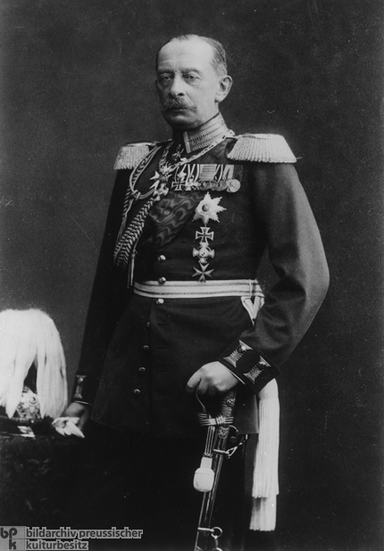
Schlieffen Plan
Devised in 1906, it tried to avoid fighting a war on two fronts by knocking France out of the war before Russia could mobilise (estimated time six weeks).
Schlieffen wanted to envelop France by sending his forces along the Channel coast through Belgium, encircling Paris, and attacking the French forces from the rear. The victories of 1870 by the Germans had taken place close to the border, where supplies could easily be brought forward to the front. By taking Alsace and Lorraine, Germany had extended its supply lines through relatively uninhabited territory, which was much harder to attack from—some debates on whether it occurred. See extension activity.

Slide 3
Changes

Slide 4
Alleged Changes made by Moltke
After Schlieffen died the new German commander was Hermann Von Moltke.
He was more cautious than Schlieffen, he removed planned invasion through the Netherlands, for a more direct route through Belgium. This shortened the supply lines, but it did the same for the French. Schlieffen envisaged encountering minimal resistance and surrounding Paris, Moltke was heading more directly towards it.
Moltke also reduced the number of troops assigned to the plan to strengthen the defenses on the German border with both France and Russia - this was at the behest of the commanders stationed on the border who wanted a more active role.
Whether it was these changes that made the difference or not to its success is debatable.

Slide 5
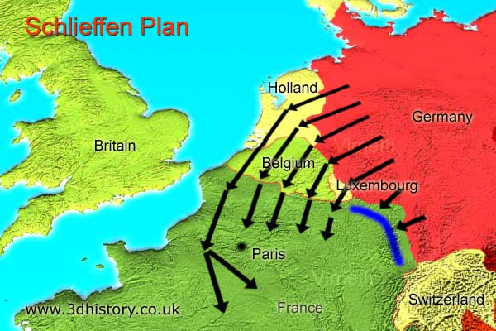
Strengths
Even if it was not successful it would ensure the bulk of the fighting was done in France.

Slide 6
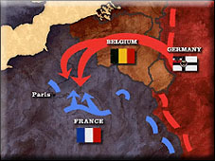
Weaknesses
The invasion of Belgium brought Britain into the war - guaranteeing the Treaty of London (1839).
It did not factor any more than token Belgian resistance.
Moltke who carried out the plan did not heed Schlieffen's dying words ‘ to keep the right strong’ this mean it was hard to outflank the French.
It was too rigid, any war with Russia would mean a war with France. Germany would not have the choice on when it would launch the war.
It did not take supply into account. France could reequip quicker than Germany.
It relied on the French collapsing and the use of Belgian rail. Any resistance from either would put pressure on the 6-week window.
If Russia had invaded before the six weeks, they would have had to choose to abandon German territory or weaken the Western front.
It had no contingencies for the ‘Fog of War’. Communication systems lagged behind other technological developments.

Slide 7
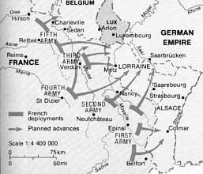
Plan XVII
Devised by Foch but carried out by Joffre, this relied on élan vital (the fighting spirit of the French soldier). Two armies would move into Alsace Lorraine and another two into Germany through the Ardennes.

Slide 8
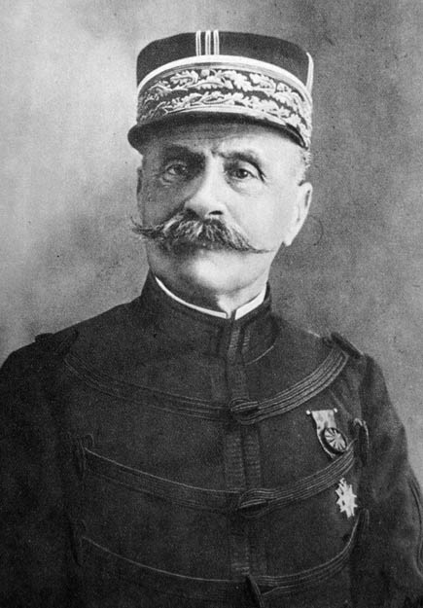
Weaknesses
Paid no consideration that Germany may move through Belgium.
Did not factor the quality of the German reserve troops.
It was obvious
Élan Vital no match for machine guns

Slide 9
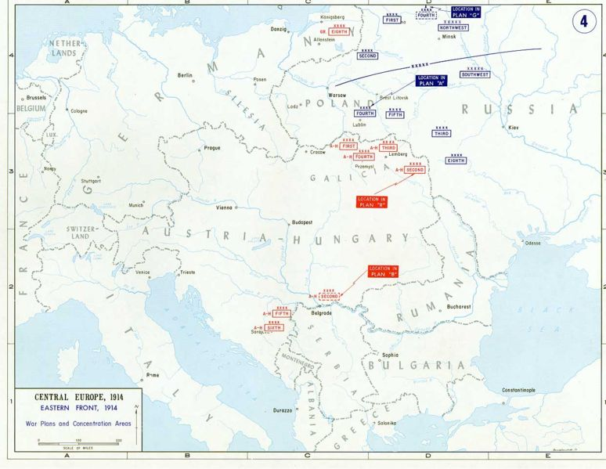
Plans G, A and 19
G: Assumed Germany would invade Russia first and to absorb the attack
A and 19: Changed in 1910 by Danilov to an attack into Central Germany whilst using a fortress defence.

Slide 10
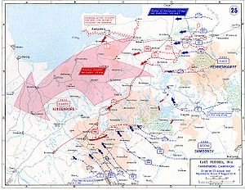
Strengths
It upset the German plans.

Slide 11
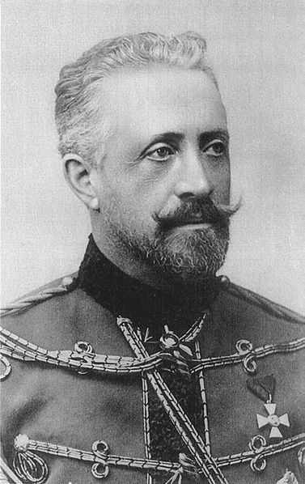
Weaknesses
It was an idea of the French
Plan G played to Russian strengths
The Russian army was not capable of offensive operations. It was cumbersome and had an outdated leadership.
The Russian economy and transport system was not able to support a large scale attack.

Slide 12
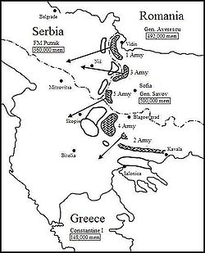
Plan B and Plan R
B: Sending three armies into the Balkans
R: Sending two armies to defend against a Russian attack.

Slide 13
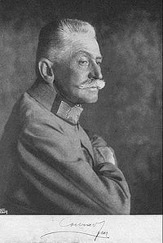
Weaknesses
The Schlieffen plan made this unfeasible as Germany was concentrating in the West
It assumed the war would be confined to the Balkans.

Slide 14
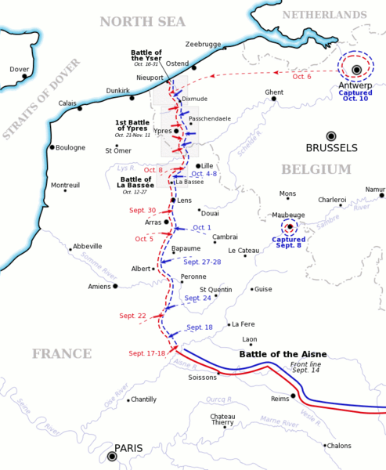
Britain
Britain had the small BEF on standby and could be deployed within 21 days.
No plans aside from protecting the empire.

Slide 15
How far did these plans contribute to the First World War
Three developed Points for:
Three developed points against:

