Slide 1
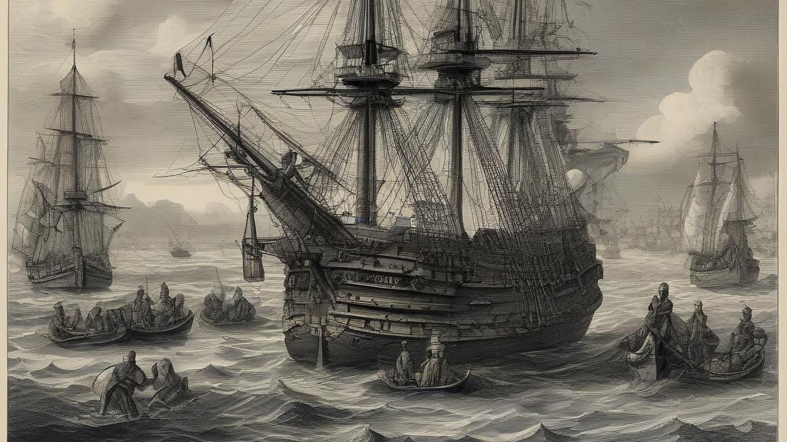
How significant were sea strategies in determining the outcome of early-modern wars?
English Civil War

Slide 2
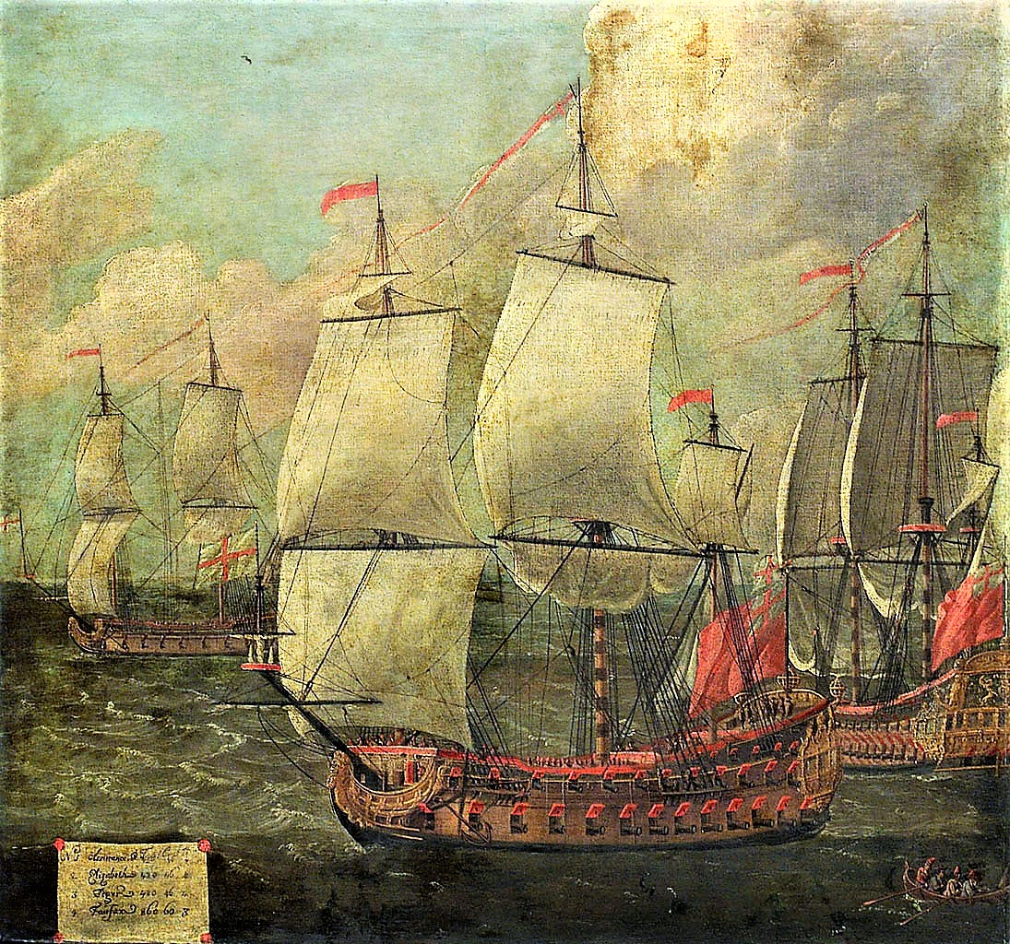
Naval Warfare in Early-Modern Europe
Naval force was not solely under the control of the state. The boundaries between the two were blurred.
Hired merchant ships still comprised the bulk of the English navy.
Charles relied on supporters to employ their vessels in his service.
Nations competed to build ever larger ships but tactics lacked sophistication. More of a series of individual duels than coordinated actions.
All nations used false flags to capture enemy vessels – it created much conjecture and rancour.
The impressment of men was discouraged but necessary. Parliament codified the practice in October 1641. Discipline was tight and wages were rarely paid on time.

Slide 3
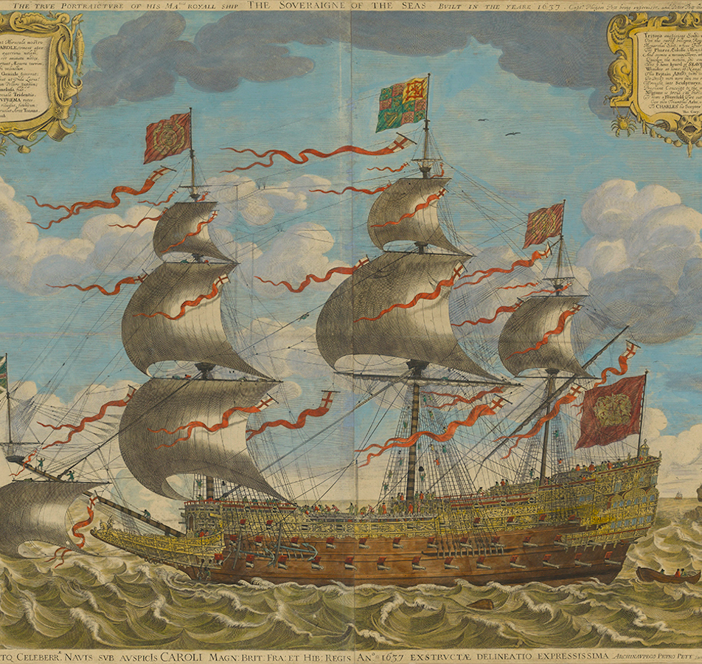
The Caroline Navy
Ship Money allowed Charles to finance a much needed naval expansion. 46 new ships of the line were commissioned in 1635/36.
Charles's navy suffered from bureaucratic inefficiency and corruption; inconsistencies in the experience and training of officers and commanders; difficulties in recruitment; above all, inadequate finances.
However, English problems were shared by all European powers, and Charles's ship money navy was formidable enough that none chose to engage against it.
Parliament declined to put the largest ships of Charles's navy to sea during the English Civil War. They were designed to counter other nations, not the more nimble privateers.

Slide 4
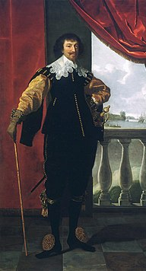
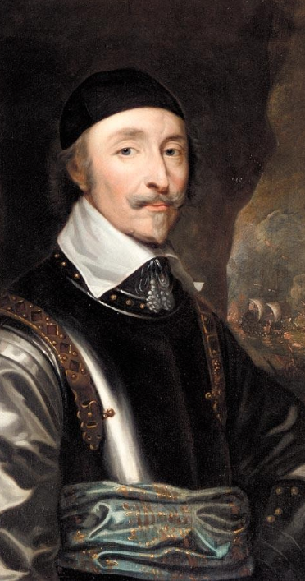
The Navy backs Parliament
In general, most sailors felt the King too sympathetic to Catholics and resented he had forbidden them from tackling Dunkirker privateers.
Throughout the Bishops’ War the navy remained critically underpaid, with only 7 vessels able to take to sea.
Seamen joined the London mobs against Charles and his advisors.
They also marched on Westminster in January 1642 to complain they were not employed to quell the Irish Rebellion.
In February/March 1642, 1688 sailors signed the Presbyterian oath. 66 refused and 510 were at sea.
Divisions increased over the deputy to the aging earl of Northampton, who illegally passed the matter to parliament. Hence the Parliamentarian the earl of Warwick prevailed over the King’s nominee Sir John Pennington.
Charles backed down as he never believed the navy would not back him.
When Warwick refused to assist Charles in taking the Hull Armoury, Charles ordered him to resign. Warwick refused and 17 ships backed him (four refused of which two surrendered). Though often framed as a financial decision, ideology also influenced the sailors.
Localism was not an issue.
Without a navy Charles was unable to counter Parliaments advantage of controlling London by blockading the city. Tonnage and Poundage could still be collected. £900,000 of the £1,100,000 spent by Parliament on the navy came from customs duties.
The loss of the Navy discouraged foreign powers from sending Charles support.
In July Parliament sent the navy to help suppress the Irish Rebellion – an operation that achieved little. When war broke out in 1642 the Eastern English coast was undefended.

Slide 5
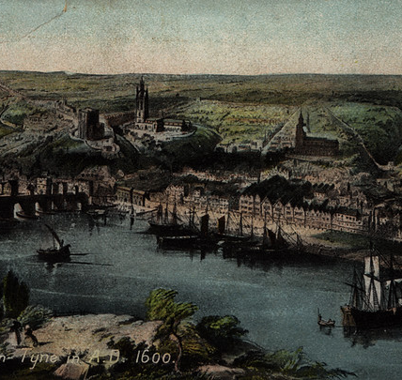
1642
If control of the navy looked to be a major advantage for parliament, the gathering of forces by confederates, and the support for the king amongst some naval captains and sailors, showed that parliament’s victory, at sea or on land, was far from certain.
Like the war on land, the naval campaign was regionalized and siege warfare dominated. Parliament ensured coastal towns did not come under royalist control. The support they gave to Southampton and London was crucial. They could not stop Newcastle from coming under Royalist control. However, Newcastle could be easily blockaded and was close to Scotland.
The most pressing maritime concerns for parliament came from the transports that brought overseas military aid to their enemies in England and Ireland.
Portsmouth, England’s major naval port, declared for Charles. Parliament immediately placed it under siege. The eventual defeat was a blow to Charles, made worse by his soldiers looting the town as they escaped, turning it irrecoverably to parliament. However, without a navy it made little sense to invest too much in holding a port.
In October 1642 the Swallow and the Bonaventure under Captain Stradling arrived at Newcastle to join the royalist cause, having abandoned their station on the Irish coast. Shortly after supplies came from Europe, notably weapons for 4,000 cavalry, 20 pieces of artillery, and £20,000.
The King also retained Chester, which allowed contact with Ireland to be maintained and Falmouth which facilitated the export of tin to Europe.

Slide 6
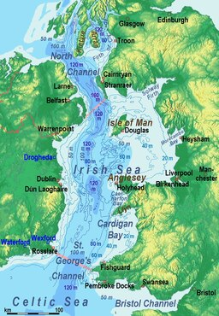
Ireland
By 1643 Parliament assembled 12 ships to blockade England and 18 for Ireland.
In January two parliamentarian ships engaged five Spanish with supplies for the Irish Catholics, sinking two for one of their own.
The Irish Catholics issued letters of marque (privateering licenses) to any European captain willing to accept.
Charles signed a truce with the Catholics in September 1643. Parliament now approved a winter blockading force of 19 ships and 23 merchantmen. To pay for it additional excises were imposed on salt and meat.
Still, Between October 1643 and February 1644 approximately 7,740 soldiers from Ireland joined the royalist armies in England and Wales.

Slide 7
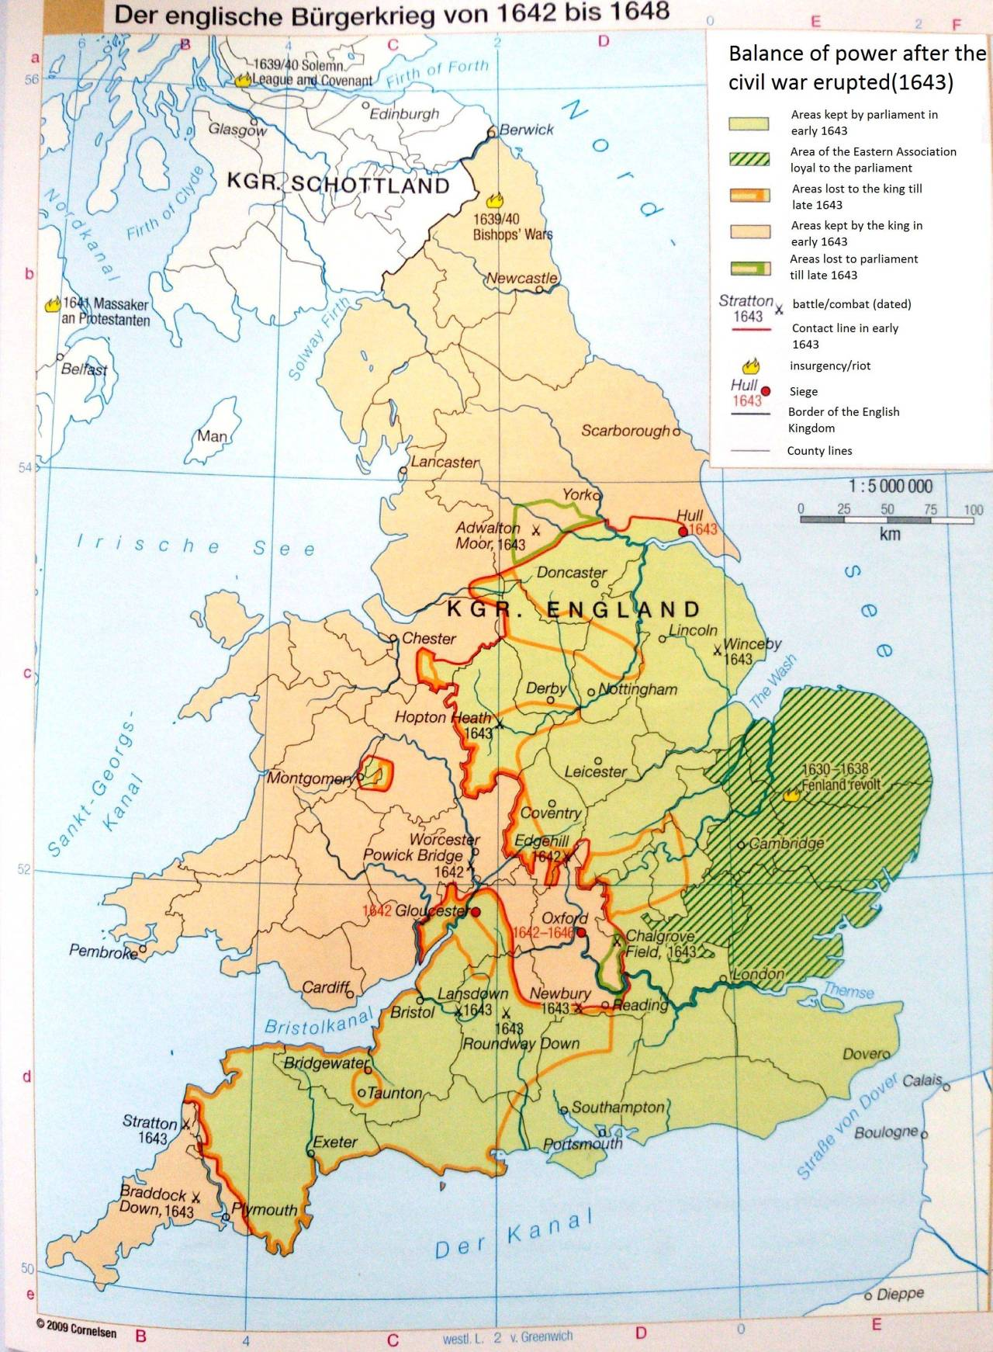
1643
Supporting isolated outposts to keep a foothold in royalist territory continued to be a naval priority, as towns such as Bristol, Pembroke, and Plymouth gave parliament bases from which to strike into enemy heartlands. They also kept the king’s armies tied down in these regions, and prevented them from moving against London; from a royalist perspective capturing these enclaves was a military imperative for precisely the same reasons.
Warwick complained that he had a force of 6,000 men but was provided provisions for only 4,000.
The retention of Hull was particularly important as it prevented the complete Royalist dominance of the North in 1643. Especially after Scarborough changed sides early in the year.
Henrietta-Maria with European supplies managed to land in Newcastle.
In July 1643 Warwick was thwarted in his attempt to land 2,000 men to break the siege of Exeter.
The people of Bristol backed the King and the city fell to Prince Rupert with little opposition. He now had a force of 18 ships under Pennington and a further three armed merchantmen. They were used to attack Parliamentarian strongholds in Wales. Potential recruits were offered generous shares of prizes captured and parliamentary estates after the war.
The loss of Milford Haven negated the newfound Royalist dominance of the Irish Sea.
In September, Colonel Gould successfully landed 400 to boost the defenses at Plymouth.
In November Parliamentary forces were expelled from the Channel Islands.

Slide 8
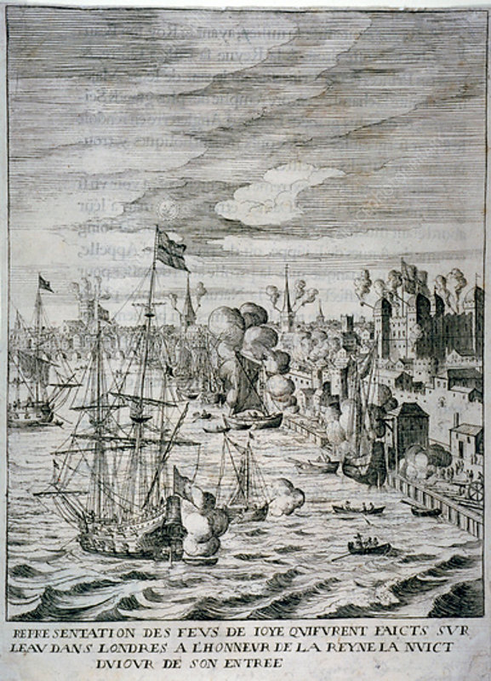
1644
By the summer, Parliament’s navy made it risky to cross the Irish Sea. Especially when reprisals against Irish troops were harsh.
The Solemn League and Covenant stretched parliament’s naval resources further as they now had to give support to their Scottish ally. The failure to protect Scotland’s west coast from Irish raids caused tension.
The Royalist naval campaign against Welsh parliamentary strongholds was ceased after the defeat at Marston Moor.
Ormonde in Ireland claimed Parliament had become too dominant in the Irish Sea to risk sending more supplies. More likely he felt the King had little chance of victory.
Royalist crews in England and Ireland mutinied over lack of pay. Conversely, parliamentary crews were promised a third of all prizes seized.
Parliament became enraged with the Dutch for allowing the earl of Marlborough to conduct privateering raids across the Atlantic from their territory.
In April 1644 Prince Maurice led his army against the relatively unimportant but staunchly parliamentarian port of Lyme. A combination of strong defensive works, and the ability of warships to get aid into the town enabled it to withstand a three-month siege despite being outnumbered 6-1.
Henrietta-Maria embarrassingly returned to France.

Slide 9
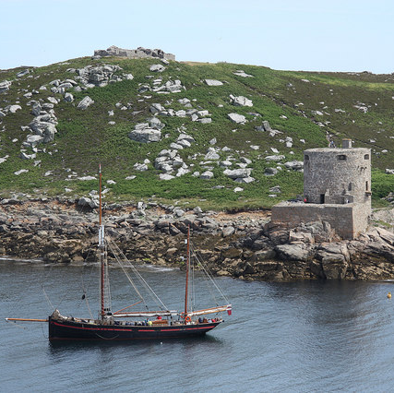
1645/46
The self-denying ordinance saw Warwick replaced by William Batten.
Following Charles’ defeat at Naseby his military position collapsed.
The last Northern Royalist port, Scarborough, fell in February 1645 and Parliament seized 120 ships.
Rupert lost Bristol in September and Thomas Fairfax captured Cornwall and Devon. The navy played a vital role in these operations, carrying supplies and munitions, blocking up hostile ports, and helping to storm recalcitrant garrisons.
The king’s surrender to the Scots in May 1646 did not mark the end of the war at sea.
The parliamentarian army and navy continued to work together to capture garrisons that held out, and to combat privateers.
In March the prince of Wales escaped from Falmouth to the Scilly Isles. A storm dispersed Batten’s fleet before he could intercept the prince there, and rather than flee to France or Ireland, the prince of Wales sailed to royalist-controlled Jersey.

Slide 10
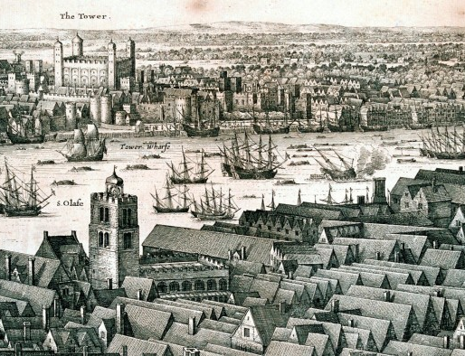
Conclusion
With control of the navy and the resources of London at its disposal, parliament should have dominated the conflict at sea, but instead the parliamentarian navy found itself in a difficult struggle against resourceful and energetic enemies who at times challenged their control of the waters around the British Isles and Ireland.
Still, although parliament failed to deny Charles the supplies, he needed to continue the war the ensured that his resources were dependent on luck or the mistakes of his enemies.
Parliament won the Civil War because of its armies performance. Yet, they were aided by the Navy transported supplies and reinforcements.
If the King had held the Navy, he would have been able to transport exponentially more troops from Ireland and the Continent.

