Slide 1
Why was the slave trade abolished?
Keywords:
Abolition – banning or getting rid of something.
Campaign – an organised course of action to achieve a goal.
The Enlightenment – New ways of thinking that emerged in the 18th century which emphasised reason and logic over tradition and superstition.
-
Notes:
This is the BIG question around abolition- you can get the students to refer to this questions over the next 3 lessons on the 4th lesson they will have an assessment answering this question, but it will be grounded in interpretations.

Slide 2
1607-1732
British colonies were established in North America. British became dominant European trader of slaves throughout 17th-19th centuries.
1831 Jamaican slave strike. Plantation owners responded with violence.
1788
Petitions flooded parliament to abolish the slave trade.
1797
William Wilberforce joined 12 opponents of slavery, including Thomas Clarkson. He made speeches in parliament.
1776
The colonies declared independence and formed the USA.
The transatlantic slave trade
1768
Granville Sharp, abolitionist, won legal case of Jonathan Strong.
1789
Olaudah Equiano wrote the story of his life. His campaign for slave ship Zong 1797 was successful.
1791
St Domingue rebellion led by Toussaint L’Ouverture. 1804 declared independent state of Haiti.
1807
The slave trade was abolished by parliament. Slaves could not be bought or sold - but could be owned.
1833 Slavery was abolished.
Notes:
Slavery has always existed, but the transatlantic slave trade was carried out on a mass systemic scale between the 17th and 19th centuries. This enquiry is focused on the abolition of the slave trade, however, to get to this point it is important to understand what the slave trade was, how it began and how it developed.

Slide 3
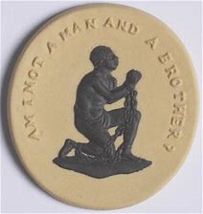
When was the slave trade abolished?
In 1807 the trading of slaves was abolished (ended) by the British Parliament. It became illegal to buy and sell slaves. But people could still own them. It wasn’t until 1833 that Parliament finally abolished slavery itself in Britain and across the British Empire.
But why did the abolition of the slave trade happen when it did?
There are many reasons and we will investigate them over the next few lessons.
White middle-class campaigners;
Actions of black people;
Economic and international reasons.
Notes:
Today we will be learning about the role white middle class men played in the campaign; next lesson will look at the action of black people and the final lesson on abolition will consider economic factors. Then we will sit an assessment where we will consider the most persuasive arguments as to why the slave trade ended in 1807.

Slide 4
White middle-class campaigners
The Enlightenment occurred in the 18th century when some writers and philosophers began to question old traditions and ideas, such as the idea that people have a right to liberty and equality became more common. Some people used this idea to begin to challenge slavery. Granville Sharp was a lawyer and in 1787 he set up an orgnaisation to campaign against the slave trade. The Abolition Committee, as it was known, was initially just a group of 12 men. Yet they were influential men and, very quickly, their campaign gained support.
Abolitionists | Who were they? | How did they campaign?
Granville Sharp
William Wilberforce
Thomas Clarkson
Explain which campaigner you think was the most influential?
Notes:
Use the hand outs from the resources to fill in the table. You can print or get them to draw in.
If you want to differentiate you can complete and discuss with them who they were and why they were influential but then get them to do the important bit of how did they campaign. This bit must be filled in and learning checked.
You can go through people one at a time with the class or get them to work independently with their own resources.

Slide 5
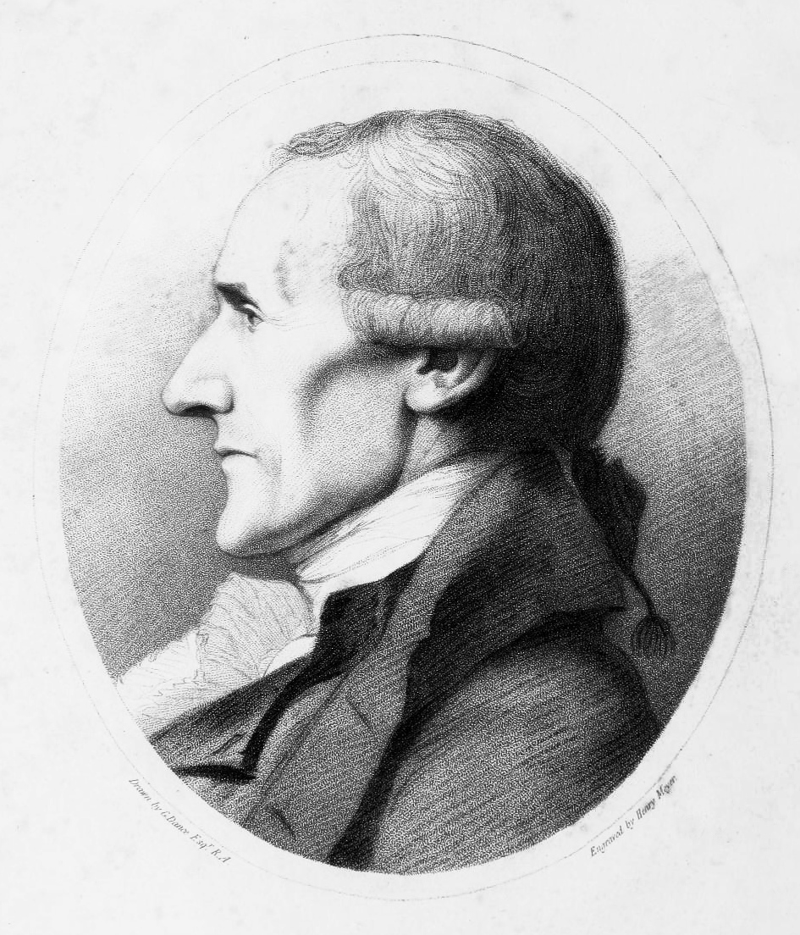
Granville Sharp
Sharp set up the Abolition Committee in 1787, which became a very powerful lobby in government. He was also an important legal campaigner and fought against injustice. He had two high profile and important cases:
One was the case of Jonathan Strong, a slave who had been badly beaten by his owner and who Sharp helped recover and helped get back into work. When his ex-owner wanted to take him back to Jamaica Sharp took the case to court and he won.
Another was the case of the slave ship, Zong, this was when the captain had ordered the crew to throw overboard the slaves to protect potential profit in court and then tried to claim insurance for damaged goods. Sharp believed they should be seen as men and not as goods.
Notes:
https://www.bing.com/images/search?view=detailV2&id=BFBD0CA6B9BA6B91EF06C3997C71C6767B961B8E&thid=OIP.CiTPBcyJ_ket8PPs35jzuAAAAA&mediaurl=http%3A%2F%2Fluna.folger.edu%2FMediaManager%2Fsrvr%3Fmediafile%3D%2FSize2%2FFOLGERCM1-6-NA%2F1158%2F030877.jpg%26userid%3D3%26username%3Djkuhn%26resolution%3D2%26servertype%3DJVA%26cid%3D6%26iid%3DFOLGERCM1%26vcid%3DNA%26usergroup%3DFolger-6-Admin%26profileid%3D27&exph=384&expw=273&q=granville+sharp+mp&selectedindex=5&ajaxhist=0&vt=0&eim=0,1,2,3,4,6,8,10
Peace and War text book = pg 83

Slide 6
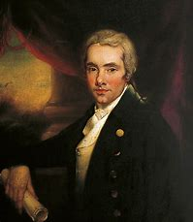
William Wilberforce
Abolition could no have been achieved without the support of MPs in Parliament. The abolitionists’ representative in parliament was the MP William Wilberforce. He was a powerful speaker and skillful politician who worked to persuade other MPs to join his cause. He had the support of PM William Pitt. Wilberforce was met with a lot of opposition within parliament. Some MPs were slave owners themselves and many profited from the trade triangle. Others feared abolishing the slave trade would ruin the British economy and threaten the empire. Wilberforce introduced the abolition bill every year between 1790 and 1806, but they kept being defeated. MPs needed to be convinced that change had to happen.
Audio clips of his speeches here
Notes:
https://www.bing.com/images/search?view=detailV2&id=3B8526206DD30A81E73ADF27E1C0B560B508679B&thid=OIP.rENqksH2l5Cdbjjio5toWQHaI3&mediaurl=https%3A%2F%2Fvictoriancommons.files.wordpress.com%2F2017%2F02%2Fwilliamwilberforce.jpg&exph=1198&expw=1000&q=william+wilberforce&selectedindex=2&ajaxhist=0&vt=0&eim=0,1,2,3,4,6,8,10
Exploring history CCC pg 115

Slide 7
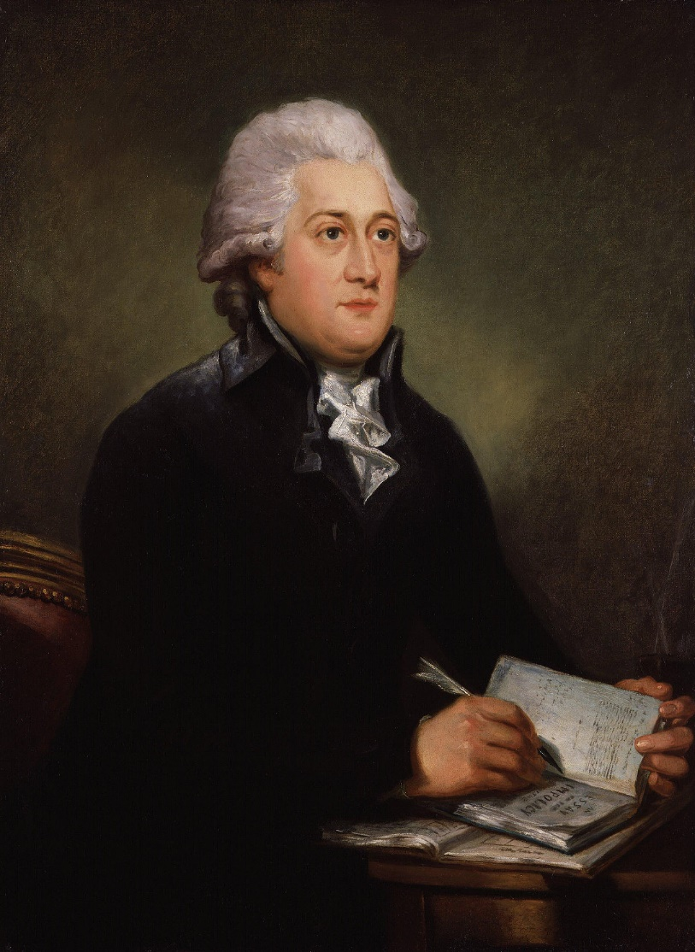
Thomas Clarkson
Clarkson’s aim was to educate the public. He was one of the first men who joined Sharp on the Abolition Committee, and he realized to make real progress they needed public support. The problem was people did not know about the reality of working on plantations or of the middle passage. He interviewed over 20,000 people connected with the slave trade and recorded their stories. His findings were then made public with a huge propaganda campaign. Between 1787 and 1794, Clarkson travelled an incredible 35,000 miles around Britain, holding meetings and giving lectures. Many people were shocked and appalled by what they heard, and the campaign gained support. For example huge petitions were signed in Manchester in 1788 where over 10,000 working people signed it and again in 1792 when over 20,000 people signed it These were presented to Parliament to show national support.
Notes:
https://www.bing.com/images/search?view=detailV2&id=C66778042EE31B99BB3B49ADA75ADCDC39A08E5D&thid=OIP.9rovblOHMo6xtfEpX7KHfwHaJo&mediaurl=https%3A%2F%2Fupload.wikimedia.org%2Fwikipedia%2Fcommons%2Fthumb%2F9%2F90%2FThomas_Clarkson_by_Carl_Frederik_von_Breda.jpg%2F1200px-Thomas_Clarkson_by_Carl_Frederik_von_Breda.jpg&exph=1560&expw=1200&q=thomas+clarkson&selectedindex=0&ajaxhist=0&vt=0&eim=0,1,2,3,4,6,8,10
Exploring history CCC pg 114

Slide 8
Key Events
 | What happened? | Why was
Somerset Case
Zong Case
Primary Evidence
Sugar Boycotts
https://www.bbc.co.uk/bitesize/topics/z2qj6sg/articles/zn7rbqt#z4y2qfr

Slide 9
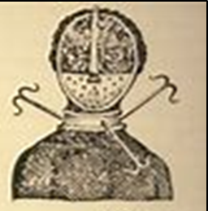
What are sources?
How many sources can you think of as a class?
If a source is primary, or, contemporary, it was produced at the time you are studying. We have used some of these sources already in this enquiry. (See source A&B)
Historians use these sources as evidence to build up a picture of what happened.
They are all useful, but some may be more useful than others, do you have any ideas why?
Letters
Diaries
Journals
Memoirs
Autobiographies
Interviews
Speeches
Newspapers
Government Documents
Photographs
Maps
Video footage
Audio recordings
Research data
Objects and artefacts
Source A: An Artefact showing a form of punishment.
The NATURE is what the source is what it is.
e.g. Source A is a picture of an artefact. It is quite limiting but useful in some ways.
Source B is a published account so has detail from a man who was there, this method provides more room for detail.
We must always consider the PROVENANCE for a source when we are using them.
Source B: Written by a man called Robert Renny who visited the plantations in Jamaica, published in 1807.
The first gang of slaves, is called just before sunrise. The register is then called, and the names of absentees noted. After which they commence their labour and continue until 8 or 9 o’clock, when they breakfast on boiled yams and vegetables seasoned with salt and cayenne pepper. In the meantime, the absentees generally arrive, and re punished by a number of lashes (whips). At sunset they return to their huts. Slaves usually work ten hours a day excluding Sundays. In the harvest season the arrangement is different the slaves often work late in the mill and the boiling houses (to make sugar) frequently al night.
Notes:
There are many kinds of sources, we know this form last lesson, we used cartoons, paintings, engravings, artefacts, diaries, published accounts etc to piece together what life was like on plantations. You can show them audio clips from the time, such as speeches in parliament in the 1800s and can be found here: http://abolition.e2bn.org/people_24.html – when the time comes, listen to Wilberforces speeches to PArliament
http://abolition.e2bn.org/sources.html

Slide 10
Interpretations
Interpretations differ to sources because an interpretation is a construct of the past and uses sources to help form an argument and persuade others of their argument. They are usually formed by historians who have completed a lot of research. Historians often have differing interpretations of the same event such as what the main reasons were for the abolition of the slave trade.
Today we will look at the most common interpretation in the century following the abolition of the slave trade. Historians tended to suggest that slavery was abolished due to the actions of the great British men, in particular William Wilberforce. They argued that Wilberforce and other British leaders realised the slave trade was wrong and so led a moral campaign against it.

Slide 11
Interpretation 1: Historian A
If it had not been for the actions of white British men of influence, the slave trade would not have been abolished as quickly as it was. They were the ones that highlighted the human cost. The slave trade thrived (was successful) and in the 1780s alone, British ships transported more than 300,000 Africans, more than 1,000 slave ships cleared the British and colonial ports making money for the empire, this was a moral quest by a few decent men.
What does interpretation 1 argue was the main reason for abolition?
What evidence does this interpretation use to justify their reasoning?
Which sources could historian A have used when forming their judgement? Underline any evidence from the sources that supports this interpretation.
What do the other sources suggest was the reason behind abolition?
Do you find interpretation 1 persuasive? Explain your thoughts.
Notes:
Quote and explain – main reason was White British influential men
The slave trade was successful so it can’t have been an economic argument and it went against people’s interests in the Empire therefore it was a moral argument led by a few decent men.
For 3 & 4 use the teacher highlighted sheet in the resources at the end of this lesson to provide support with this. It is a good point to live model the annotaton and explain the process of how primary evidence links into the interpretations.

Slide 12
Explaining paragraph
Considering everything that you have read and learnt today:
Explain how white middle class men helped to abolish slavery in 1807.
Planning an explaining paragraph. Don’t just list each individual and their stories but try and sythensise your knowledge to create a powerful paragraph. It should have a clear point and powerful specific knowledge that helps you to explain your point.
For example:
Point: Their positions in society
Evidence: Use individuals you have studied
Explain: What the outcome was
Notes:
You may wish to see how students cope before sharing a plan, o you may wish to plan your own paragraph together. If out of time you may want to set for homework.
You do to need to worry about balance – next less is all about black actions – indeed they need to have this knwoeldge to support with their assessment in a few lessons time and understand that white middle class men did have an important role to play in the abolition of the slave trade.

Slide 13
How do historians use evidence?
Interpretation 1: Historian A
If it had not been for the actions of white British men of influence, the slave trade would not have been abolished as quickly as it was. They were the ones that highlighted the human cost. The slave trade thrived (was successful) and in the 1780s alone, British ships transported more than 300,000 Africans, more than 1,000 slave ships cleared the British and colonial ports making money for the empire, this was a moral quest by a few decent men.
Source A: Written by poet William Beckford in 1790 about the situation in the West Indies.
“Without slaves being sent to the Americas, crops will decline, and the population and the produce will be extinct and at an end.”
Source C: From a trader's log in 800.
“A shipment from West Africa to the West Indies included 750 slaves… 140 deceased upon arrival… £5,500 profit”
Source B: Written by economist Adam Smith in 1776.
“Whilst it appears to only cost their maintenance a person who has no aspiration to acquire property can have little interest in their work. He can only be made to work through violence. This is not sustainable for successful trade.”
Source D: From a speech by Prime Minister William Pitt in 1792. “I know of no evil that ever existed worse than the tearing of 70,000 or 80,000 persons annually from their native land. If we tempt the slave traders to sell their fellow creatures to us, we may rest assured they will use every method to supply their victims to us.
Notes:
Use sources from the resources to answer these questions. Depending on your group you may want to go through the questions together slowly or independently

Slide 14
For the teacher use
Economic reasons
Interpretation 1: Historian A
If it had not been for the actions of white British men of influence, the slave trade would not have been abolished as quickly as it was. They were the ones that highlighted the human cost. The slave trade thrived (was successful) and in the 1780s alone, British ships transported more than 300,000 Africans, more than 1,000 slave ships cleared the British and colonial ports making money for the empire, this was a moral quest by a few decent men.
Source A: Written by poet William Beckford in 1790 about the situation in the West Indies.
“Without slaves being sent to the Americas, crops will decline, and the population and the produce will be extinct and at an end.”
Source C: From a trader's log in 1784.
“A shipment from West Africa to the West Indies included 750 slaves… 140 deceased upon arrival… £5,500 profit”
Source B: Written by economist Adam Smith in 1776.
“Whilst it appears to only cost their maintenance a person who has no aspiration to acquire property can have little interest in their work. He can only be made to work through violence. This is not sustainable for successful trade.”
Source D: From a speech by Prime Minister William Pitt in 1792. “I know of no evil that ever existed worse than the tearing of 70,000 or 80,000 persons annually from their native land. If we tempt the slave traders to sell their fellow creatures to us, we may rest assured they will use every method to supply their victims to us.
Economic reasons
Notes:
To support teachers with interrogating the sources and interpretations and answering the questions on slide 9.

Slide 15
Black people’s actions
In the 18th century many black slaves in Britain began to demand to be treated like ordinary servants. They demanded wages. Many others simply refused to be kept as slaves and ran away. Often the slave’s owner went to court to get the slave back, but the legal position of slavery in Britain was never clear. Slaves could be kept in other parts of the Empire and traded around the world, but what happened if a slave was brought to Britain? When cases of slaves claiming their freedom came to court in Britain the courts made different decisions every time. Sharp helped many slaves in court, like with the case of Jonathan strong we’ve looked at, increasingly courts set them free and soon it was not worth owner’s time and money to chase down the escaped slave. By 1800 most Back people in Britain were free, although slaves could be shipped to the West Indies to work there as slaves.
We are going to research two areas black people’s actions had a large impact on abolition:
* Slave rebellions
* Black abolitionists
On your sheet add in the detail as we go through the next 3 slides together.
Notes:
Pre-teach - Be clear about the difference of treatment in Britain compared to the West Indies – legal grey area.
Emphasize two key areas we will look at today and their geographical difference – who thinks that will make a difference to the impact they have?

Slide 16
Slave rebellions
Slave resistance happened throughout the period of the slave trade and took many forms.
Mutinies occurred on the slave ships; historians have calculated that 10% of slave ships experienced some sort of revolt. Usually these mutinies would be defeated by the crew with great bloodshed.
Slave resistance included pretending not to understand, working slowly, taking more food. Cultural resistance included preserving their own language, music, dance and drums sometimes contained coded messages for the next village.
The other common forms of protest were revolts on plantations through violence, setting crops on fire and overthrowing their oppressors. This was very dangerous but was common, for example, there were 16 slave rebellions in Jamaica between 1655 and 1813, all were unsuccessful and changing the system. In the late 1700s the most successful revolt happened on the French west Indian Island of St Domingue.
Notes:
You could read through the next few sheets and get students to annotate their sheets or print out and get them to condense on to their sheet.
There is the big question to extend about impact and significance of these methods of black action, which you can choose to emphasise as you choose or do homework from either writing and research.

Slide 17
Primary Source on the suppression of a slave rebellion
Here the insurgents were assembled, about 400 in number and drew up in order to attack the left wing of the 1st West India Regiment about 150 men; they killed two and wounded one of the four men were instantly charged and despatched having about 40 hours of combat in the field as 70 prisoners in our hands. Many of them killed and wounded, leaping from the windows and rushing from the doors, a very pretty scene did it exhibit, our men following them across the fields and firing as fast as possible. A party of the 15th Regiment under Major Grierson also had a brush with the rascals, and punished them pretty handsomely for their temerity. The insurgents did not think our men would fight against black men, but thank God they were deceived. I assure you the conduct of our Bourbon Blacks, particularly the Light company under Captain Firth (an old twelfth hand) has been the admiration of everybody, and deservedly.
What happened during the insurgency?
What is the authors views about those who revolted?
What did the source reveal about the contradictions within the British Empire?
How do you these revolts contributed to the breakdown of slavery?
Notes:
Quote and explain – main reason was White British influential men
The slave trade was successful so it can’t have been an economic argument and it went against people’s interests in the Empire therefore it was a moral argument led by a few decent men.
For 3 & 4 use the teacher highlighted sheet in the resources at the end of this lesson to provide support with this. It is a good point to live model the annotaton and explain the process of how primary evidence links into the interpretations.

Slide 18
Black abolitionists
The Abolition committee was keen for the voices of slaves to be heard. In 1787, it published the autobiography of Ottobah Cugoano. He was a former slave who had worked on the plantations in the Caribbean before being brought to England. In 1789 another freed slave Olaudah Equiano published his autobiography this was important because it helped the public to see slaves as real people, not property. The authors also proved what former slaves could achieve given the chance of freedom.
A historian has recently proved Equiano was born in South Carolina and it is believed his account of life in early Africa and the middle passage was fiction, based from other slaves' stories that he grew up with. This was because it would be more powerful to support the abolitionist propaganda with a firsthand account.
We usually think of propaganda as being negative, what are your thoughts about abolitionist propaganda and Equiano’s account?

Slide 19
Interpretations
Interpretations differ to sources because an interpretation is a construct of the past and uses sources to help form an argument and persuade others of their argument. They are usually formed by historians who have completed a lot of research. Historians often have differing interpretations of the same event such as what the main reasons were for the abolition of the slave trade.
Today we will look at a modern interpretation of the abolition of the slave trade. This is the impact of Black people’s actions and how it created mass shock at how slaves were treated. Look at your timeline consider the impact that the 1831 rebellion played in finally abolishing slavery.

Slide 20
Interpretation 2: Historian B
…the slaves in the Caribbean were very aware of the debate in Britain. With planters and merchants, traders, sailors and visitors to the islands all discussing the ways slavery was being handled in London, it was inevitable that West Indian slaves would hear about what was being discussed in Britain. This would encourage slaves to attempt to take control and rebel to quicken the process of abolition. In turn news of the treatment of slaves after rebellions had a big impact on campaigns in Britain and rebellions played an important role in escalating the abolition movement.
What does interpretation 2 argue was the main reason for abolition?
What evidence does this interpretation use to justify their reasoning?
Read your hand out. Which sources could historian B have used when forming their judgement? Underline any evidence from the sources that supports this interpretation.
What do the other sources suggest was the reason behind abolition?
Do you find interpretation 2 persuasive? Explain your thoughts.
Challenge - Do you find it more persuasive than interpretation 1? Explain your response.
Notes:
Quote and explain – main reason were actions of slaves in America helped abolition in Britain
The communications through trade spreading abolition updates and equally messages being returned about how slave rebellions were being dealt with made the public outraged at the situation.
For 3 & 4 use the teacher highlighted sheet in the resources at the end of this lesson to provide support with this. It is a good point to live model the annotation and explain the process of how primary evidence links into the interpretations.

Slide 21
Student note sheet
Black Protest | What happened and where? | How successful were they?
Mutinies
Slave rebellions
Black abolitionists
Which method do you think had the biggest impact on the abolition movement in Britain?

Slide 22
The economy
From the 1770s onwards the West Indies were becoming less important to Britain. Cuba and Brazil could produce cheaper sugar. Therefore many plantations in the West Indies began to close. This led to the demand for slaves decreasing. For example, in 1771 Barbados import 2728 slaves but in 1772 none were imported. It became clear to plantation owners that it was cheaper to employ ex-slaves as waged labourers that to own slaves who you had to house and feed. This in turn meant it was less profitable for slave traders in the West Indies.
Source A: Written by economist Adam Smith in 1776.
The experience of all ages and nations, I believe, demonstrates that the work done by slaves, though it appears to cost their maintenance a person who has no aspiration to acquire property can have little interest in their work. He can only be made to work through violence. This is not sustainable for successful trade.”
Adam Smith laid the foundations of classical free market economies. He developed the concept of division of labour and considered that self-interest and competition can lead to economic prosperity (success). He believed that opening up trade in Africa would benefit the global economy.
Notes:
Pre-Teach - We have studied most of this source in the previous 2 lessons by Adam Smith – a leading economist from the time.
Discuss and summarise what Smith is suggesting in source A and why.

Slide 23
The economy
There was a world over-supply of sugar and British merchants had difficulties re-exporting it. Sugar could be sourced at a lower cost from Britain’s other colonies e.g. India. The Industrial Revolution (a process when machines replaced humans and factories were built in towns and cities in order to manufacture more) and advances and improvements in agriculture were benefiting the British economy. Since profits were the main cause of starting a trade, it has been suggested, a decline of profits must have brought about abolition because: The slave trade was overtaken by a more profitable use of ships (used in other British colonies). Wage labour became more profitable than slave labour. At various times plantations that provided the market for slave ships struggled to make profits.

Slide 24
The popular / fashionable movement
Abolition became fashionable in Britain and the abolitionist campaign gained momentum in the late 1700s and early 1800s with many petitions being signed by working men and ladies boycotting sugar and other commodities, this had a significant impact because it also effected the profitability of the slave trade. Many anti-slavery societies were created many by religious groups like the Quakers and women’s groups where they would write books, poetry and plays with anti-slavery messages. People proudly wore abolition medallions and brooches and Josiah Wedgewood created pottery with an anti slavery message (see on the previous slide). Members of the public put pressure on their MPs to pass the abolition law. The MPs could not ignore the popularist movement that had evolved, many were scared of damaging their reputations or of further rebellions. After a 10-hour debate at the end of a 20-year campaign in 1807 the bill was finally passed.
Notes:
Teacher pre-teach. Explore why and how abolition became fashionable. You may have some artefacts or students may have seen some to discuss.

Slide 25
Quakers and the Working Class.
Nine of the twelve members of the Society for the Abolition of the Slave Trade were Quakers, formerly known as the Society of Friends. The Quaker Church strongly opposed the slave trade in Britain and America. In 1783, the London Society of Friends sent a petition against the slave trade to the British Parliament.
Working-class people in Britain also played a key role in calling for abolition. Despite benefiting from economic links to the slave trade, many workers in the port cities of Liverpool and Bristol signed petitions that were presented to Parliament. Over 500 petitions, with a combined total of around 390,000 signatures, were submitted in support of Wilberforce’s abolition bill in 1792.

Slide 26
Other Factors
A major turning point however was the break-away of the American colonies in 1776–1783. The ideology of that revolution established a universal vernacular of equality which could not simply be limited to white people (its impact on slavery in North America took a different trajectory, however). That war also left the British with thousands of 'loyalist' ex-slaves on their hands; people who had accepted the British offer of freedom in return for joining the (losing) British side. This group was scattered to a cold fate in Canada or to live on the streets of London, the latter attracting charitable efforts to relieve them in 1787, which, eventually, prompted a government-backed scheme to encourage black migration to Sierra Leone.
Prominent people like Pope Benedict XIV protested against slave trade and also prohibited it.

Slide 27
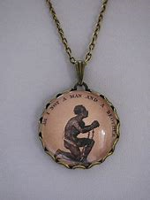

Quiz
Why did the demand for slaves fall after 1770s?
What did plantation owners do to drive down costs with labour?
What was the name of the economist who believed in a free market?
What was boycotted and by who?
Define a petition.
Why did politicians change their minds?
Why had it become a popularist movement?
Notes:
New markets could produce sugar etc cheaper, so there was less produce being bought for Britain and the empire which meant fewer slaves were needed as plantations closed.
They stopped slavery on their plantations and employed them as cheap labour – this was still poor conditions for workers, and they had to pay for food and rent but they technically were free men.
Adam Smith
Women boycotted sugar
Petition is a list of names for a cause/ against something presented to parliament
Reputation / slave rebellions
Many people wore supportive jewelry / pottery everyone was involved

Slide 28
Interpretations
Interpretations differ to sources because an interpretation is a construct of the past and uses sources to help form an argument and persuade others of their argument. They are usually formed by historians who have completed a lot of research. Historians often have differing interpretations of the same event such as what the main reasons were for the abolition of the slave trade.
Today we will look at an interpretation of the abolition of the slave trade. This is emphasising the economic argument. It is controversial because it suggests that the slave trade would have ended naturally due to market demands without the legal abolition law being passed and it was self indulgent for politicians to take credit for something they never attempted to stop while huge profits were being made.

Slide 29
Interpretation 3: Historian C
“Those who see abolition of slavery as the awakening conscience of mankind should spend a few minutes asking themselves why it is that mans’ conscience, which has sleep peacefully for many centuries, should awake just at the time that men began to see the unprofitableness of slavery.”
What does interpretation 3 argue was the main reason for abolition?
What evidence does this interpretation use to justify their reasoning?
Who is Historian C criticising? use a quote to support your response.
Read your hand out. Which sources could historian C have used when forming their judgement? Underline any evidence from the sources that supports this interpretation.
What do the other sources suggest was the reason behind abolition?
Do you find interpretation 3 persuasive? Explain your thoughts.
Challenge - Do you find it more persuasive than interpretation 1&2? Explain your response.
Notes:
Quote and explain – main reason were actions of slaves in America helped abolition in Britain
The communications through trade spreading abolition updates and equally messages being returned about how slave rebellions were being dealt with made the public outraged at the situation.
Criticising those who saw abolition as the “awakening conscience of mankind” because he thinks this is oversimplified, inference is, if it was still profitable, they would not have allowed it.
For 3 & 4 use the teacher highlighted sheet in the resources at the end of this lesson to provide support with this. It is a good point to live model the annotation and explain the process of how primary evidence links into the interpretations.

Slide 30
Explaining paragraph
Considering everything that you have read and learnt today:
Explain how the economic changes helped to abolish slavery in 1807.
Planning an explaining paragraph. You may wish to group actions in The Americas and actions in Britain.
For example:
Point: Writing autobiographies
Evidence: Use individuals you have studied
Explain: What the impact was on the abolitionist campaigns
Notes:
You may wish to see how students cope before sharing a plan, o you may wish to plan your own paragraph together. If out of time you may want to set for homework.

Slide 31
Essay Question
Why was the slave trade abolished?
Three groups (one paragraph each)
Abolitionists
Black actions
Economic reasons
Write the introduction and conclusion individually

