Slide 1

The Royal Families of Europe

Slide 2
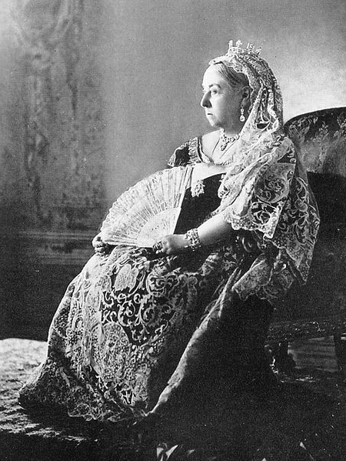
Queen Victoria 1837-1901
Known as the grandmother of Europe, having arranged marriages for her nine children and 42 grandchildren.
Initially unpopular but became a symbol of empire largely because of her longevity.
After Alfred died in 1861, she wore black and rarely came to London.

Slide 3
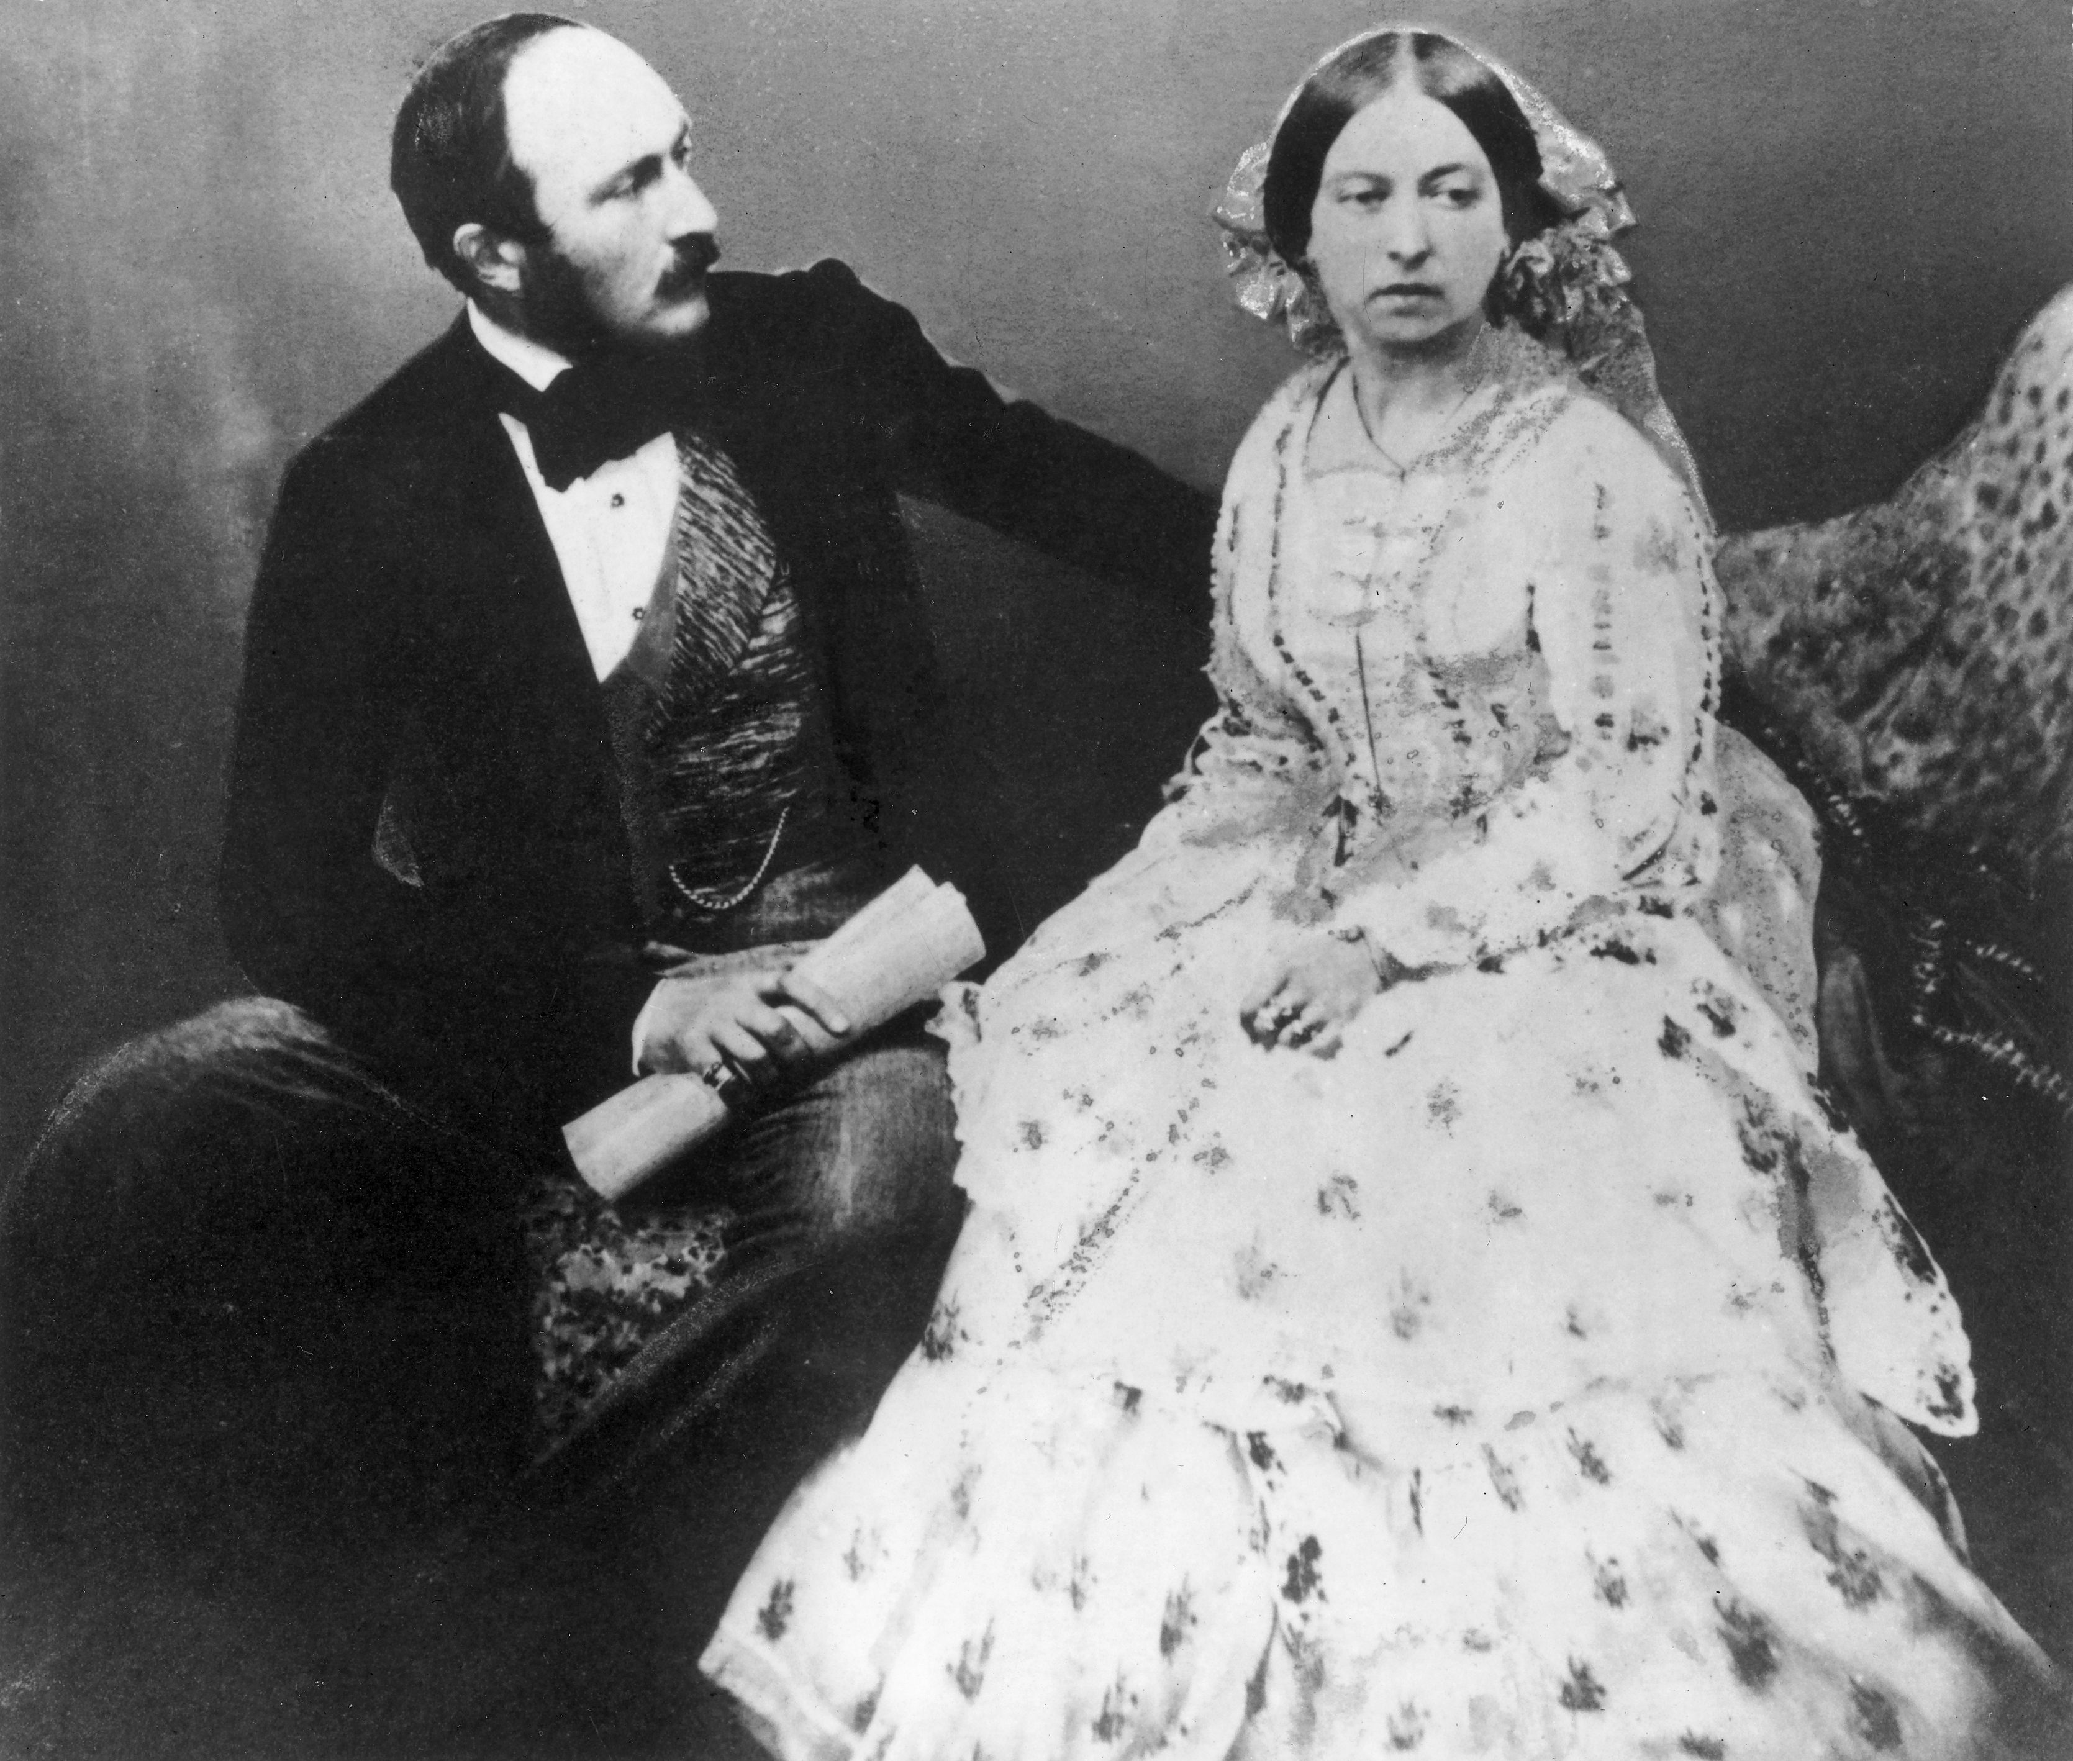
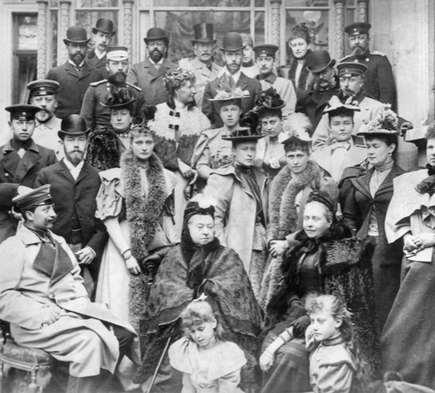

Slide 4
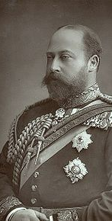
Edward VII 1901-1910
Reign best remembered for permissiveness following Victoria.
Very popular in Europe and important in forging relations with France, probably due to his dislike of his nephew Wilhelm of Germany.
Frustrated at lack of power. Most noted for his appetite and his mistresses. Had little training in kingship. Surprisingly popular.

Slide 5
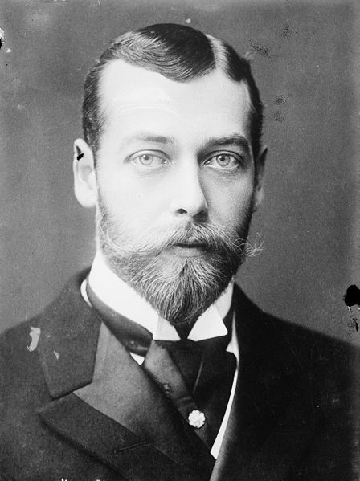
George V 1910-1936
Was never meant to be King and hated having to do it.
Very dull; he had no real interests outside of stamp collecting and hunting.
Spent most of his early life in a successful navy career.
Abhorred the idea of war and the ordeal defined his life. He also had an active dislike for racial or religious discrimination.

Slide 6
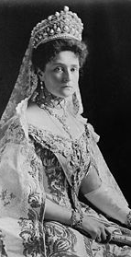
Alix of Hesse
Favourite granddaughter of Victoria. She was deeply in love with Nicholas II of Russia but dreaded becoming Tsarina.
She was painfully shy and struggled to interact with her subjects.
Anti-German, deeply conservative and painfully loyal. Passed Haemophilia onto her only son.

Slide 7
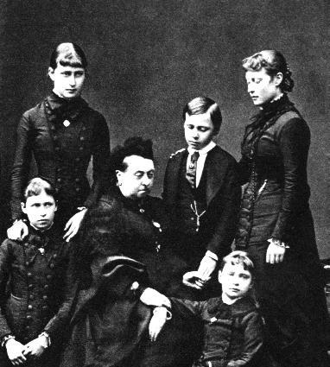
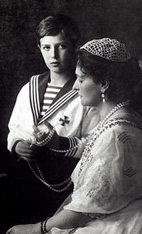

Slide 8
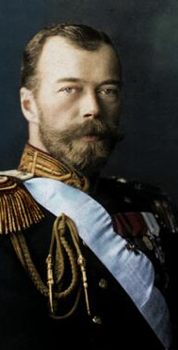
Nicholas II 1896-1917
Stable childhood, but struggled to match his father's expectations.
Adequate intelligence, known to be unfailingly polite and obsessed with formality.
Caring father and loving husband. His devotion to his family in many ways cost him his throne

Slide 9
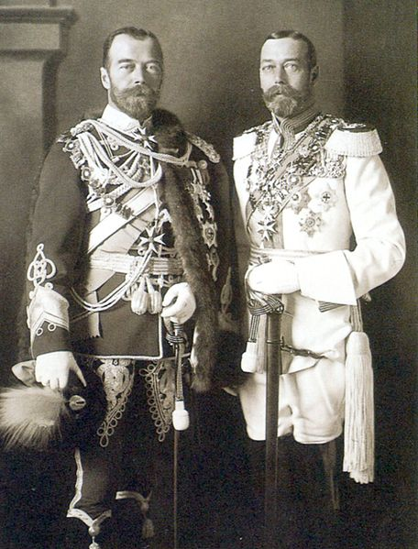
Nicholas II 1896-1917
Took his position very seriously believing he had a special bond with his people.
Staunchly conservative and took too much advice from those who supported his views.
Did not distance himself from atrocities committed in his name.
Initially paid too much attention to his cousin Wilhelm, but soon found him wearisome and his favourite relation was George.

Slide 10
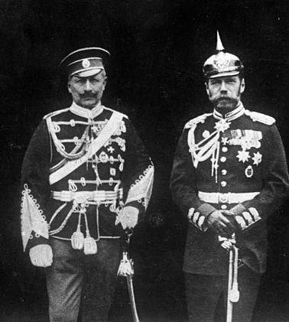
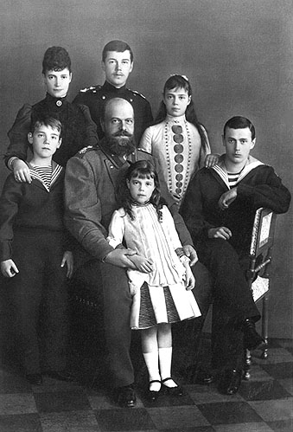

Slide 11
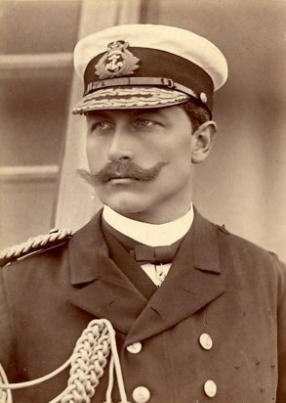
Wilhelm II 1888-1918
Misguided and foolish, but not an evil man.
Hated both his father and his mother. Regarded his father as weak and treated his mother with contempt. His treatment of his family caused mistrust with his English relatives.
Awkward childhood, failure in most respects, birth defect may contribute to his warped personality. Playmates were paid to be his friend.

Slide 12
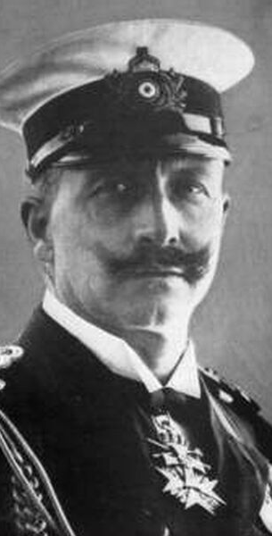
Relations with England
Desperate for approval with his English relatives. His visits proved to be to much to take.
Obsessed with England’s navy and ecstatic when made an admiral.
Occasionally would redeem himself with gallantry. But hated following the Boer war.
Hated his uncle whom he referred to as a Satan.

Slide 13
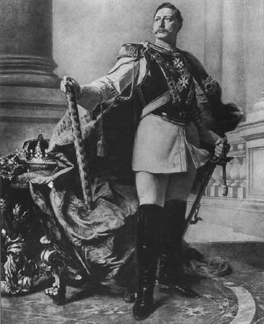
Personality
Megalomaniac. Obsessed with the military (uniforms) and foreign affairs, was convinced he was an expert.
Enjoyed schoolboy pranks and humour.
Was inconsistent and contradictory had no management of the press.
Would not alter the constitution even though it was causing internal pressures.
Increasingly came under the control of his ministers who managed his behaviour.

Slide 14
How did tensions within the Royal Families of Europe contribute to War?

