Slide 1
The Czechoslovakian Crisis
Spetember – October 1938

Slide 2
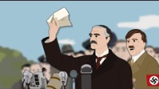

Slide 3
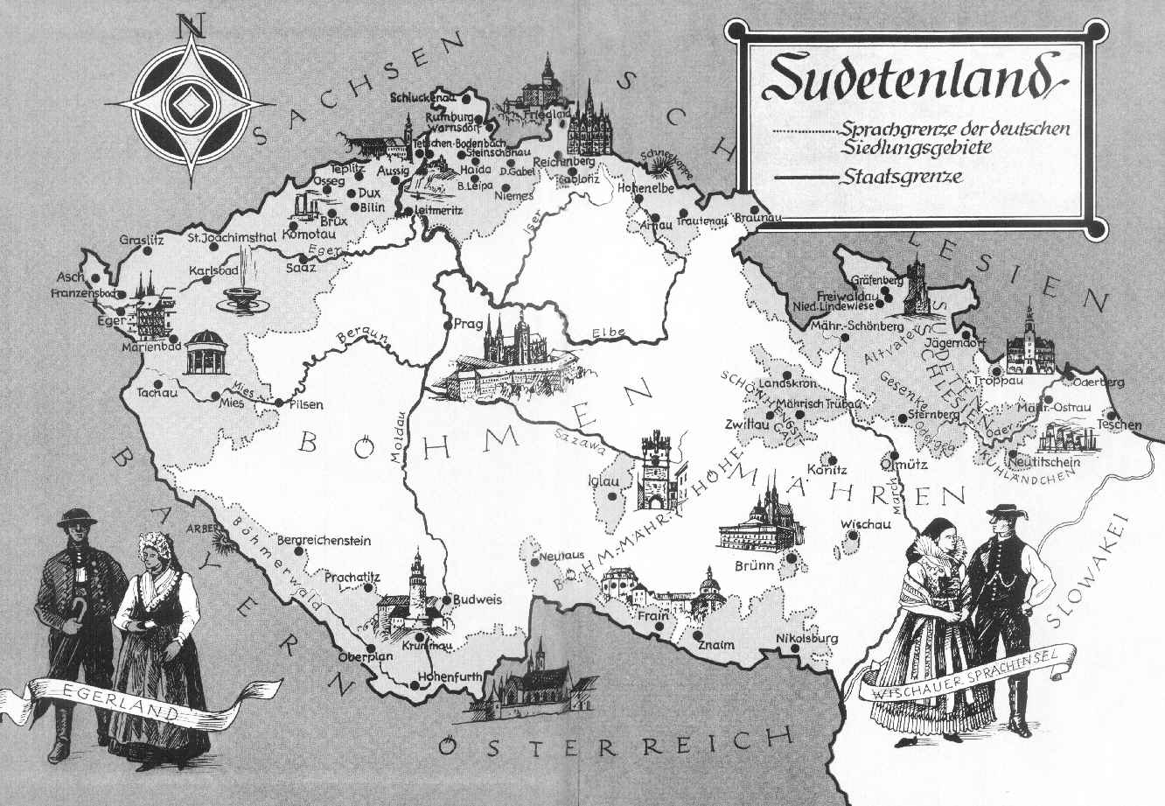
The Issue
Britain felt guilt over the Treaty of Versailles and the hypocrisies about national self determination.
While the Sudeten Germans were persecuted, Chamberlain never brought up the rights of minorities in Germany.
While the Nazis attracted increased support in the the Sudetenland in 1938, voting was done under intimidation.
The French had signed a defensive alliance with Czechoslovakia and were bound to intervene if Germany attacked.
Hitler actively courted war, both ideologically and because as Britain had begun rearmament, he felt Germany now had its greatest material advantage.
Why might the Sudeten Crisis prove difficult to prove?

Slide 4
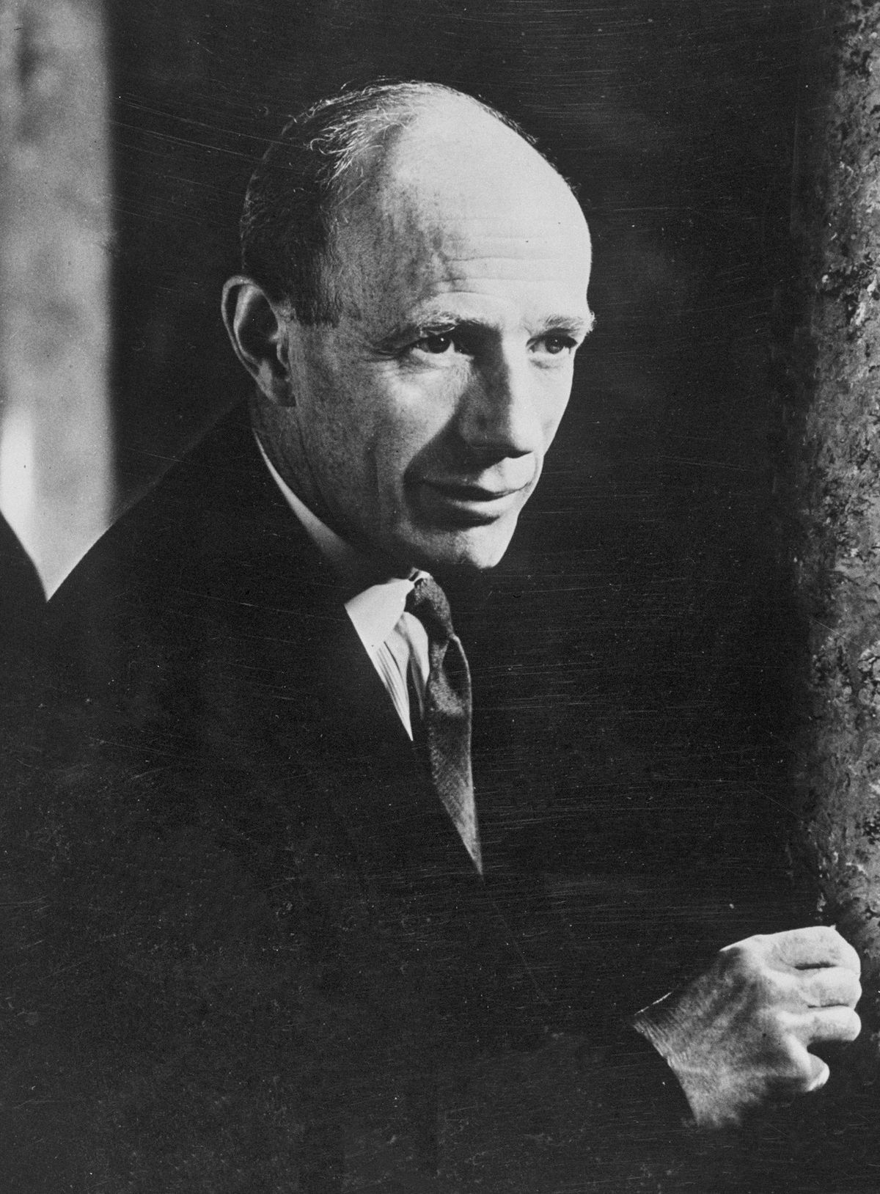
Initial British Position
In the summer of 1938 the British atttempted to find a rapproachment between the Czech president Edward Benes and the leader of the Germans in the Sudentenland Konrad Henlein.
The Foreign Office headed by Lord Halifax was against any British intervention.
The British cabinet and press believed Hitler to be to astute to risk war over Czechoslovakia. But, their transparent position emboldened the dictator, knowing their was no prospect of serious British opposition.
Why was Chamberlain in a difficult position?

Slide 5
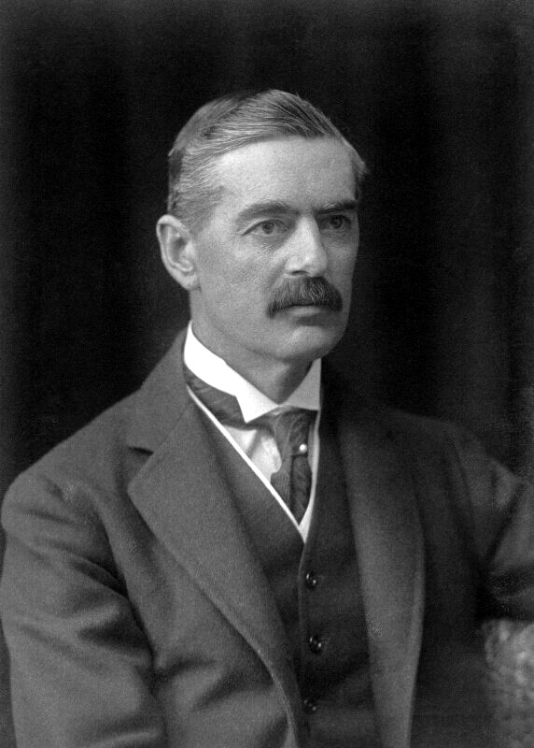
Neville Chamberlain
His brother Austen had been the Foreign Secretary in the 1920s and had negotiated the Treaty of Locarno.
His father was a powerful industrialist and local politician.
He had been the mayor of Birmingham.
He had a cousin that he was close to who had been killed in the First World War.
He was convinced that he could not threaten Hitler, if Britain did not have the military ability to follow through on them.

Slide 6
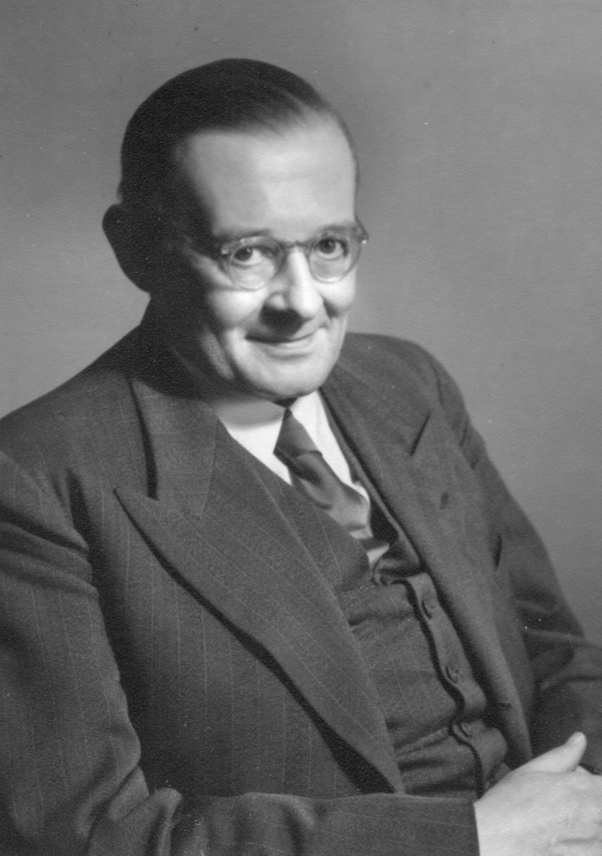
The situation intensifies
The crisis became more acute when the Charge de Affaires of the German Embassy was snuck into Downing Street to warn that Hitler would march on Czechoslovakia on 19 September.
“Is it not positively horrible, to think that the fate of hundreds of millions depends on one man and he is half mad.”
“Owing to the neglect of our defences and the mishandling of the German problem in the last five years, we seem to be very near the bleak choice between War and Shame. My feeling is that we shall choose Shame, and then have War thrown in a little later on even more adverse terms than at present”

Slide 7
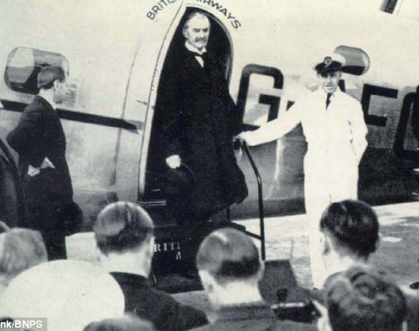
Plan Z
On 13 September, following the Nuremberg Rally the previous day, the Sudeten Germans rose in revolt.
Fearing a German invasion Chamebrlain invoked his Plan Z. Here the PM would fly to Germany to meet Hitler personally.
The public and press were behind the trip, but Churchill referred to the emissary as the stupidest thing that has ever been done. Mussolini referred to it as the “liquidation of British prestige.”
Why was Plan Z such a risk?

Slide 8
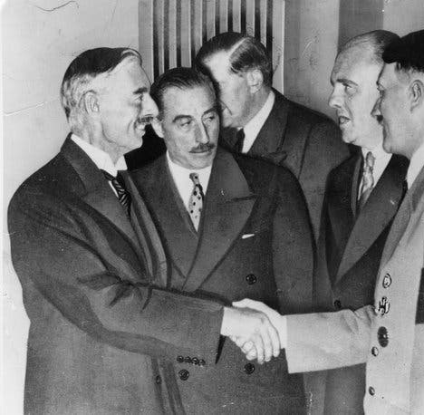
Berchtesgaden Meeting
Chamberlain’s welcome was deliberately militaristic.
There was some awkward small talk before Chamberlain suggested they outline each others position, before settling details the next day.
However, Hitler immediately claimed the Sudeten situation had deteriorated with 300 Germans killed that day. He claimed that he would risk war, rather than let this drag on. The tirade angered Chamberlain who asked why Hitler had met with him at all.
Hitler claimed that he had no designs beyond the unification of the German speaking people. Chamberlain indicated he would not stand in the way of national self-determination.
It was agreed that Hitler would undertake no invasion, while Chamberlain discussed this with the British cabinet.
Who got the best of the first meeting?

Slide 9
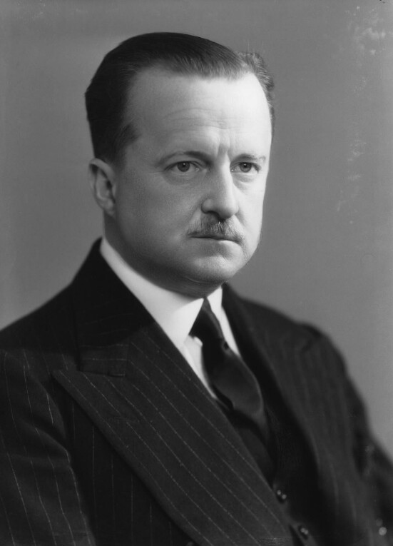
Events in Britain
Chamberlain, while disparaging of Hitler’s appearance, told the cabinet that he believed he could be trusted.
There was some dissent from minor cabinet members (aside from Duff Cooper, First Lord of the Admiralty). The major members all favoured surrendering the Sudetenland, even if they were skeptical of Chamberlain’s claims he had matched Hitler in the negotiations.
On 18 Spetember, the French President Edouard Daladier, journeyed to London and agreed to Chamberlain’s proposal.
On 20 September the Czechs were informed that Britain and France would not stand by them if they objected to the cessation of their territory.

Slide 10
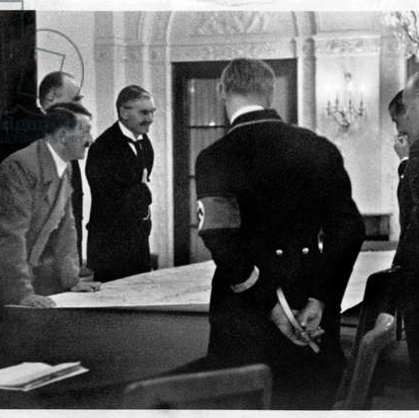
Meeting at Bad Godesberg
Chamberlain assumed the second meeting would merely formalise the deal he had organised.
The public mood was beginning to question the surrender of the Czechs. The cabinet warned Chamberlain they would not accept further concessions and expected Hitler to show some good faith.
To Chamberlain’s horror Hitler demanded that the area be handed over by 1 October and that the rights of other nationalities be recognised.
After fruitlessly trying to reach an agreement Chamberlain left the meeting and returned to his hotel across the Rhine.
The next day, Hitler showed the ‘memorandum’ he was to give to the Czechs to abandon the Sudetenland by 26 September. After a tense exchange with Chamberlain he backtracked to say he could refrain until 1 October.
How well did Chamberlain handle the second meeting with Hitler?

Slide 11
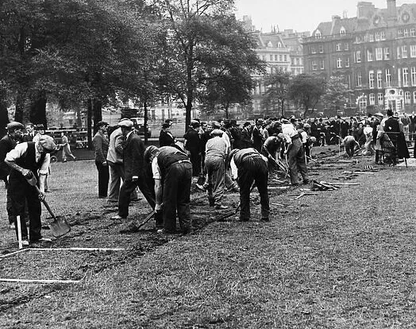
Events in Britain
While Chamberlain was in Germany, Tory rebels, the liberals and Labour agreed to reject concessions to Germany.
Meanwhile, Halifax ignored the PMs instructions and gave permission for the Czechs to mobilise. The Foreign Secretary then led a revolt in cabinet, that they could not submit to further demands.
The British began preparing for war. Gas masks were issued, bomb shelters prepared and vulnerable children evacuated to the countryside.

Slide 12
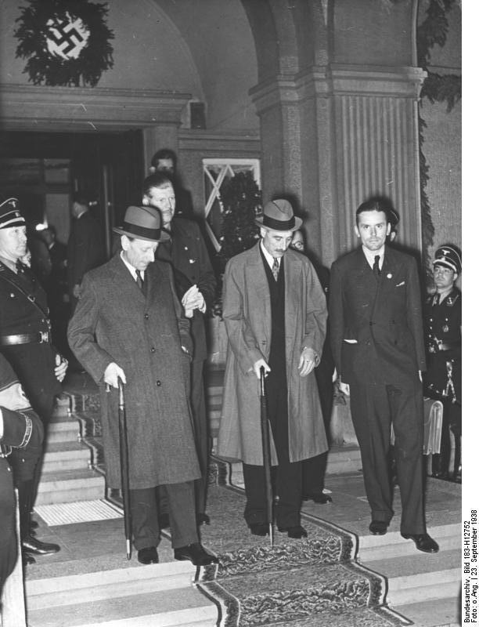
Horace Wilson in Berlin
On 26 September the Civil Servant, Horace Wilson, a trusted advisor of Chamberlain was dispatched to Berlin.
Hitler was in a foul mood and cut off the emissary after he again offered to negotiate between the Germans and the Czechs.
The next day he returned and warned Hitler that if France fulfilled their security obligations to the Czechs then Britain would join them.
Hitler replied, “If France and England strike … let them do so! It’s a matter of complete indifference to me … It is Tuesday today, and by next Monday we shall be at war”
How effective was Wilson’s warning?

Slide 13
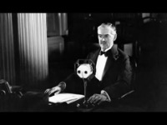
Chamberlain’s 27 September Speech
Listen to the Speech by Chamberlain to the British public.
What do you think of the tone and the content?

Slide 14
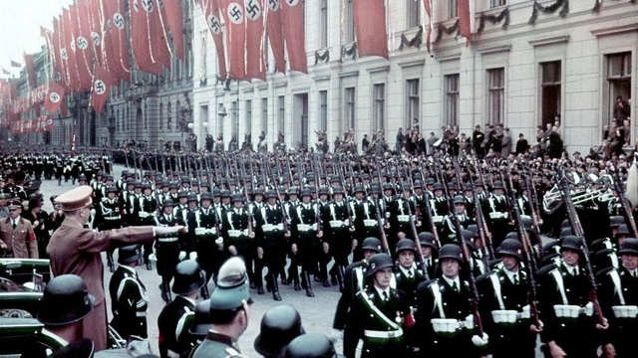
Hitler changes his mind
The German high command was against going to war in 1938. General Beck was fired for his constant protestations that Germany was incapable of fighting a war against Britain, France and Czechoslovakia.
Unbeknownesnt to Hitler his replacement Franz Halder had devised a plan to overthrow Hitler if the invasion took place.
On 27 September he watched the German divisions heading for the Czech front in the Wilhelmstrasse. Shocked by the lack of enthusiasm from the German onlookers, Hitler replied to an earlier telegram of Chamberlain. Here he promised not to move beyond the areas already agreed and that there would be a free plebiscite.

Slide 15
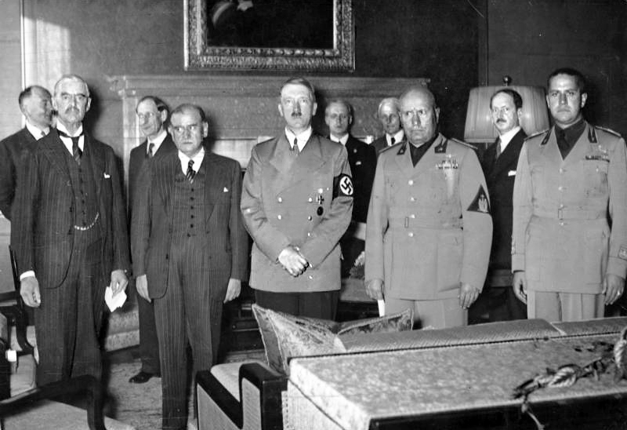
The Munich Conference is Agreed
After Hitler’s reply, Chamberlain again offered to fly to Germany to ensure German demands were met. He also proposed talks with Italy and France.
Whilst Chamberlain was briefing the Commons on the situation, he got word that his proposal had been accepted.
“When I was a little boy I used to repeat: ‘If at first you don’t succeed, try, try, try again.’ That is what I am doing. When I come back I hope I may be able to say, as Hotspur says in Henry IV, ‘Out of this nettle, danger, we pluck this flower, safety.”
Why did Chamberlain resume negotiations?

Slide 16
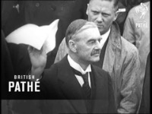
The Munich Conference
The conference was a shambles. The seating was awkward and the chairs too low. The British and French were unable to confer. The agenda had been ostensibly prepared by Mussolini but he had been provided it from the Germans. There was also insufficient pens or paper for the delegates.
The Munich Conference was just a ceremony – a face-saving exercise for all concerned. Not only had the British and French capitulated to the substance of the German demands on 18 September, they had even coerced the Czechs into accepting them. Now Hitler had been persuaded, against his own preference for a localised war, to accept their capitulation.
Either keen to salvage something for the Czechs or due to British reverence for property rights, Chamberlain kept raising the issue of compensation for the loss of Czech property in the Sudetenland and even asked if livestock might be moved from the zones of occupation. Hitler lost his temper. ‘Our time is too valuable to be wasted on such trivialities’, he yelled, and the matter was dropped”
At 2:15am, the British and French informed the Czechs what had been decided.
IS there any defense for the Munich Conference?

Slide 17
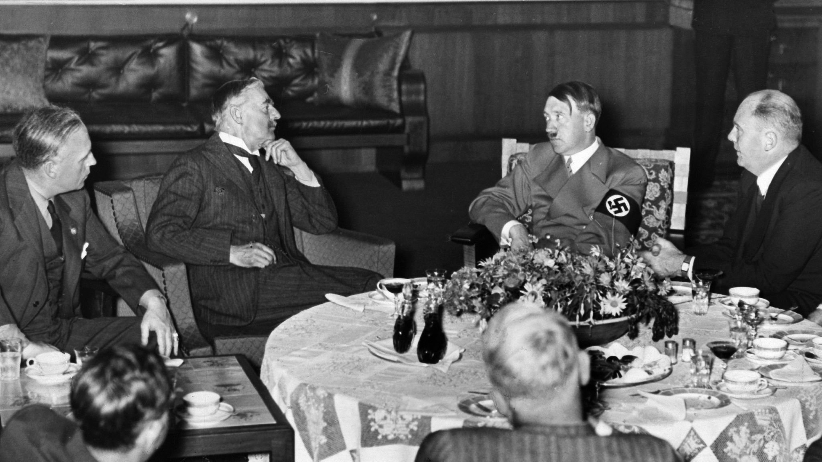
The Breakfast Meeting
The next day Chamberlain met Hitler for breakfast in his private quarters. The British PM found him friendly and agreeable, while the translator thought him moody and absent minded. After running through a series of European issues Chamberlain had Hitler sign a piece of paper he prepared stating:
"We, the German Führer and Chancellor, and the British Prime Minister, have had a further meeting today and are agreed in recognizing that the question of Anglo-German relations is of the first importance for our two countries and for Europe.
We regard the agreement signed last night and the Anglo-German Naval Agreement as symbolic of the desire of our two peoples never to go to war with one another again. We are resolved that the method of consultation shall be the method adopted to deal with any other questions that may concern our two countries, and we are determined to continue our efforts to remove possible sources of difference, and thus to contribute to assure the peace of Europe.”
How binding an agreement had Hitler made?

Slide 18
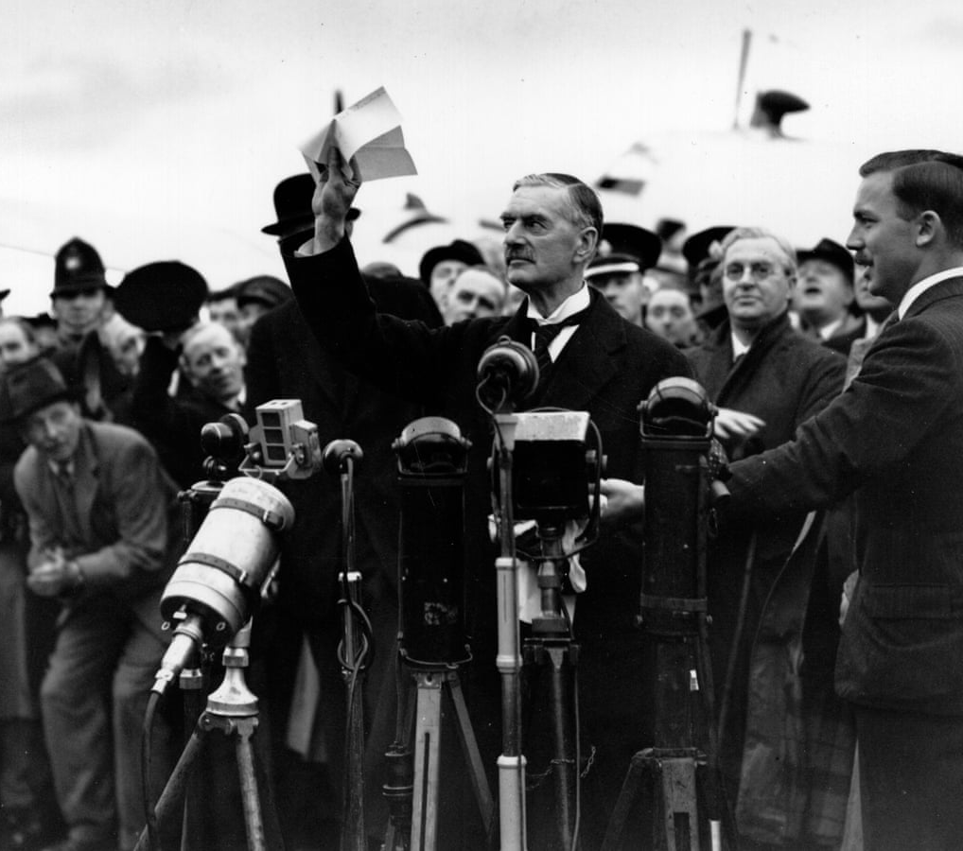
Aftermath
Chamberlain arrived on the 28 of September.
He addressed the crowd at the airport and announced that Hitler had signed the Peace of Paper.
He then unconstitutionally appeared on the balcony of Buckingham Palace with the King and Queen.
On returning to Downing Street he repeated a speech previously given by Benjamin Disraeli.
“My good friends, this is the second time in our history that there has come back from Germany to Downing Street peace with honour. I believe it is peace for our time. We thank you from the bottom of our hearts … Now I recommend you go home and sleep quietly in your beds”
Why was Chamberlain’s behaviour on returning to England a mistake?
Research what Hitler thought of the agreement?

Slide 19
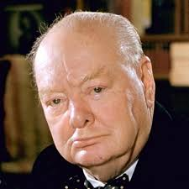
Churchill’s Speech
I will begin by saying what everybody would like to ignore or forget but which must nevertheless be stated, namely, that we have sustained a total and unmitigated defeat…. £1 was demanded at the pistol’s point. When it was given, £2 were demanded at the pistol’s point. Finally, the dictator consented to take £1 17s. 6d. and the rest in promises of goodwill for the future…. I fear we shall find that we have deeply compromised, and perhaps fatally endangered, the safety and even the independence of Great Britain and France…. there can never be friendship between the British democracy and the Nazi power, that power which spurns Christian ethics, which cheers its onward course by a barbarous paganism, which vaunts the spirit of aggression and conquest, which derives strength and perverted pleasure from persecution, and uses, as we have seen, with pitiless brutality the threat of murderous force.
Still only 30 Tory MPs voted against the government and only Duff Cooper resigned.
Is Churchill correct?

Slide 20
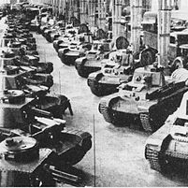
Allied Losses
The Czechs lost 11,000 square miles of territory, comprising 2,800,000 Sudeten Germans and 800,000 Czechs, along with all their fortifications and the majority of their natural resources.
Militarily they gained 1.5 million rifles, 750 aircraft, 600 tanks, 2,000 field guns, not to mention timber and other raw material.
Undertake further research on why else the Munich agreement was a bad idea for the allies?

