Slide 1
The League and Disarmament

Slide 2
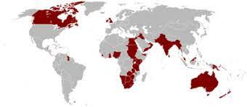
Why would the League struggle to impose disarmament?
Article Nine

Slide 3
The TMC
The first League Assembly established a Temporary Mixed Commission on Armaments (TMC), which was to consist of independent civilian experts who might be politicians, economists, businessmen or labour leaders but who were to take a broad view of disarmament and to put forward ideas on how to advance its cause.
Whilst the French and British governments were not happy with the establishment of the TMC, and Sir Eyre Crowe dismissed its members as ‘absolutely irresponsible amateurs’, it was the individuals who were appointed to serve on this body who, in the next few years, came up with a range of different schemes designed to promote disarmament.
From 1923 the League published statistics on each nations defense expenditure.

Slide 4
Washington Naval Conference
This was to resolve the size of the major powers navies. Japan wanted a 10:10:7 ratio – The US wanted 10:10:5.
Ultimately, they agreed on warship tonnage of:
Britain and USA: 500,000
Japan: 300,000
France and Italy: 175,000
Also
Japan returned Shandong to China in return for its preeminence in Manchuria to be recognised. Neither country could prevent another from pursuing economic opportunities.
The Anglo-Japanese Treaty was replaced by a looser four-power agreement to maintain the status quo in the Pacific.
Potential Issues?

Slide 5
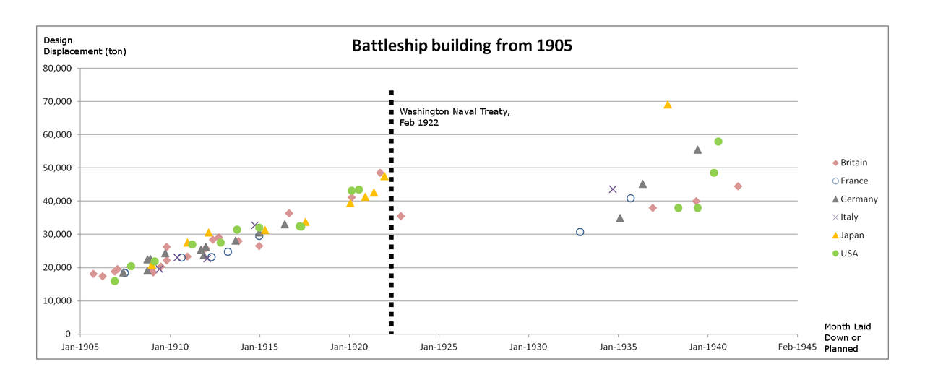

Slide 6
Lord Eshers 1922 Proposal
Using a military unit of 30,000:
France = 6
Italy & Poland = 4
UK, Greece, Netherlands, Yugoslavia, Czechoslovakia, Spain & Romania = 3
Why would this be rejected?

Slide 7
Geneva Conference 1925
This was to revive the Convention for the Control of the Trade in Arms and Ammunition which all major powers has signed but then collapsed after the US failed to ratify it.
Britain, France and Eleven other states signed it. But 14 was required to bring it into force.
All nations agreed to outlaw land, sea and air chemical and bacteriological weapons (USA not to 1975).
A global disarmament conference was planned.

Slide 8
British and French Divisions
Land, Sea and Air should be counted as a whole.
Disarmamanet should not include reservists.
Air Power should be reduced
Colonial Forces should be included
Budgetry limitation
International Verification
They should be separate
It should
It shouldn’t
They Shouldn’t
Quantative limitation
None

Slide 9
Further disagreements before the Disarmament Confernce
Britain and the USA about cruiser numbers.
France and Italy in the Mediterranean.
France and Britain over whether Germany could rearm.
The Soviet Union and everyone over how serious disarmament was being taken.
The Depression
Rising nationalism in Germany and Japan

Slide 10
Disarmament Conference – 1932
Britain believed that France and her Eastern European Allies were the greatest threat to stability. They feared unless France made concessions it would feed the Nazis in Germany.
Nobody believed Japan or Italy’s sincerity.
Germany, knowing nothing would be agreed, stated that unless meaningful progress was made they would rearm.
The USA seeking to slash budgets offered massive cuts, which infuriated the other delegates.

Slide 11
Disarmament Conference 1933
In January 1933, Hitler came to power in Germany.
Britain’s proposals presented in March could have made progress earlier (and was supported by the new US President, Franklin Roosevelt), but now had no chance.
In March 1933, Japan lef the League.
In June the four powers agreed to revisions to the Treaty through the League.
In October, Germany left.

Slide 12
What is the message of the cartoonist?

Slide 13
Why did Hitler take Germany out of the League of Nations in 1933?

