Slide 1
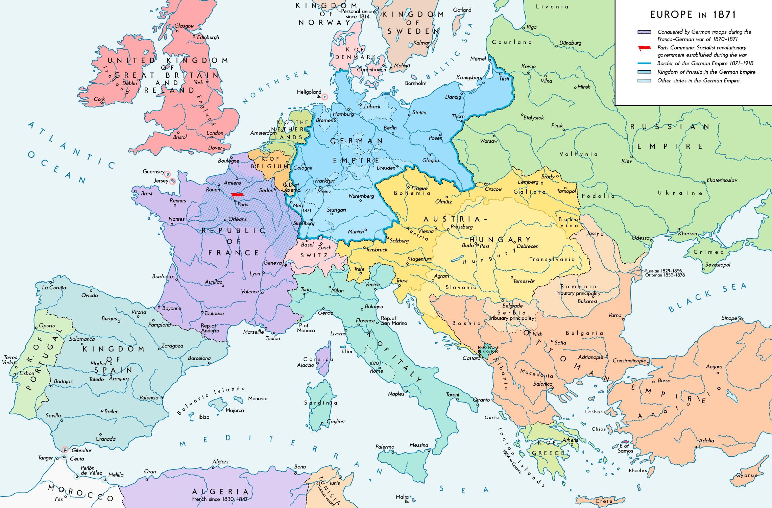

Slide 2
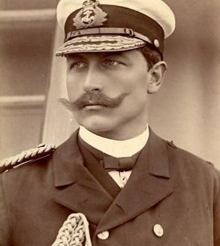
Recently created in the 1860s
Worlds second biggest industrial base.
Autocratic government
Largest standing army in the world.
65 Million People
Socially divided

Slide 3
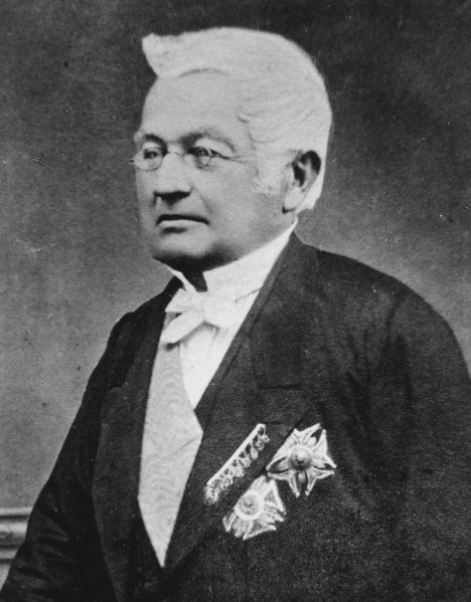
Europe’s second largest army
40 Million people
Fragile democratic republic.
Insecure after military defeats in 1871.
The socialist ‘Paris Commune’ ruled the city for two months in 1871. The eventual suppression left lasting divisions.
Slow to industrialise. Largely Agrarian
Worlds second largest empire

Slide 4
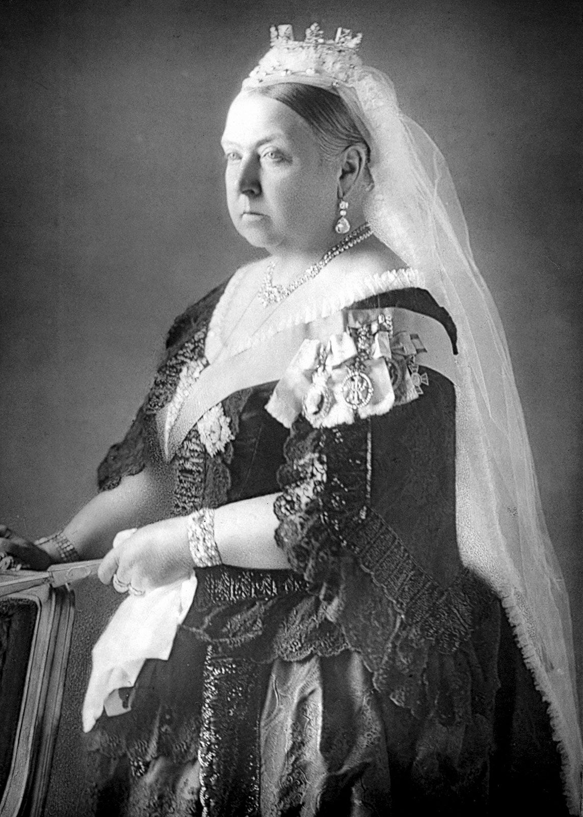
Significantly wealthier than its European rivals but with an aging industrial base.
Worlds largest navy but very small army
40 million people
Constitutional monarchy with a limited voter base
Worlds largest empire but with troubles in Ireland

Slide 5
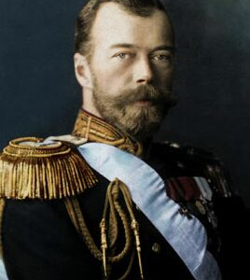
Europe’s largest country. 169 million
Autocratic monarchy
Many different racial groups.
Less advanced than other European nations but experiencing rapid industrialization.
Looked to expand eastwards after the Crimean War.
Recently abolished serfdom; huge differences in income

Slide 6
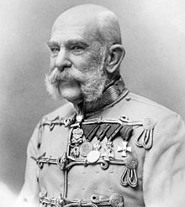
A collection of 41 different nationalities with almost irreconcilable ethnic differences
Held together by an autocratic monarch. Power was almost entirely controlled by two nationalities.
Inefficient with a small industrial base
50 million people

Slide 7
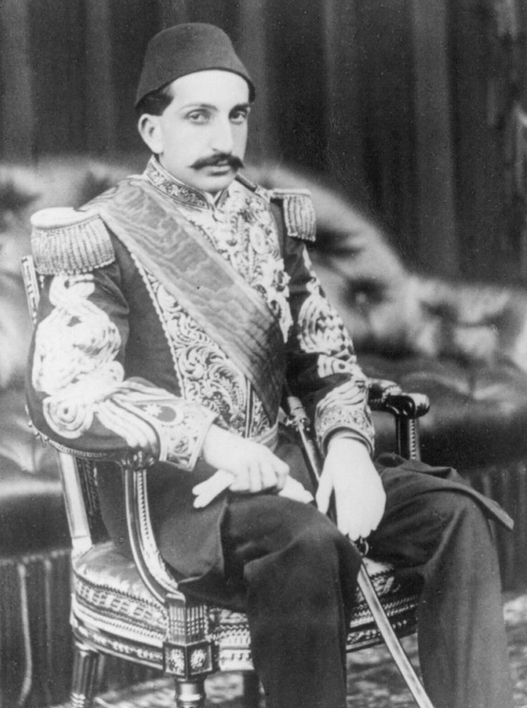
Described as the ‘Sick Man of Europe’
It held a large diverse empire of 25 million people.
It had failed to modernise in the Nineteenth Century
Exhausted from the Crimean War. Its empire had been in steady retreat in Europe. Most humiliatingly it had lost its colony of Greece.

Slide 8
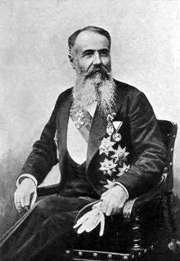
Unstable country; historian Christopher Clark classified it as a rogue state.
Long path to independence. Only formally recognized in 1878.
Backward with no industrial base.
Population of 5 million

