Slide 1
What were the American tactics and why did America Lose the Vietnam War?

Slide 2

What were the objectives of the Americans in Vietnam?

Slide 3
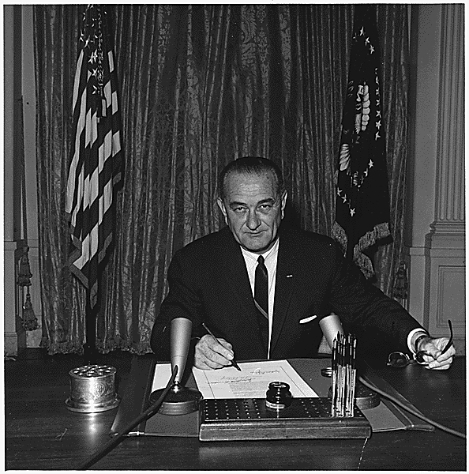
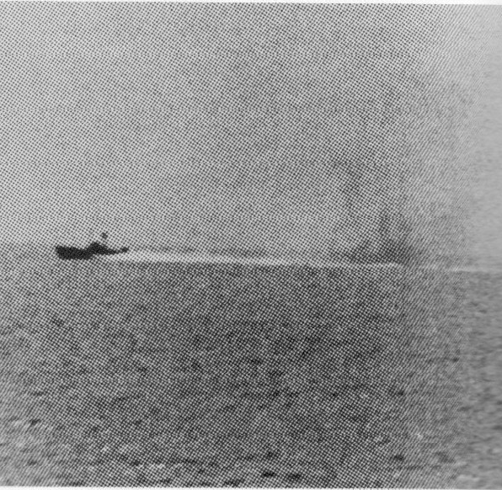
Why would the Gulf of Tonkin be an unsatisfactory pretext to war?

Slide 4
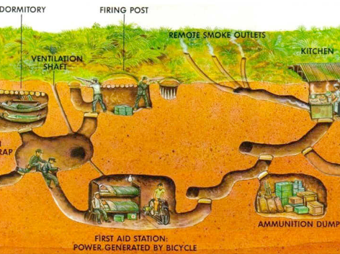
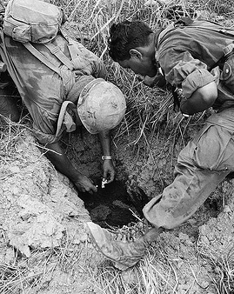
Why did the Viet Cong fight from underground?

Slide 5
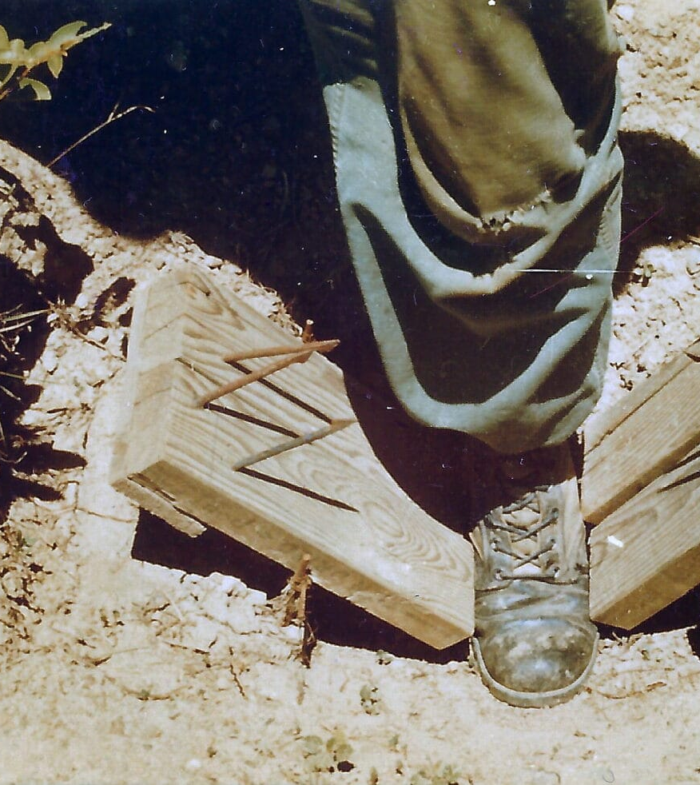
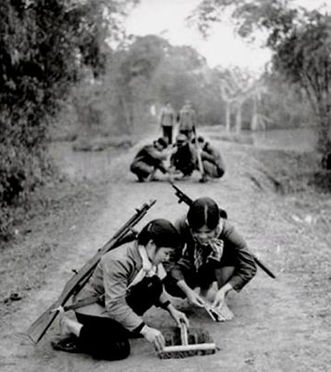
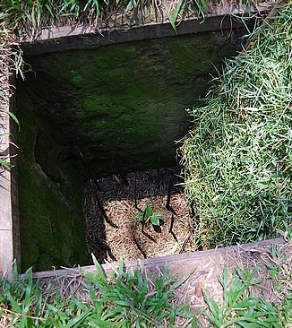
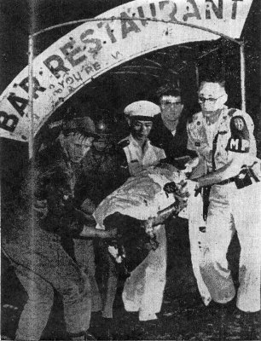
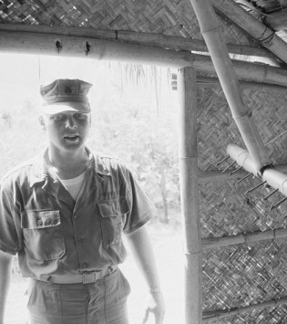
How did the Viet Cong sap American morale?

Slide 6
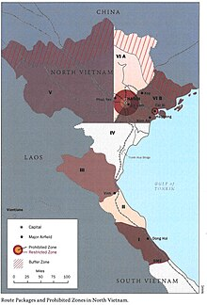
Why was airpower not decisive?
Johnson claimed the US could land a bomb on a dime, but they could not. The computer systems could not guide the bombs.
Bombing often fails against dug-in troops and complex industrial and communications targets.
More was dropped on North Vietnam than Germany and Japan combined. Turns the public and world opinion against the war.
Vietnam was a pre-industrial society, Most of the supplies were from the USSR and China. The USA would not attack within 15 miles of the Chinese border or Haiphong Harbour.
The US took pains to limit civilian casualties. This caution reduced the effectiveness of the bombing, but failed to sway international opinion and appealed to neither hawks or doves at home.
The Soviets provided MiG aircraft and SAM sites. Johnson refused permission to attack cities so half the SAM sites were immune to attack.
Vietnam is covered in cloud much of the year.

Slide 7
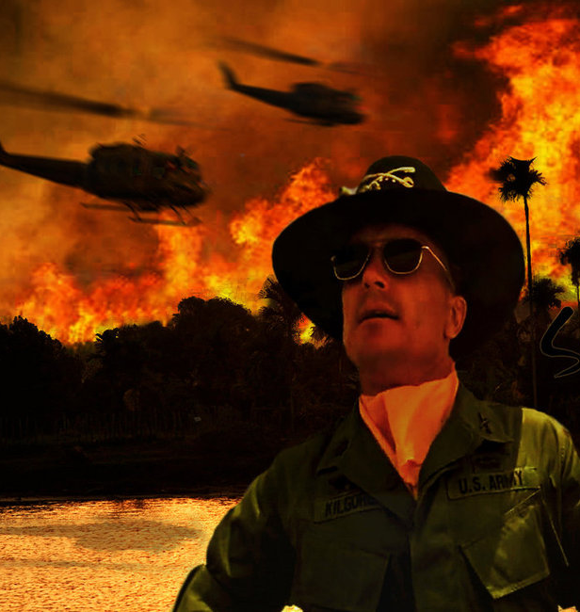
Search and Destroy
Watch the excerpt from ‘Apocalypse Now’ what does it show about the mindset behind these Search and Destroy missions?

Slide 8
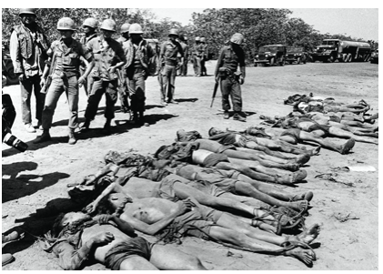
Body Count
US Commanders exagerrated their successes. Up to 100%.
Up to a third of all those counted were civilians.
Official US figures were 950,000 Communist fighters killed. The North reported 330,000

Slide 9
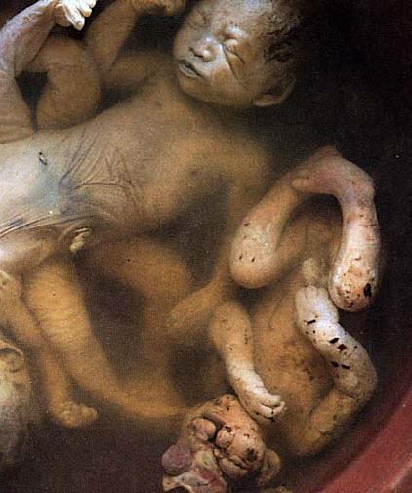
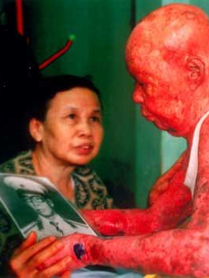
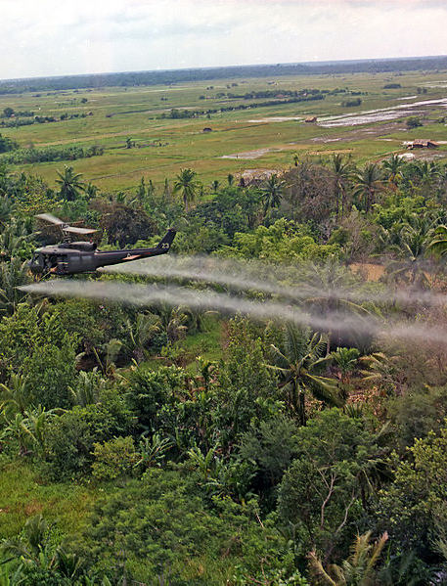
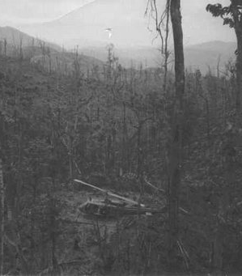
Operation Ranch Hand
24% of Vietnam was defoliated.
4.8 million people were exposed.
400,000 died early deaths.
150,000 Vietnamese children were born with birth defects.

Slide 10
Why did the US Tactics not work?
In Vietnam, Washington policy-makers assumed that US technology and firepower could substitute for the acknowledged absence of a viable political and social structure.
In the 1950s Nine-tenths of US aid was spent not on economic or agricultural development, but instead on arms to sustain the regime. The American advisory group focused on creating a conventional army, capable of resisting an invasion from the North such as South Korea had faced.
By the end of 1960 it was estimated that a third of South Vietnam was under secret Communist control.
The ARVN was a disaster. All 21-22 year olds were subject to conscription, but the wealthy could bribe their way out of service. Despite the vast American aid, soldiers were paid a pittance. Few had any prospect of completing their three-year tour unscathed. It caused resentment in the countryside for both the removal of manpower and the occupation by men perceived as foreigners.
US Advisors lacked a common language and often treated battalions as a personal plaything. By the time they built a relationship with those they were advising they would return home, and the cycle began again. The advisors live apart from the Vietnamese. Wanting to win the war as quickly as possible they could not empathise with the ARVN’s reluctance to engage with the enemy.
Strategic Hamlets and Search and Destroy alienated the population and provided more recruits.
The VC gained the support of locals by attacking wealthy peasants. In 1963 2,000 political assassinations were carried out.
Warfare was not conducive to maintaining tight discipline
Only 4 set piece battles in the war.
The Americans were unwilling to listen to British or Australian advice about their successful campaign to eradicate Communist insurgents from Malaya.
Bombing left explosives that would be used for booby traps.
Even if US captured a village the VC could still be active underneath.
The US underrated the VC who were relatively well supplied.
There were no-operatives working in North Vietnam.

Slide 11
The one-year tour of duty meant that soldiers were always inexperienced, the Vietcong had been fighting since the Japanese
Operation Rolling Thunder had too many conditions to be effective. It cost $10 for every $1 worth of damage and did not stop NVRN soldiers
US got involved in a war of attrition without the desire to stay in Vietnam.
Up to TET, the USA had eliminated 220,000 NRVN and Viet Cong soldiers, but 80,000 were still available for TET. The US had run out of time for the publics support.
American soldiers’ morale was low. They had an oversized admiration for the skills of the Vietcong.
The US did not launch a full-scale invasion of North Vietnam, ensuring that the South suffered from the bulk of the fighting.
There was little international support
The US bombing was intensive, but it would not bomb 9km from the Chinese border or Haiphong Harbour Bay where the Russians were supplying
The Phoenix counter-insurgency program was a huge failure.
A US general said : We went into Korea with a rotten army, and came out with a fine one; we went into Vietnam with a great army, and finished with a terrible one.
The US Army contrived to be sufficiently intrusive and racially contemptuous – also intermittently murderous – to earn the hostility of the population; yet inadequately savage to deter many peasants from supporting the communists.

Slide 12
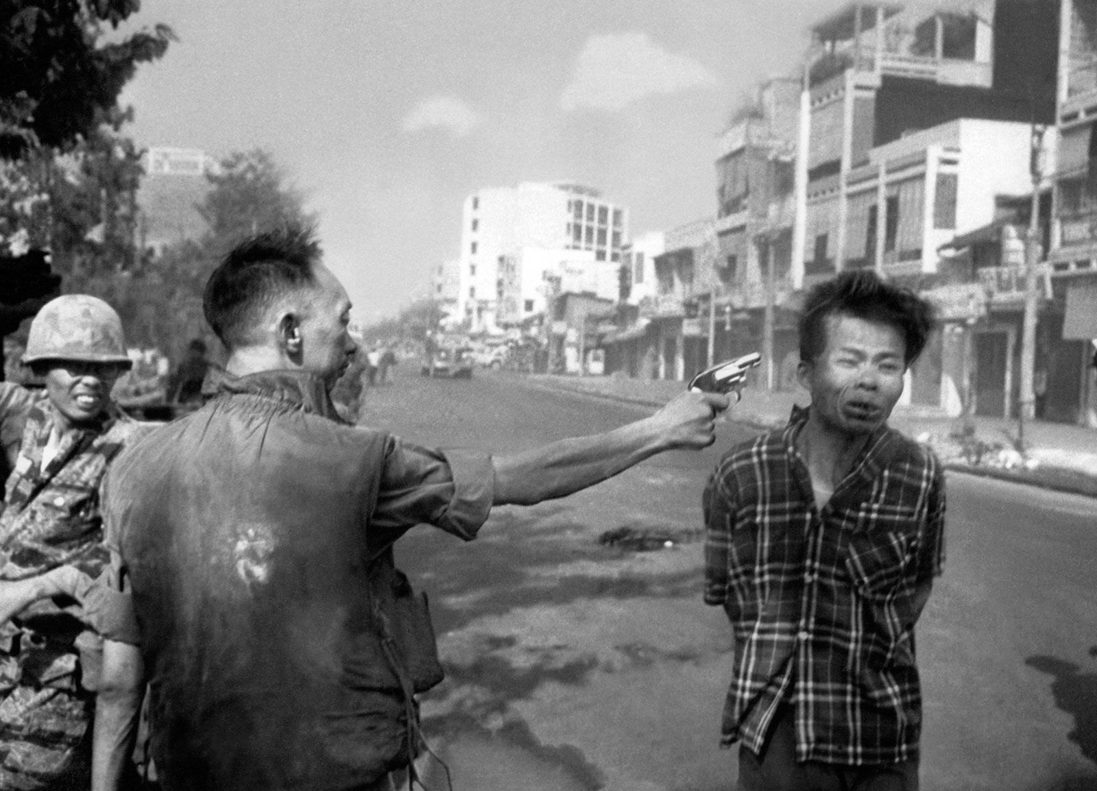
Tet Offensive
The US should have been in the ascendancy . In January 1968 they had 492,000 troops and roughly 3,000 each of tanks, aircraft and helicopters. They had 61,000 allied soldiers and 342,000 ARVN troops.
The Viet Cong lost 37,000 men while US forces were only 2,500 (6,000 South Vietnamese). 60-70% VS strength was wiped out. Why then was it considered a Vietcong victory?

Slide 13
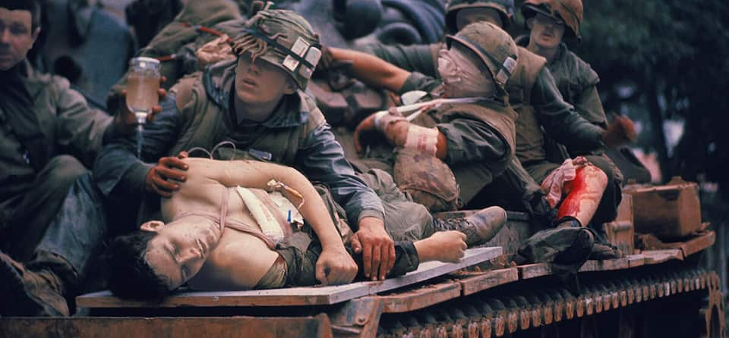
North Korean leadership predicted that 500,000 in the South would rise against the government.
Eventually it was only a few hundred.
A Tet truce had been agreed. Given the reports of North Vietnamese activity the US should not have honoured it.
The siege of the US Embassy was embarassing. It took 6 hours to dislodge the 17 VC attackers.
While most formations held their position and inflicted higher casualties, the public were exposed to mayhem and carnage.
The real significance of the Tet Offensive is it prevented the Viet Cong from being capable of defeating the Americans. As long as the US had the will to stay then they could remain.

Slide 14
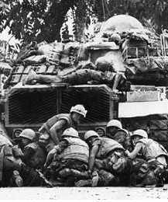
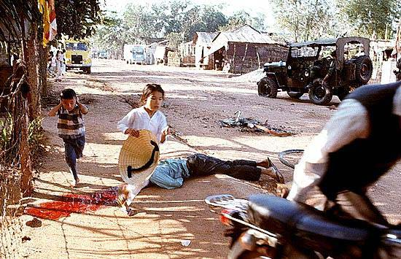
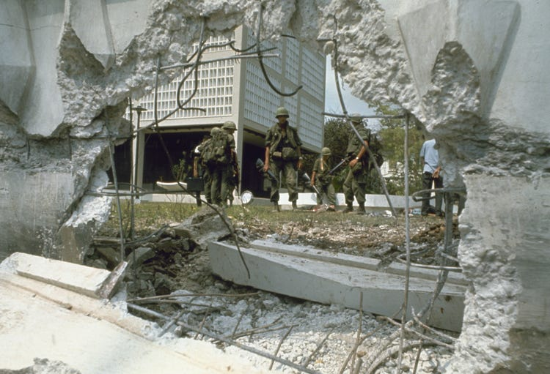
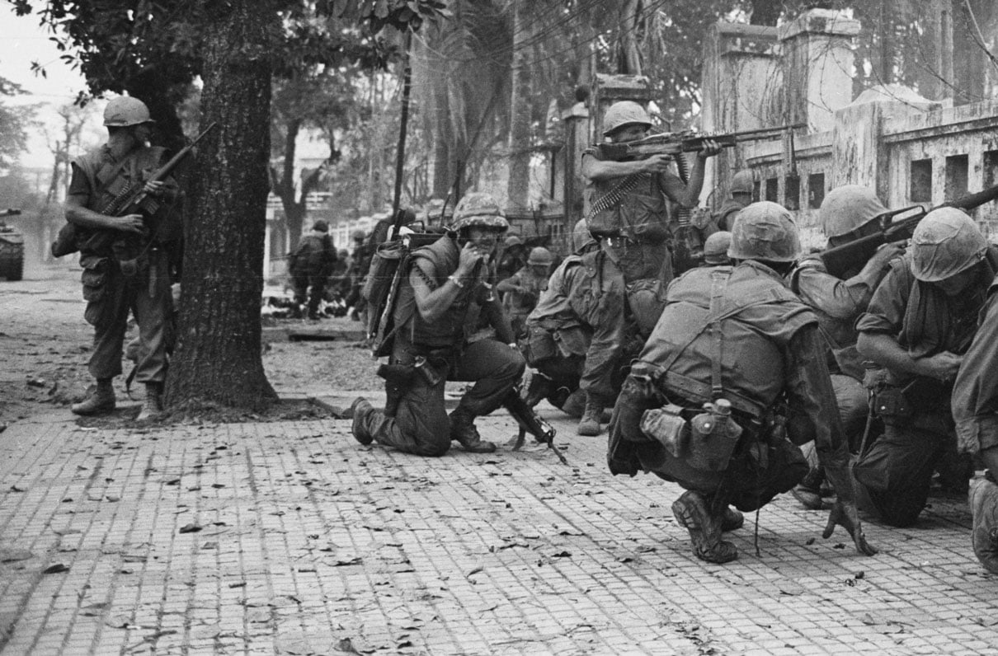

Slide 15
‘The Tet Offensive was the main reason for American withdrawal from Vietnam.’
How far do you agree with this statement? Explain your answer.

Slide 16
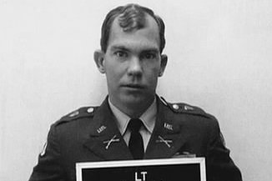
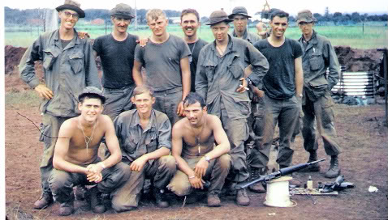
Burning the Village: My Lai 1968
On 16 March 1968 40 soldiers of C Company of the 1/20th Infantry murdered 504 civilians in My Lai.
Many women were also gang raped.
There was an instutional cover up. No investigation was carried out despite repeated reports of the atrocity.
The trial and imprisonment of Platoon Leader William Calley set off a culture war. Nixon capitalised on the controversy by pardoning Calley. In private the President blamed ”dirty rotten Jews from New York”

Slide 17
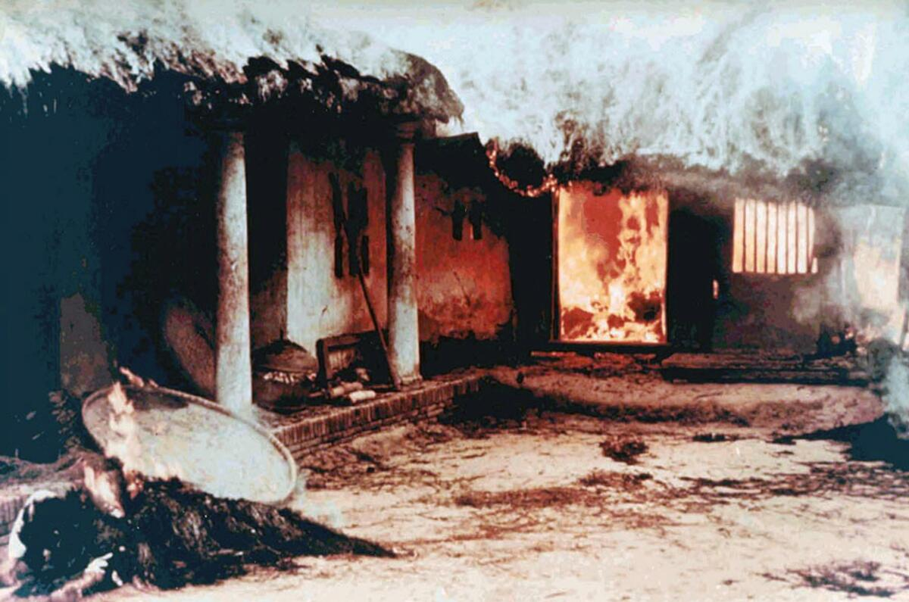
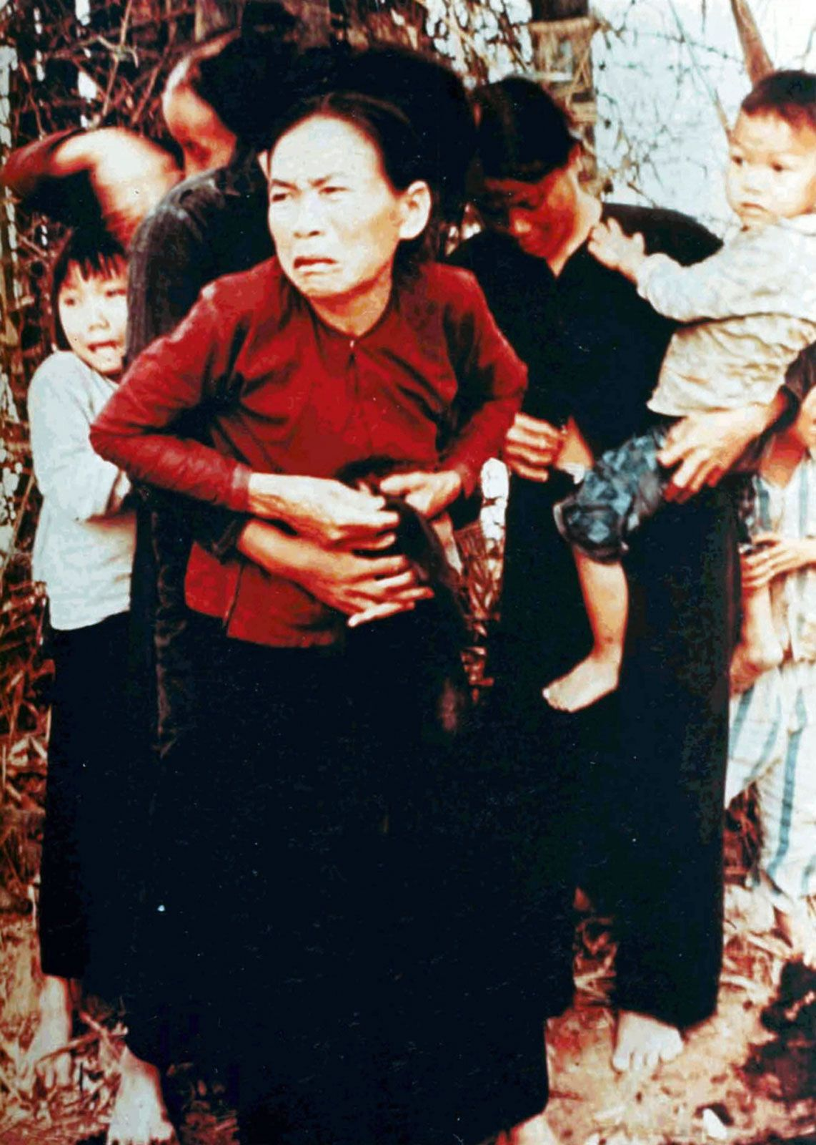
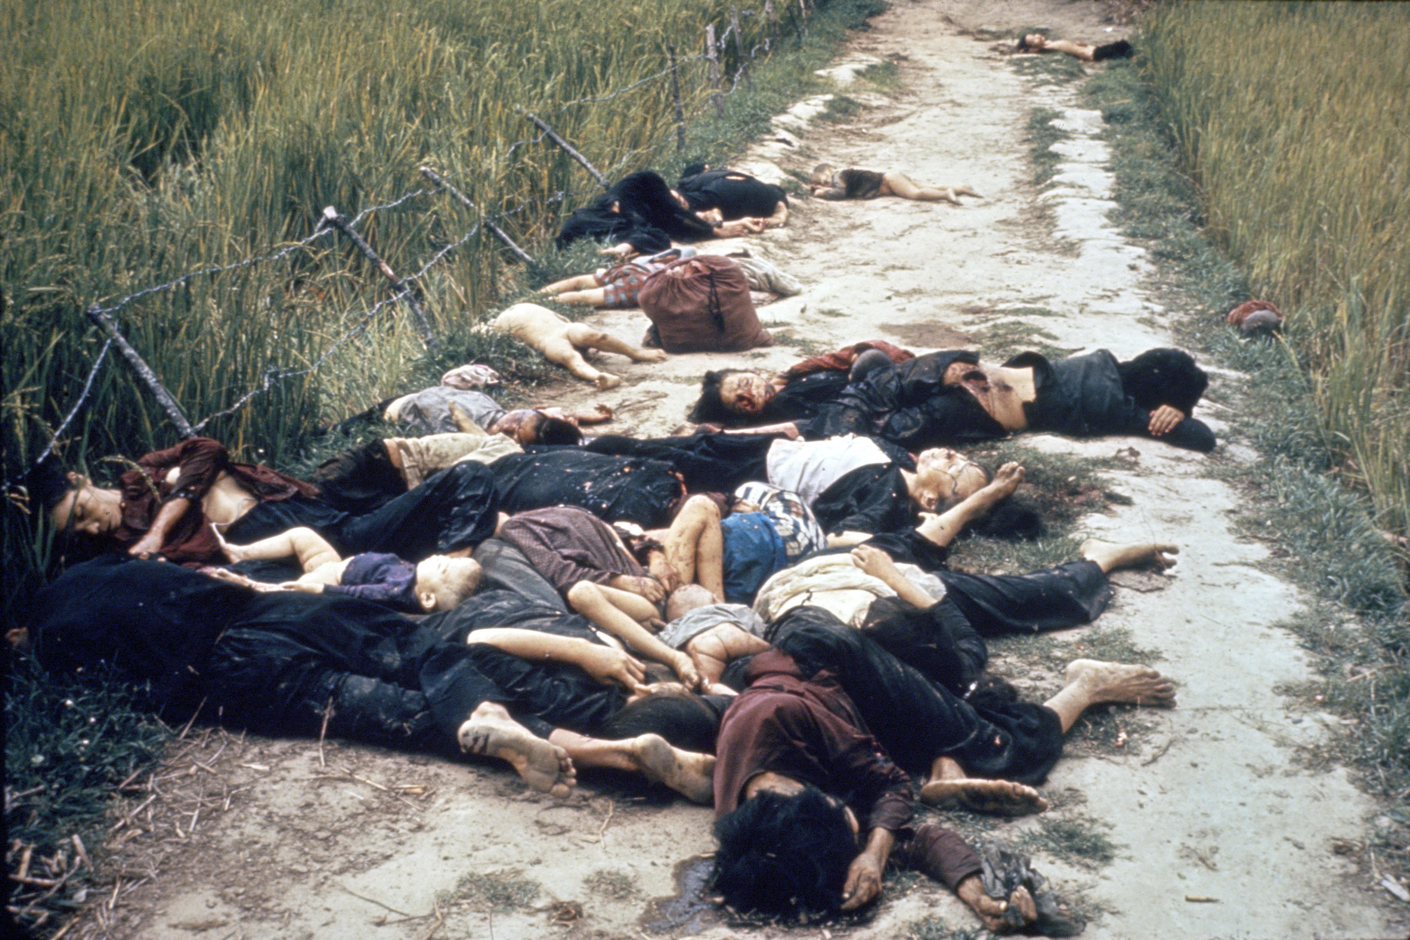

Slide 18
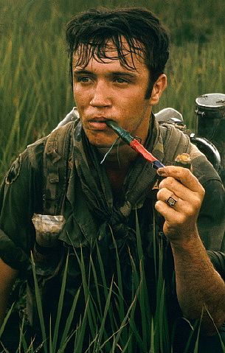
US Troops
By 1971 60% of US soldiers were regular pot smokers, 22% had used heroin.
Soliders would ‘flake out,’ refusing to go in the field, clean their weapons, or handle equipment.
The killing of officers with grenades: ’fragging’ became ubiquitious. There were 600 attempts between 1969-1971, killing 82.
In 1969, 2,500 military absentees were loose in country, most engaged in crime.

Slide 19
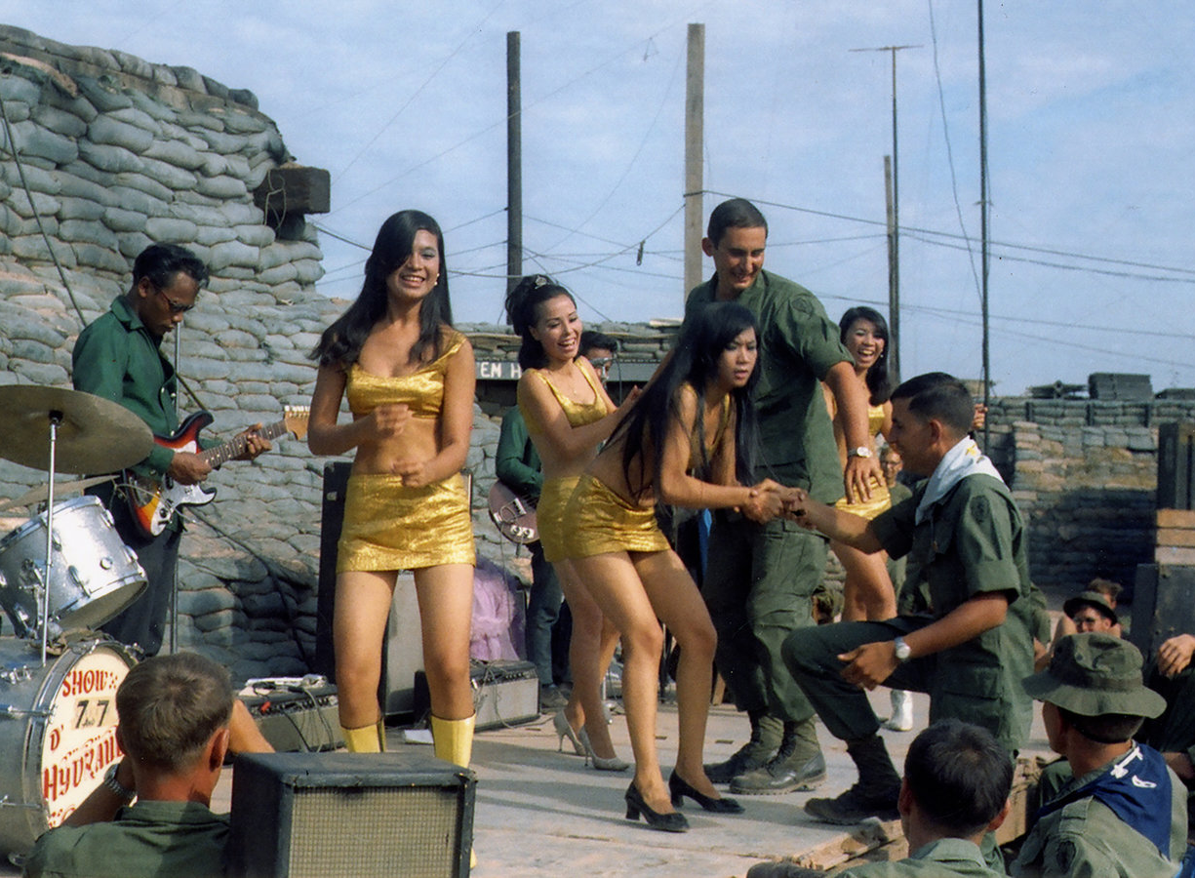
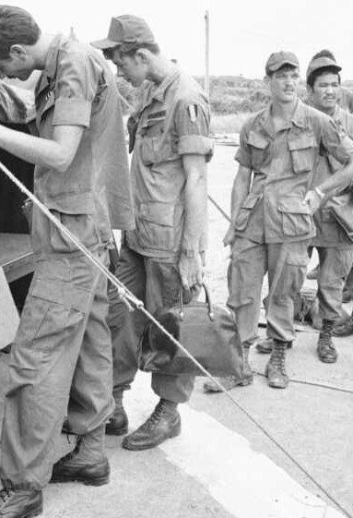
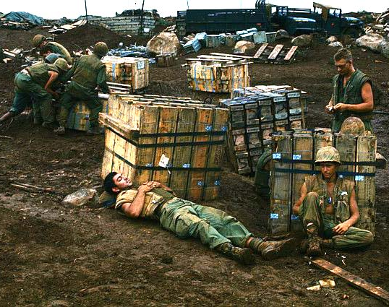

Slide 20
‘US involvement in Vietnam was an error from the beginning.’
‘In Vietnam, Kennedy was more successful than Johnson.’ How far do you agree with this statement? Explain your answer.

Slide 22
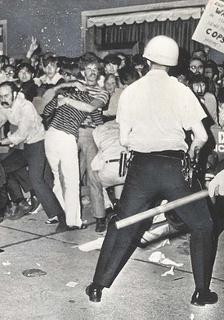

1968 Democratic Convention
The Democrat Party was divided between a pro and anti-war faction in 1968.
The anti-war candidate, Robert Kennedy, had been assasinated in June 1968, leaving the presidential nomination open for the pro-war Hubert Humphrey.
The Democrat party boss in Chicago, Mayor Daley, was determined to prevent any disorder. He refused to grant any permits to protestors and recruited 23,000 police and national guardsman to suppress disent.
After four days of increasing tensions, riots broke out. 668 protestors were arrested and 1,100 were injured or needed tretment for tear gas exposure. 192 police were injured. The breakdown of societal norms that had occurred in Vietnam had been brought to the USA.

Slide 23
‘When Nixon became President in 1969, he needed to seek a peace settlement with North Vietnam.’ How far do you agree with this statement? Explain your answer.

Slide 24
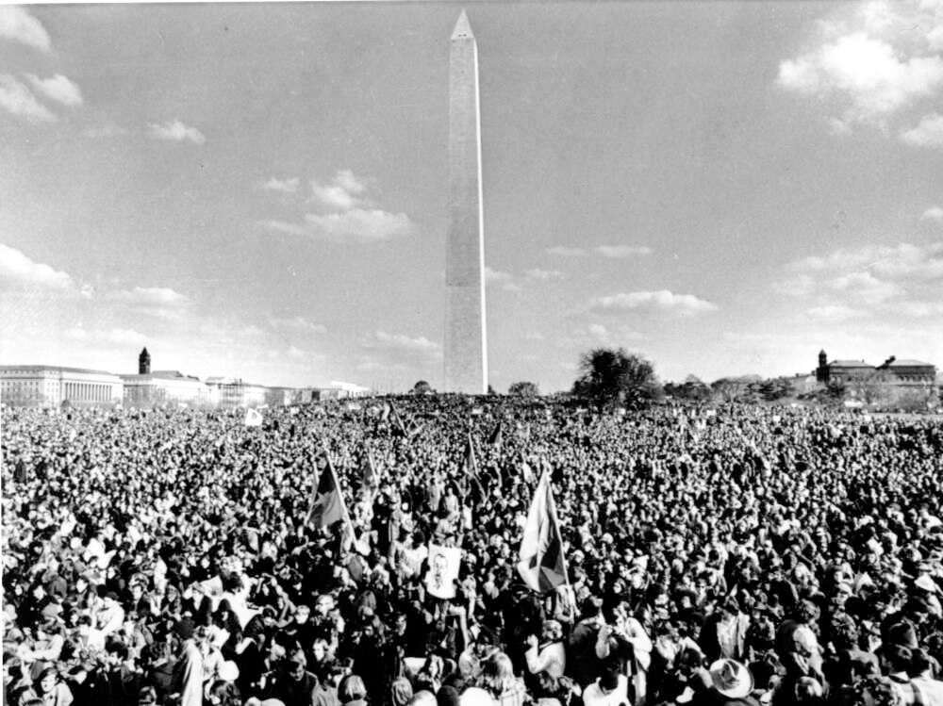
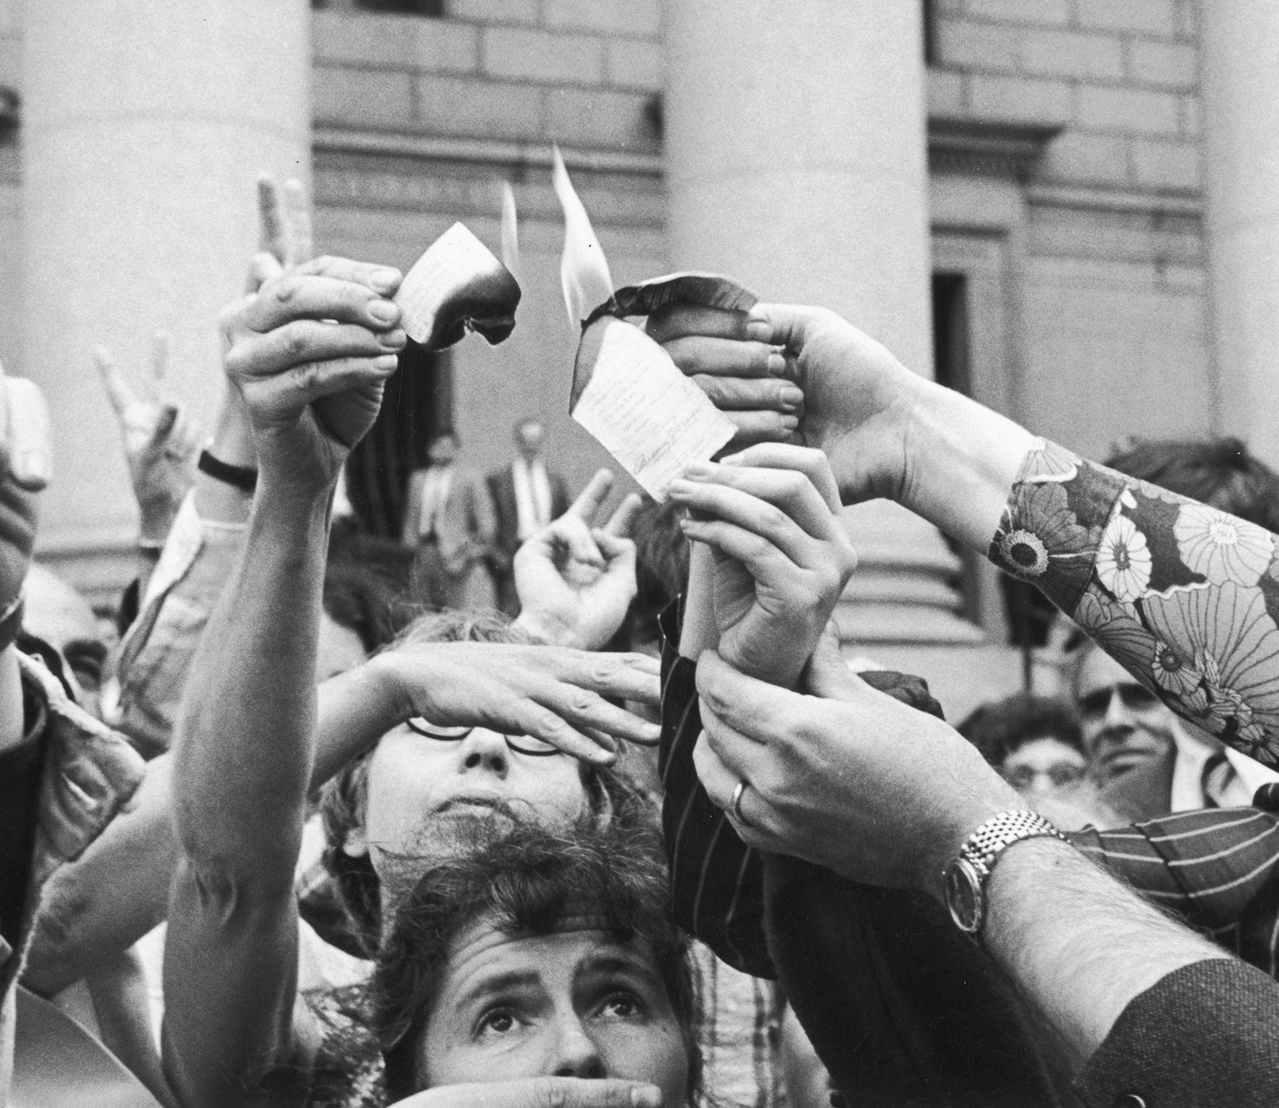
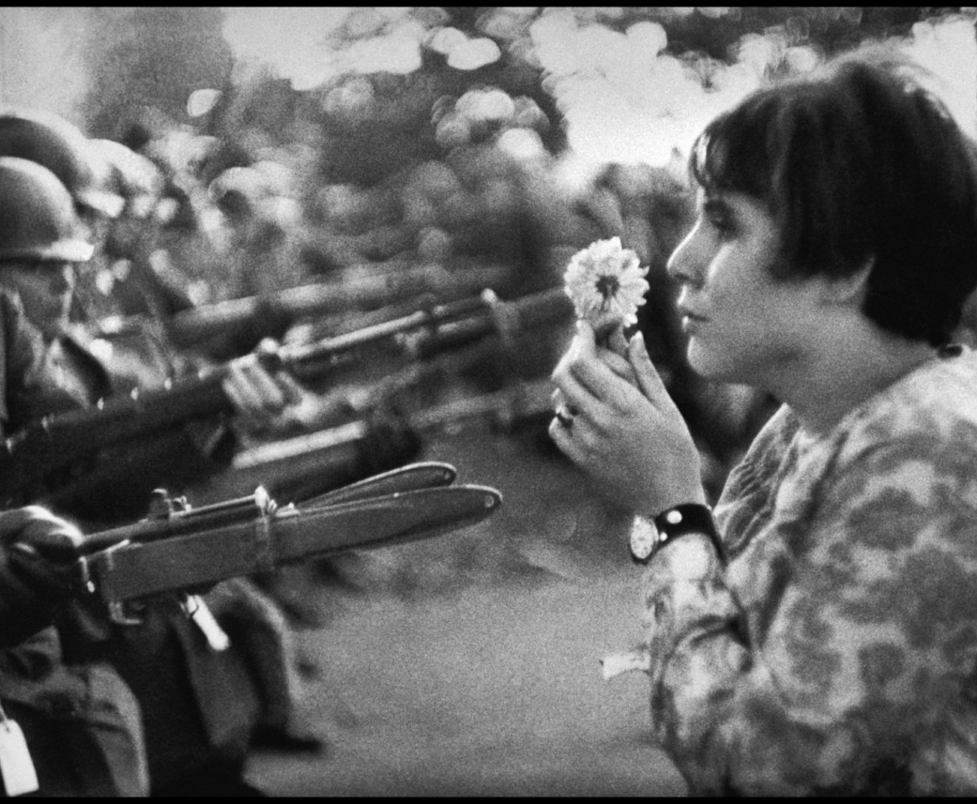
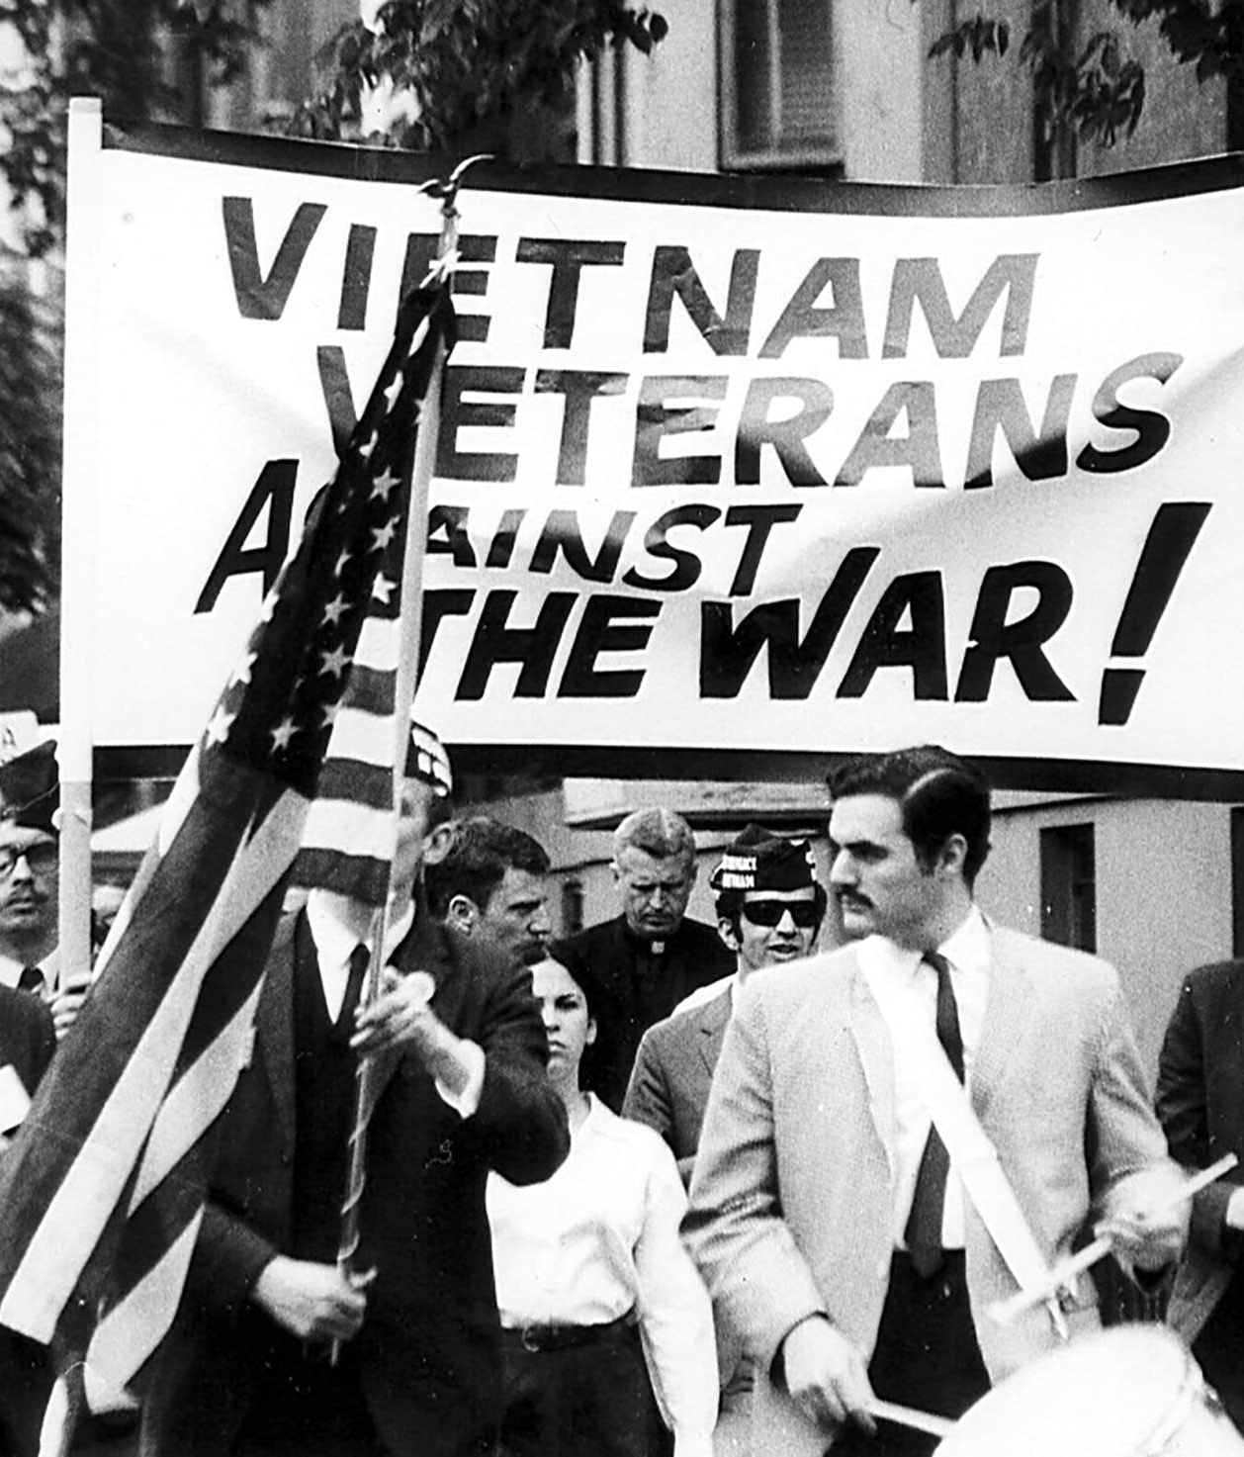
Protest Grows

Slide 25
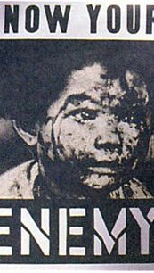
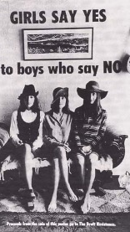
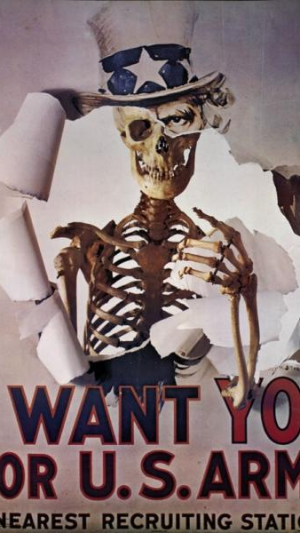

Slide 26
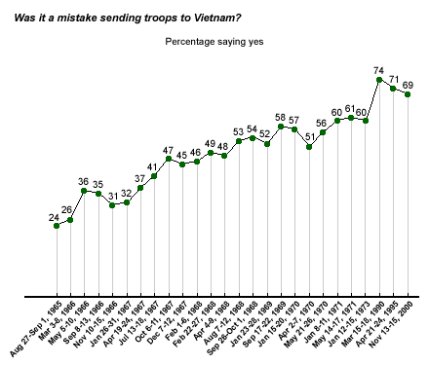

Slide 27
Why was there so much opposition?
No Moral Authority
Extensive media coverage. North Vietnamese atrocities not covered (Loan)
CONITELPRO
Creditability Gap
Returning soldiers joined the anti-war movement
Johnson had to suspend much social spending (Great Society)
The rich could escape the draft much easier
Average soldier killed was 19
Black community suffered
Undeclared war against Cambodia caused outrage
William Calley (My Lai) was paroled , there was a belief that war crimes were accepted in the US military.
Pentagon Papers fueled peoples distrust of the government
Veterans March
Silent majority
Kent State

Slide 28
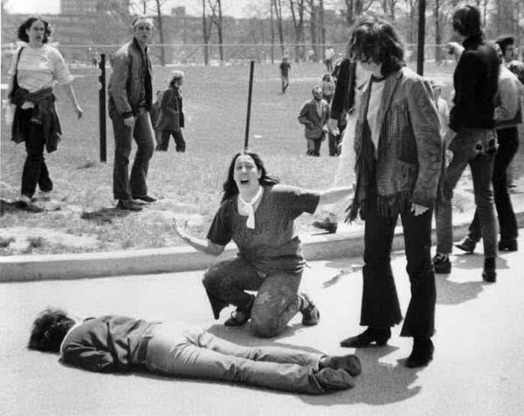
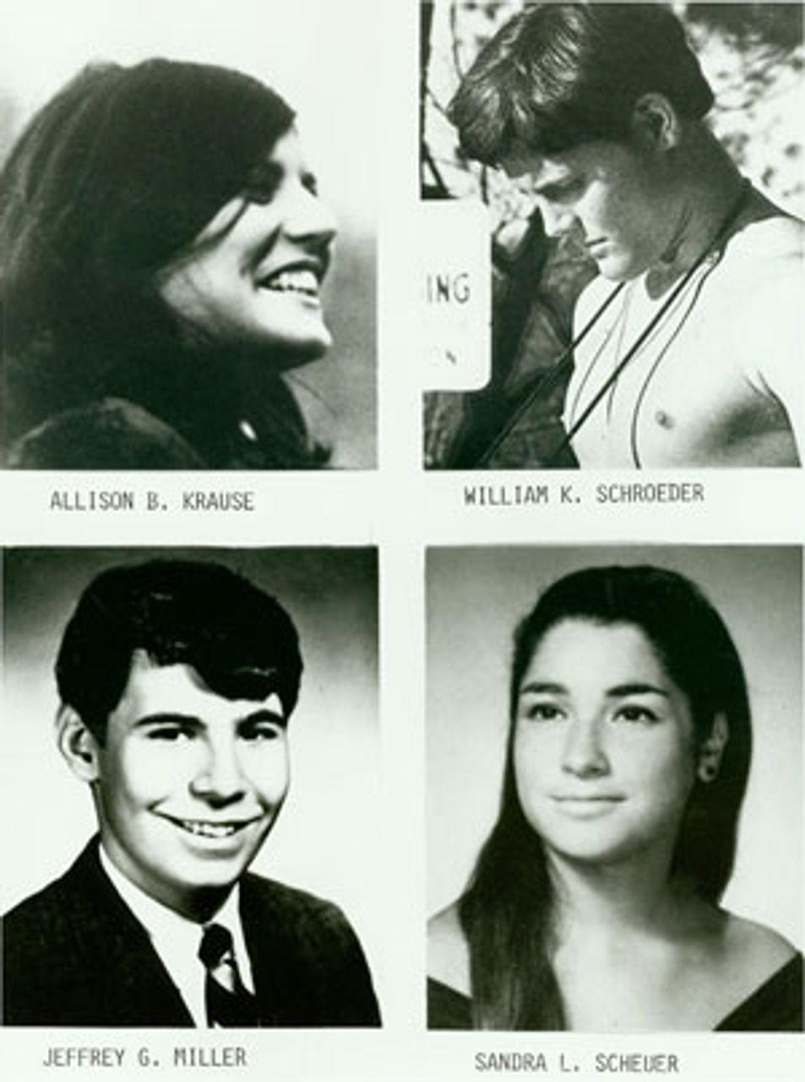
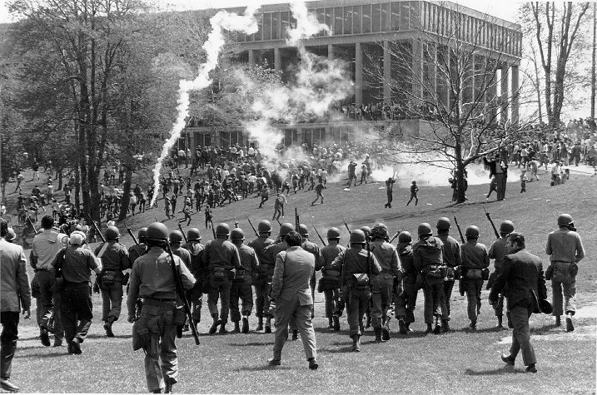
Kent State: May 4 1970

Slide 29
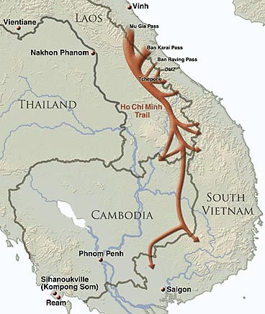
What was the Ho Chi Minh Trail?

Slide 30
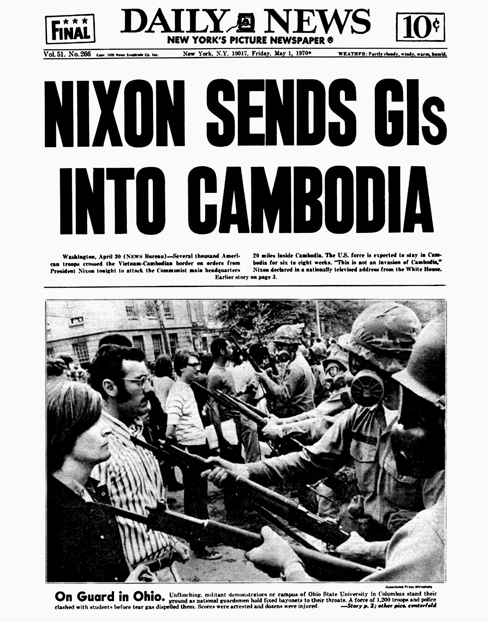
Cambodia
To demonstrate a show of strength at the Paris Peace Talks, the US launched a 50,000 strong campaign into Cambodia to remove North Vietnamese fighters.
The Cambodian leader, Prince Norodom Sihanouk, was in Beijing attempting to enlist Mao’s help in removing the North Vietnamese.
A coup removed Sihanouk, replacing him with a military dictatorship. The US gave aid to the new regime, but an insufficient amount to deal with the growing power of the communist Khmer Rouge.
60% of Americans opposed the intervention. Policy analysts found the intervention reckless when the US had already singalled it intended to leave SE Asia. The invasion was also illegal, tantamount to an undeclared war.
The attacks caused discomfort for the North, but did not stop the supplies of the Ho Chi Minh trail.

Slide 31
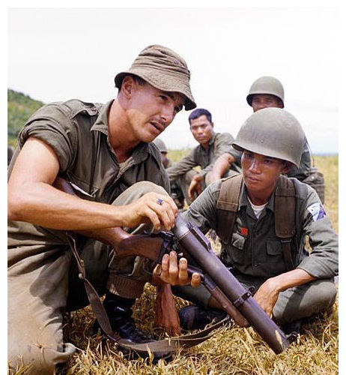
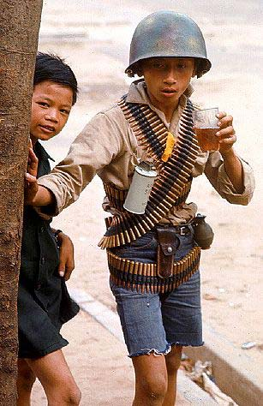
Vietnamisation
Nixon and his National Security Advisor Henry Kissinger reduced US ground troops (70,000 in 1970), while increasing bombing of the North and authorising operations over Cambodia.

Slide 32
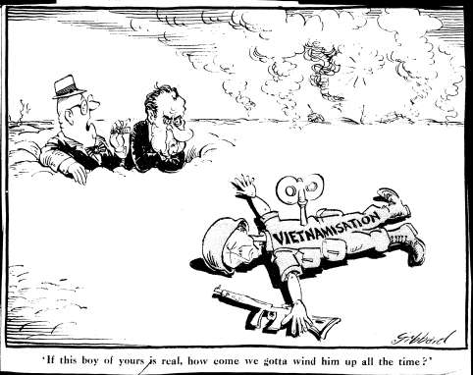

Slide 33
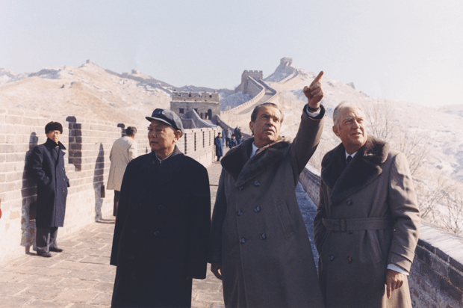
Nixon in China
The two sides spoke with considerable frankness, agreeing to differ about Taiwan.
The president made plain his determination to get out of South Vietnam, and his indifference to what took place thereafter, so long as before the communists took over there was a ‘reasonable interval.’ ‘The Chinese asserted a desire for an end to their isolation; a new working relationship with the US for which they were prepared to make political sacrifices.
They would not, however, cut off aid to Hanoi. and it was naïve of the two Americans to fantasise that they might.
Nonetheless, Nixon returned home confident that he could now do almost anything he liked to the North, with the decade-long spectre of Chinese intervention banished.

Slide 34
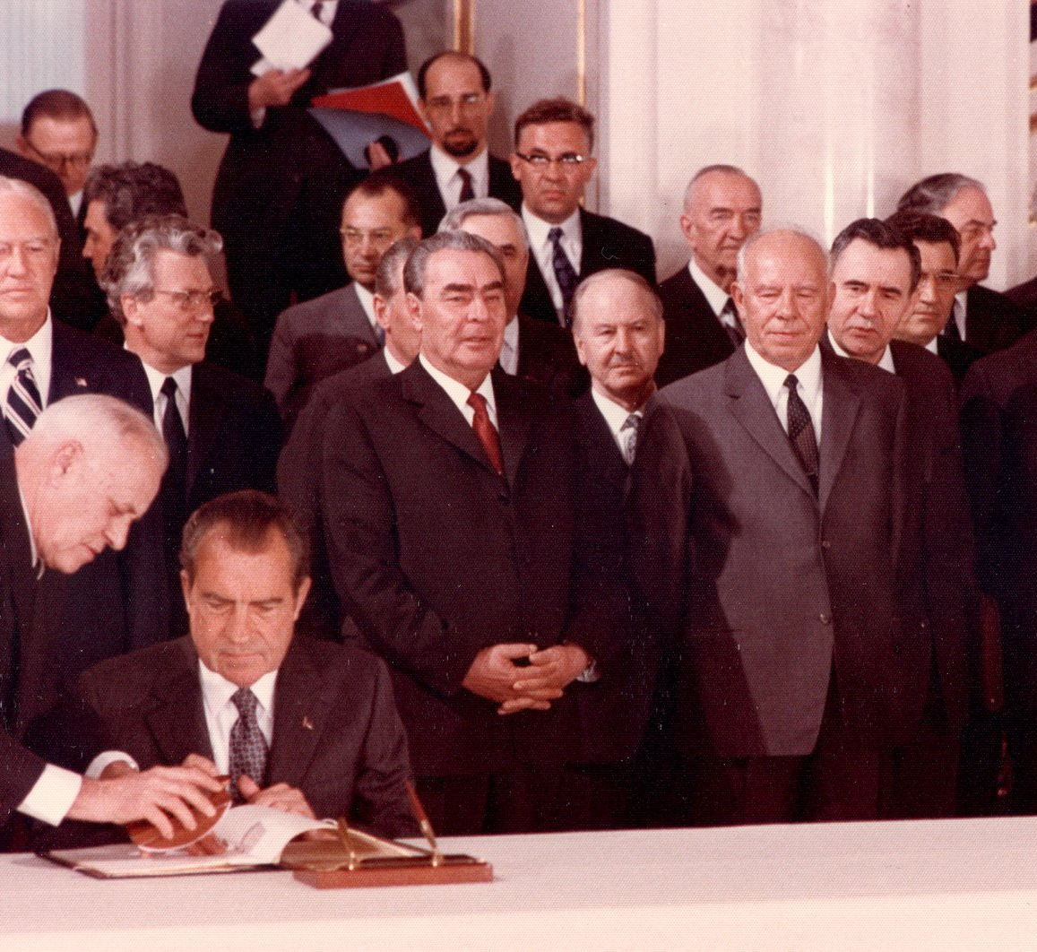
Nixon in the Soviet Union
Kissinger failed to understand that the Soviet Union was incapable of exercising influence over North Vietnamese policy.
The USSR stated that if the USA could not control Israel then how could they North Vietnam.
Both sides were occupied with nuclear. arms limitation.

Slide 35

1972 Easter Offensive
In April 1972 North Vietnamese forces, armed with cutting edge Soviet weapons, swept South.
The South Vietnamese lost 200 tanks, 300 pieces of artillery and nearly 1,000 other vehicles. US airpower prevented the defeat turning into a rout.
Despite taking over 100,000 casualties the North Vietnamese leadership remained optimistic. Again it had been proven that ARVN units could only survive with US airpower.

Slide 36

Operation Linebacker
In response to the North Vietnamese attack, Nixon approved the dropping of 155,000 tonnes or ordinance to be dropped on North Vietnamese targets. All North Vietnam’s oil storage and 70% of its electricity production was destroyed. Imports were cut by 95%.

Slide 37

Paris Peace Conference
Talks between the US and North Vietnam began in 1968, but little progress had been made.
In September 1972, both sides were desperate enough to come to a deal. Nixon hoped to have the accords signed before the November election, even offering $10 billion in potential reparations.
In December Nixon ordered Linebacker II with 20,000 tonnes dropped on Hanoi. The bombing had little impact other than anger world opinion. The loss rates amongst US crews were 2.6%.
Eventually the accords were signed in January after the US made further concessions. .
Neither Kissinger or Nixon believed that South Vietnam would survive. They hoped they could get US troops out before a Communist takeover.
The withdrawal of all U.S. and allied forces.
The return of prisoners of war
The clearing of mines from North Vietnamese ports by the U.S.
A cease-fire in place in South Vietnam followed by precise delineations of communist and government zones of control.
The establishment of a “National Council of National Reconciliation and Concord” to ensure democratic liberties and organize free elections in South Vietnam.
The reunification of Vietnam through peaceful means without coercion or annexation by either party, and without foreign interference.
The establishment of “Joint Military Commissions” composed of Canada, Hungary, Indonesia, and Poland to implement the cease-fire.
The withdrawal of foreign troops from Laos and Cambodia.
A ban on the introduction of war material in South Vietnam unless on a replacement basis.
A ban on introducing further military personnel into South Vietnam.
U.S. financial contributions to “healing the wounds of war” throughout Indochina.

Slide 38

Watergate
Kissinger often asserted that he achieved a decent settlement at Paris, which was wrecked by Watergate, communist perfidy and congressional pusillanimity.
Watergate changed nothing. Neither Nixon or Kissinger believed that South Vietnam could survive. The Secretary of State had got the US out of Vietnam with some dignity, but they had abandoned the South Vietnamese.
The big change Watergate brought, was limiting the power of the President to conduct covert actions.

Slide 39
Explain the methods used by President Nixon in an attempt to gain ‘peace with honour’ in Vietnam’.

Slide 40

Fall of Saigon
Following the US withdrawal the South Vietnamese economy went into depression.
Finally, land reforms were udenrtaken and off-shore oil was discovered, but it had come too late.
US aid had fallen from $2.3bn to $700 million. The number was insufficient to maintain a million strong American trained army.
Despite Ford’s assurances that the US would enforce the Paris Peace Accords, the North Vietnamese did not believe the President would reengage. The US was now preoccupied with the Middle East.
The North began a series of well conceived raids in March 1975. The lack of US air retaliation emboldened the attackers and demoralised the defenders.
Southern resistance killed around 10,000 North Vietnamese, but they were overwhelmed. On 30 April the North declared victory.
Several thousand South Vietnamese were subsequently murdered in the following months, though these were unsanctioned. 300,000 were sent to labour camps and 10,000 died. The economy collapsed with much of the South’s wealth requisitioned.

