Slide 1
Mao and Stalin

Slide 2
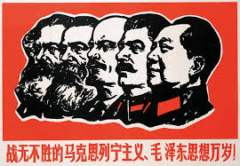
Mao’s views on Stalin.
Mao never fully subscribed to Comintern advice. Still, he recognised the Soviet Union's achievements but did not find its methods applicable to China. He was resentful about his past treatment, but he had nowhere else to turn. He feared a resurgent US-backed Japan.
Because the Soviet Union was the first socialist country in the world and established the only example of building a socialist state and society, Mao’s continuous revolution had to follow the Soviet experience. He publicly labelled his desire for friendship as “leaning to one side.”
Many also felt negatively about the USSR because the Soviet Red Army had pillaged north-east China of its industrial equipment when it liberated the territory from the Japanese at the end of the war.
What dilemma does Mao face?

Slide 3
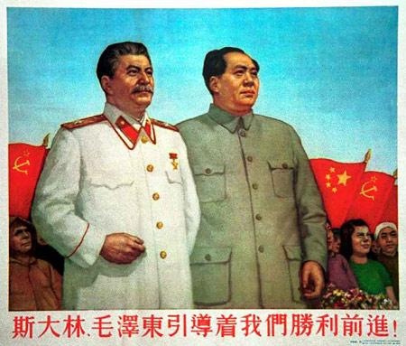
Stalin’s view on Mao
Stalin was as surprised as anyone with the speed of the Communist victory. He had told Mao to wait in 1949 rather than cross the Yangtse. Rather embarrassingly he was still allied with the Nationalists in 1949. He never trusted Mao, viewing him as another Tito. Stalin realised the USSR had little prospect of controlling China in the long term. He wanted to keep it under control initially through a binding treaty. Too much independence was dangerous given the increased US interest in Asia.

Slide 4
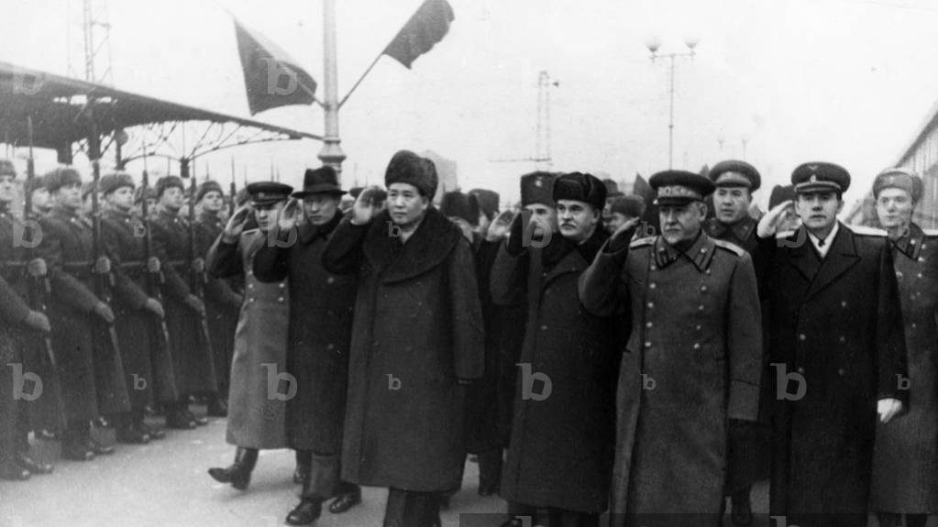
Mao’s Arrival
Molotov and Bulganin greeted Mao at the train Station but did not accompany him to his residence.
The Chairman gave a speech at the railway terminal, reminding his audience how the unequal treaties between Tsarist Russia and China had been abolished after the Bolshevik Revolution in October 1917, a broad hint referring to the treaty signed between the nationalists and the Soviet Union five years earlier.
Stalin granted Mao a brief interview that day, flattering and praising him for his success in Asia, but also teasing him by feigning ignorance of the real reason for his visit. Eventually, he told the chairman that it was in his and the USSR's interest to maintain the1945 Sino-Soviet treaty. Five days later, Mao was treated as a guest of honour among many other delegates who had travelled to Moscow to celebrate Stalin’s seventieth birthday.
But then Mao was whisked off to a dacha outside the capital and made to wait several weeks for a formal audience.
Stalin was wearing down his guest, insisting that the Yalta accords were binding –disingenuously expressing concern that tampering with them could cause problems with Washington including Soviet control over the ports of Port Arthur and Dalian as well as the Chinese Eastern Railway in Manchuria. Mao would recall his belief that Stalin thought ‘our revolution was a fake’.
Meetings were cancelled, and phone calls were never returned. The Chairman lost his patience. ‘I have only three tasks here,’ he cried out: ‘The first is to eat; the second is to sleep; the third is to shit.’ Taken to Leningrad, he made a point of being unimpressed. Still, he refused to go home, and Stalin decided to take a softer line.

Slide 5
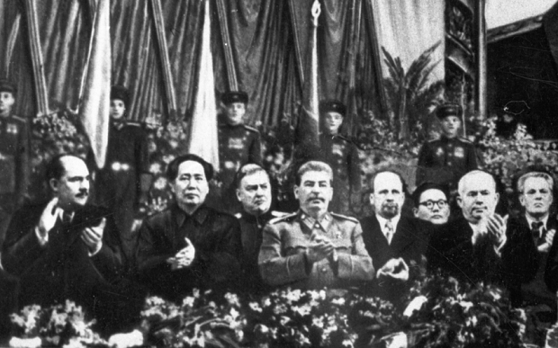
Mao spent three months in the Soviet capital. A remarkable amount of time for a leader of a country three months into his regime. He was later to say of this stay that he had argued with Stalin for two months. It was doubtless a difficult time.

Slide 6
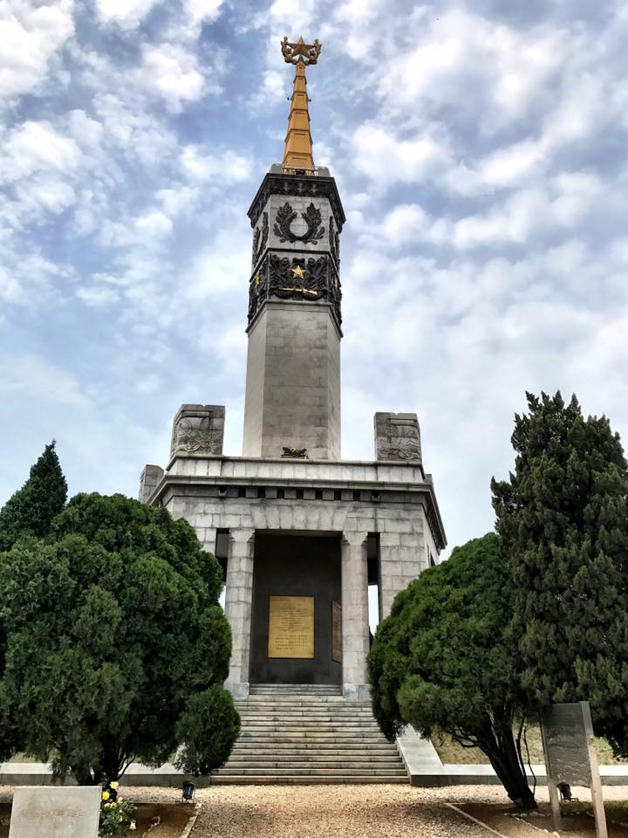
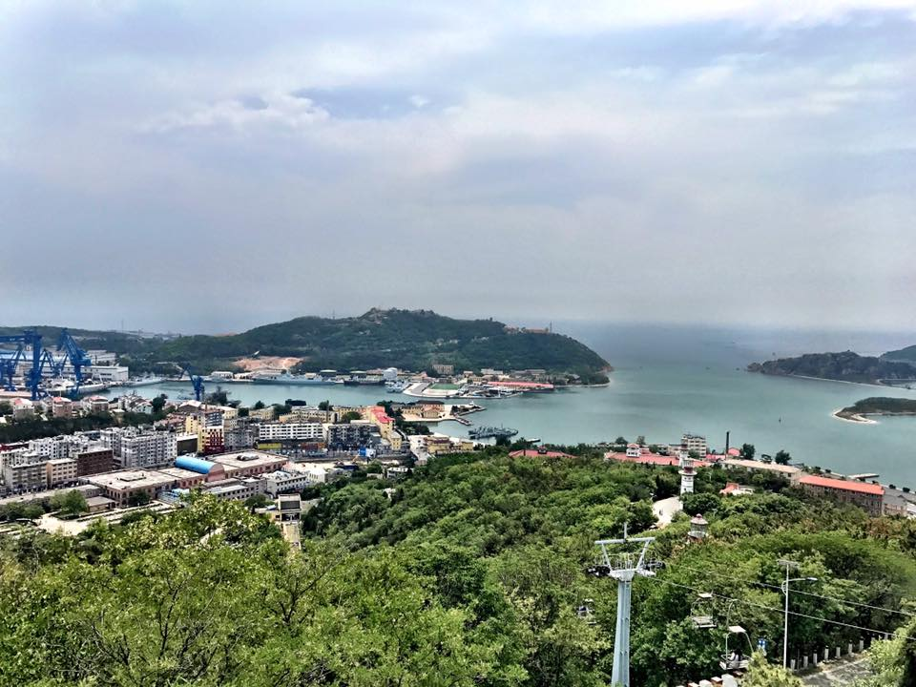
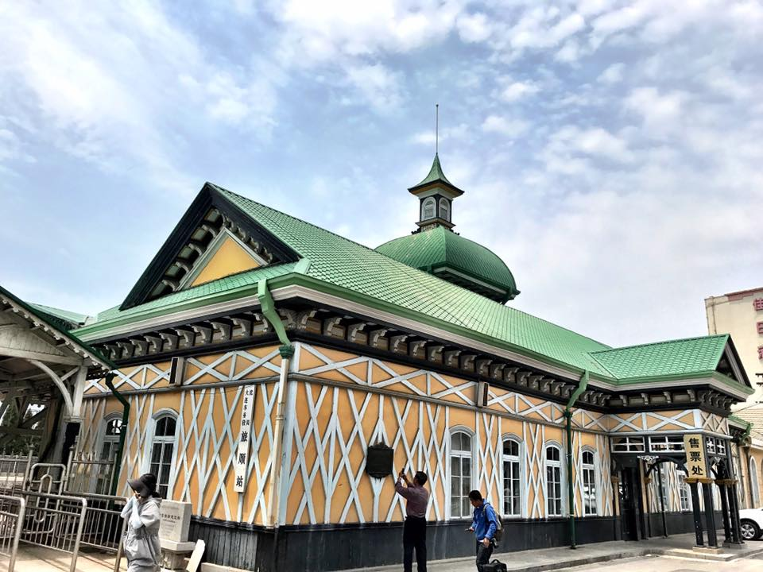
Port Arthur and Darien

Slide 7
Liu Shaoqi (1949)
If we attach great importance and give particular appreciation to the friendship and cooperation between the Chinese and Soviet peoples, this is because the road travelled by the Soviet people is exactly that which the Chinese people must follow. The experience of the Soviet people in the construction of its country is one that deserves our attention.

Slide 8
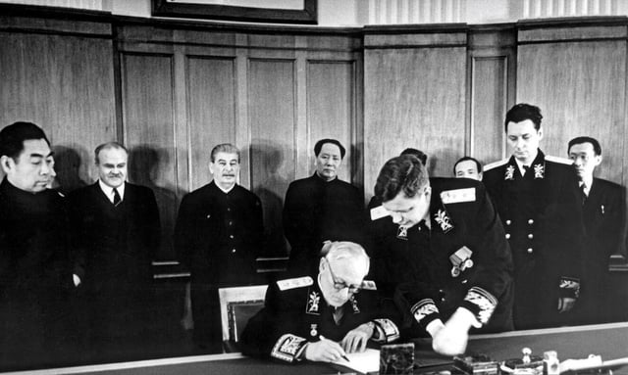
Sino-Soviet Pact
Zhou Enlai eventually arrived to use his diplomatic skills to come to an agreement.
The treaty ports in Manchuria and Port Arthur would be returned by 1952. But the Soviets there and in Xinjiang would have freedom of movement.
Mongolia, which had been part of the Qing Empire was to remain a Soviet puppet state.
The USSR was to get ‘surplus’ stocks of Chinese tin, tungsten and antimony for fourteen years, depriving Beijing of the chance to earn foreign currency by selling them elsewhere. China could define what was considered surplus materials.
China agreed to pay thousands of Soviet advisers and technicians high salaries in gold, dollars or pounds.
In a condition which was kept secret because of its echo of the concessions of the Qing to foreigners, the Soviet advisers were not subject to Chinese law.
Two mixed mining companies were created (oil and nonferrous metals) and a joint civil aviation company.
In return, China received US $300 million in loans over five years (the first year was held back to repay Chinese debts to the USSR). The amount was to be repaid between 1954 and 1963 at 1% interest.
Assistance with the construction of 50 major projects and a guarantee of Soviet protection if it was attacked. The USSR agreed to build air defences in coastal regions.
How fair was the Sino-Soviet Agreement?

Slide 9
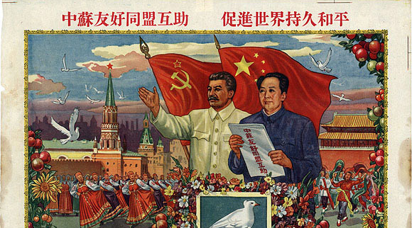

Slide 10
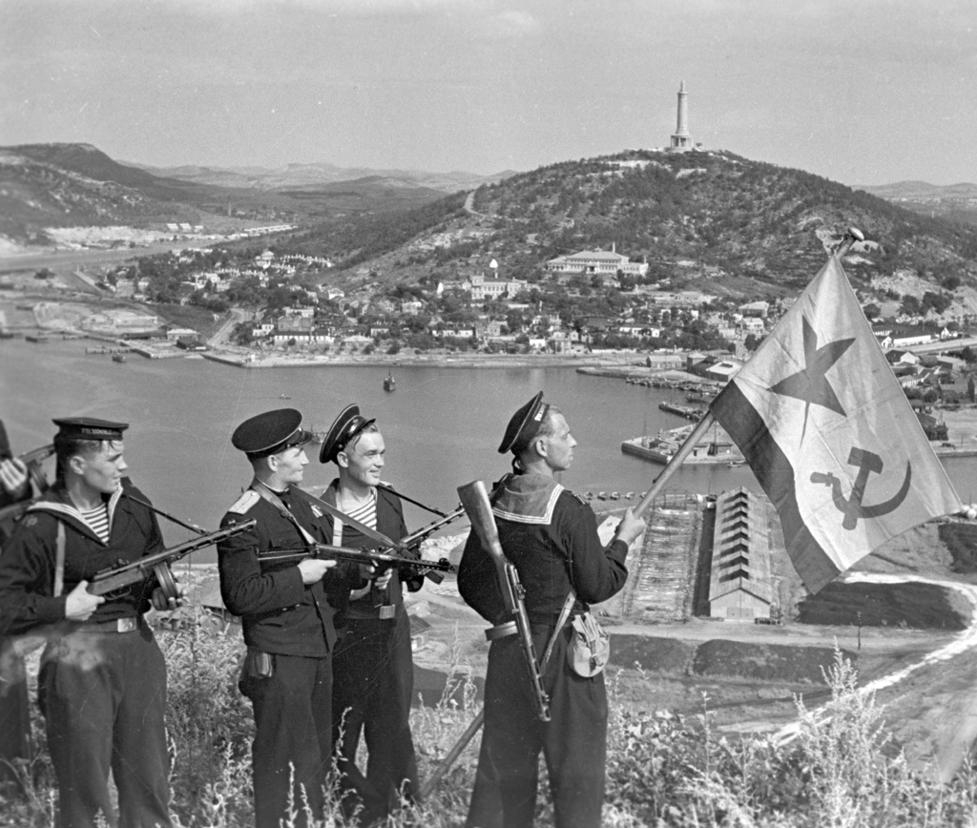
Soviets in Chinas
Mao’s wish to discuss revolutionary ideals and the Communists’ historical responsibilities came to nothing.
There were 150,000 Red Army soldiers stationed in China. With a further 60,000 Naval personnel in Port Arthur and 50,000 guarding the Trans-Siberian railway in Manchuria.
Russians were rarely seen aside from shopping trips. Their high wages paid by the Chinese government allowed them to buy masses of US and European goods to be sent back to the USSR.

Slide 11
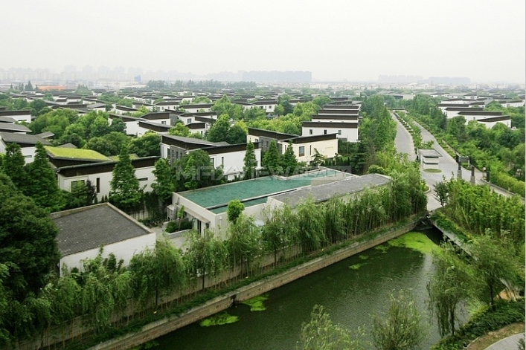
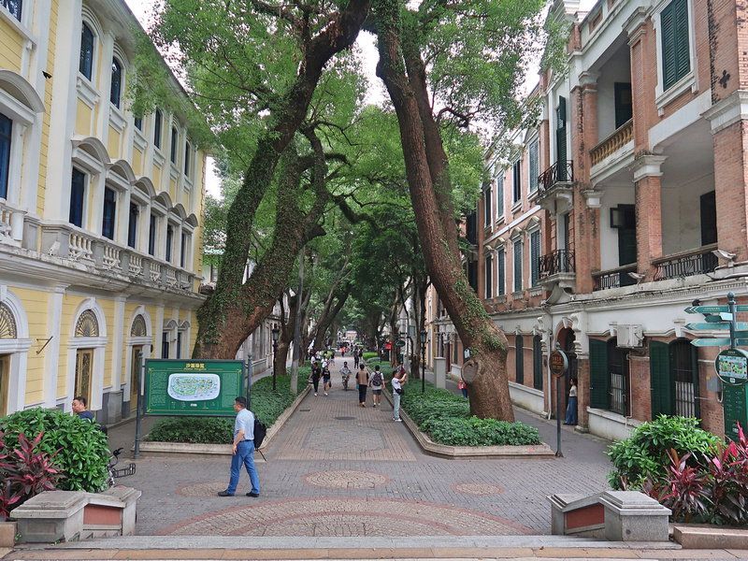
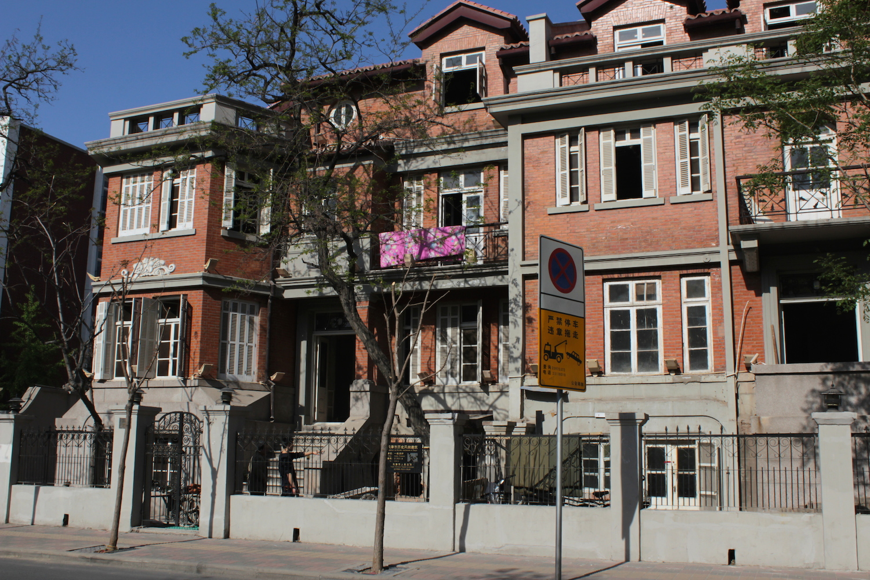
Soviet advisors accommodation in Shanghai, Guangzhou and Tianjin.

Slide 12
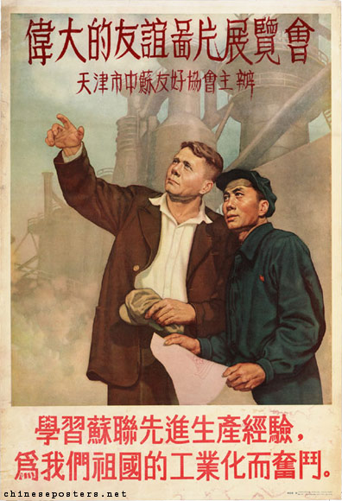
The Impact of the Soviet Union
Chinese experts were sent to remodel the Chinese state along Soviet lines. This devotion to the Soviet Union helped avoid ideological cleavages – debate was on nuances and points of detail – especially in economics.
Cadres and intellectuals were compelled to study Stalin’s The History of the All-Union Communist Party: A Short Course.
In education, every minute detail was copied from the Russians; even the lunch hour was pushed back to three in the afternoon to ensure the practice of having six classes in succession in the morning.
The Sino-Soviet Friendship Association – with its 120,000 branches – distributed books, magazines, films, lantern slides and plays, as well as generators, radios, microphones and gramophones to spread the message. In 1952, it consisted of 1,260 principal and 44,778 secondary organizations and had 18 million members (more than the total membership of the Chinese Communist Party).
Dozens of exhibitions were organised on themes from ‘Soviet Women’ and ‘Soviet Children’ to ‘Construction in the Soviet Union’.
Mao certainly did not want to make China into an imitation of Russia; he only sent his country to school in Moscow so that at the end of its education it could become independent and master of its own house. -Jacques Guillermaz

Slide 13

Write your first paragraph for the foreign policy question on the importance of the Sino-Soviet friendship agreement.

