Slide 1
Why did the Portuguese Explore?

Slide 2
Portugal

Slide 3
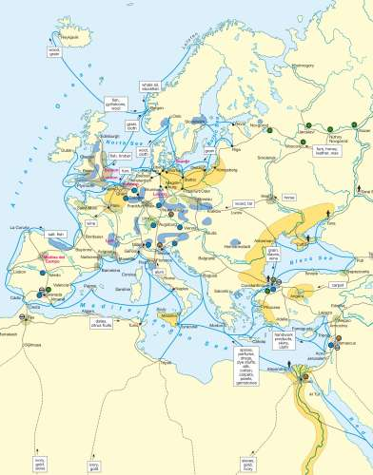
Trade Routes in the 15th Century

Slide 4
Genoan Trade Routes

Slide 5
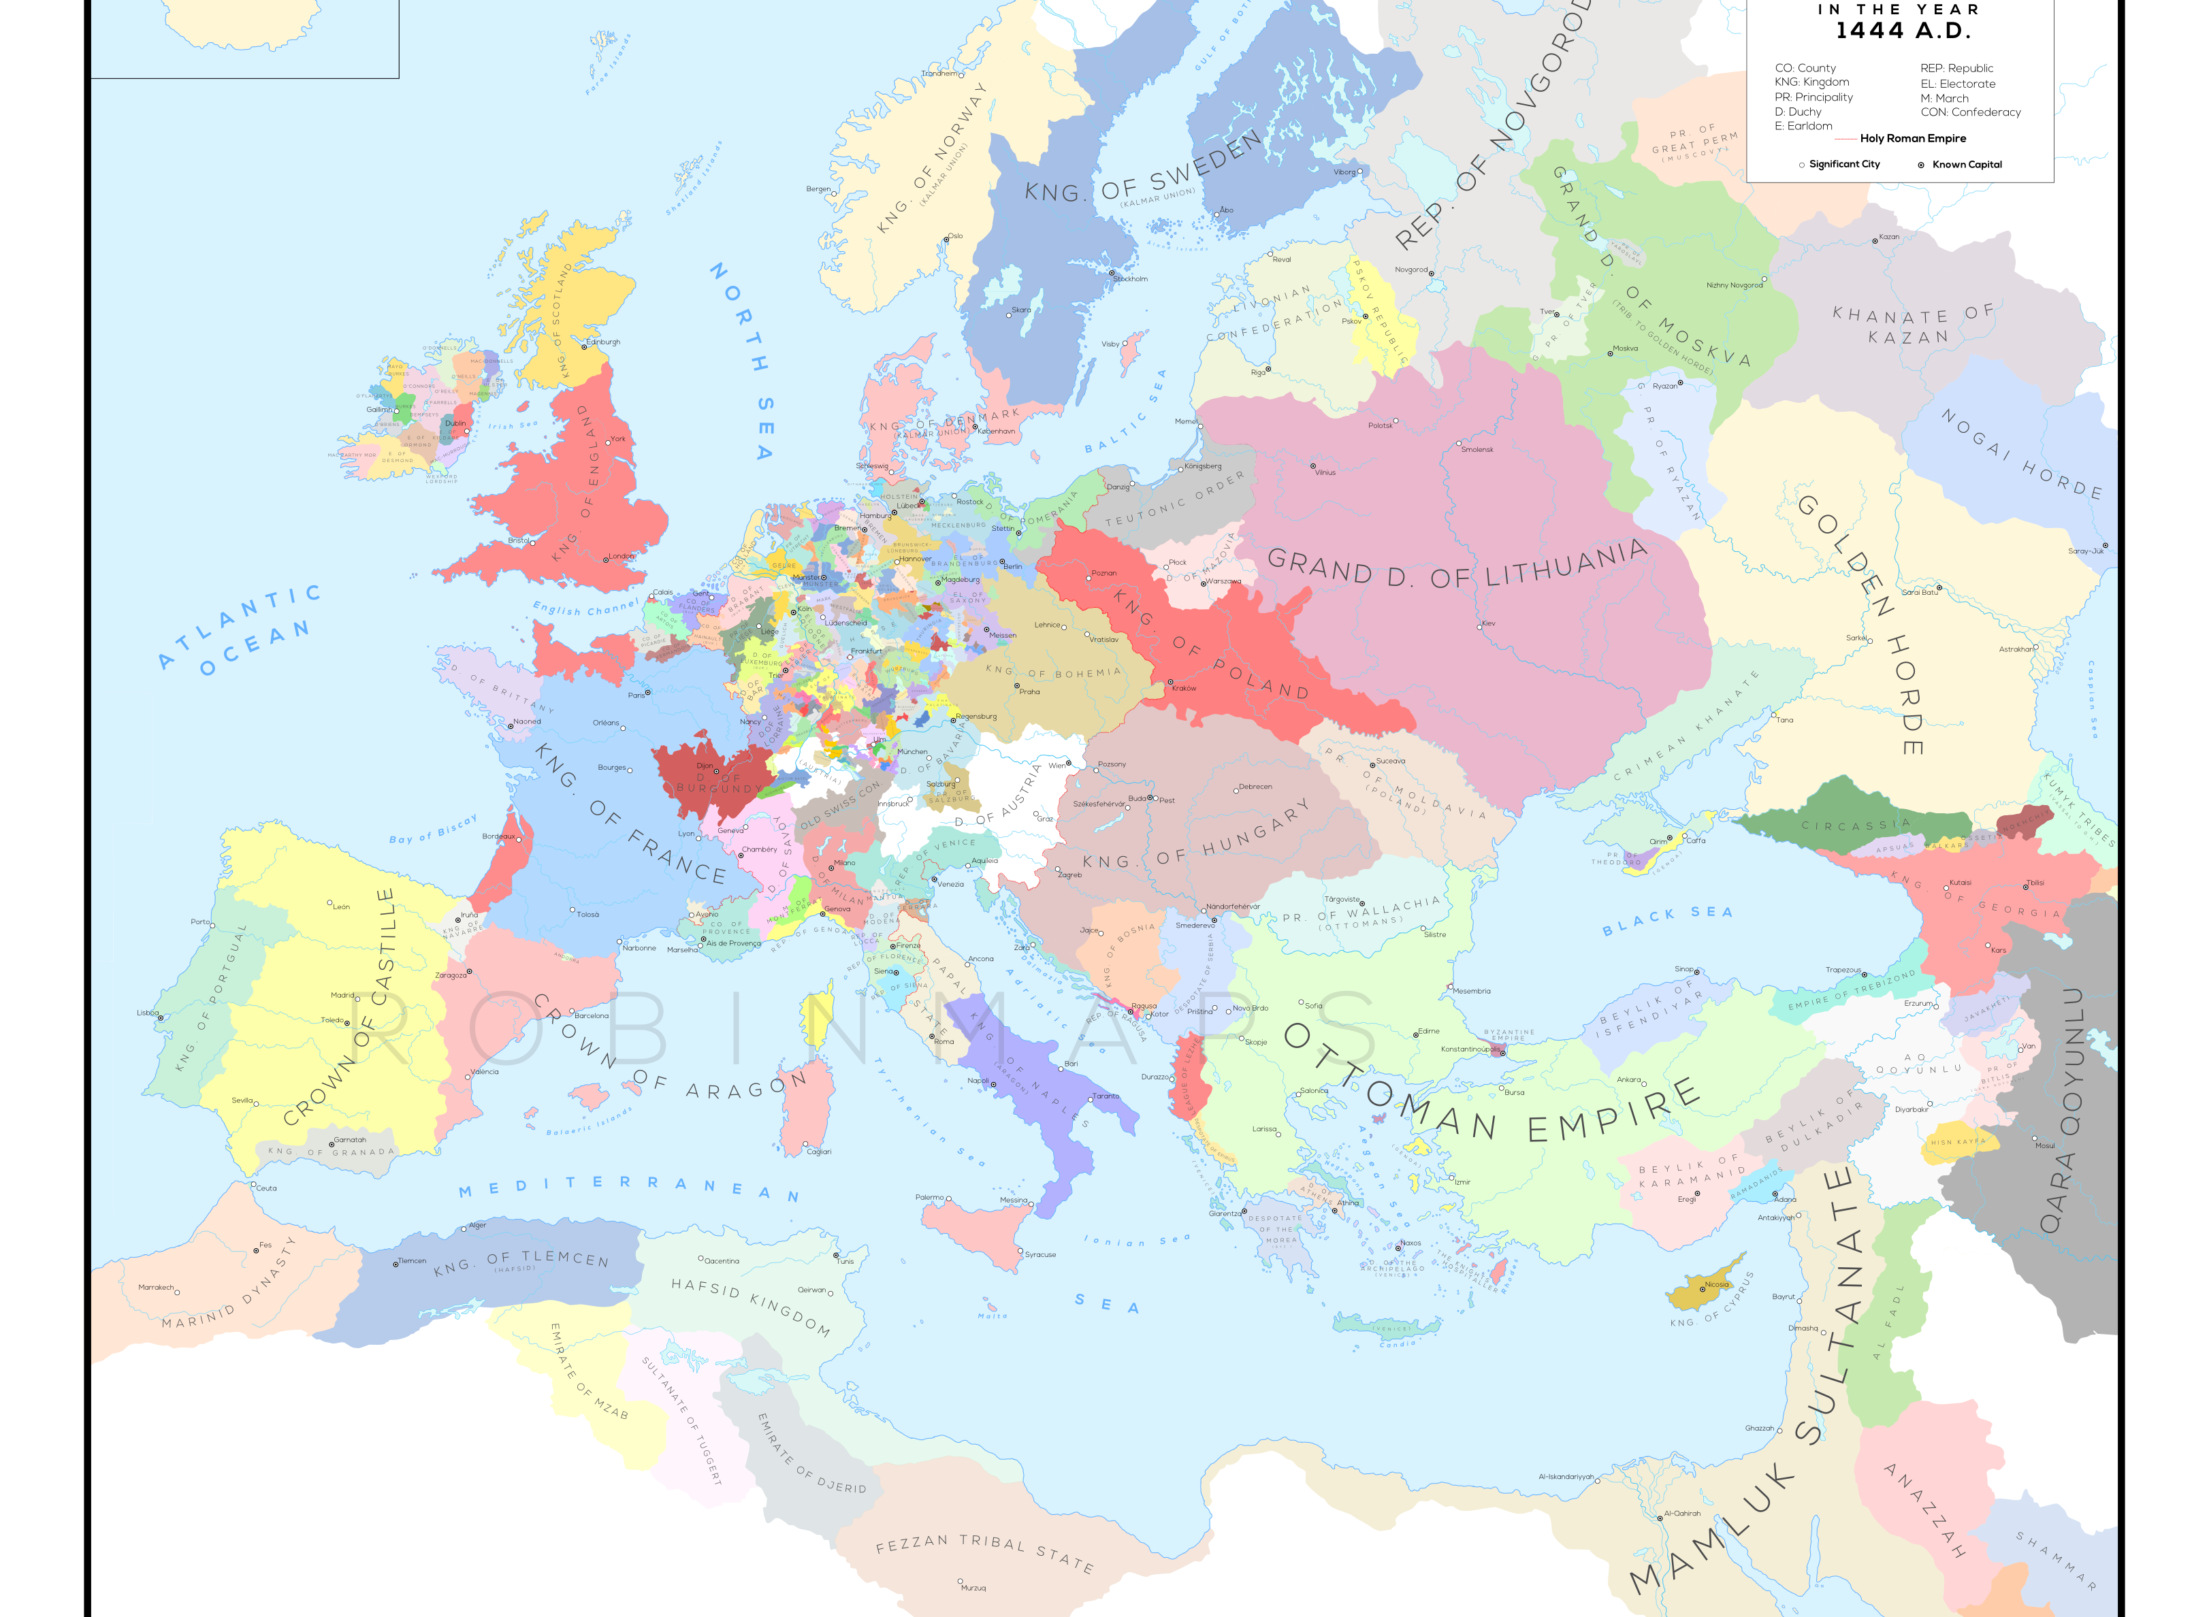
Europe in 1453

Slide 8
Lisbon

Slide 10
Porto

Slide 11
King Denis (1279-1325)

Slide 12
John I of Portugal (1385-1433)

Slide 13
Philippa of Lancaster

Slide 14
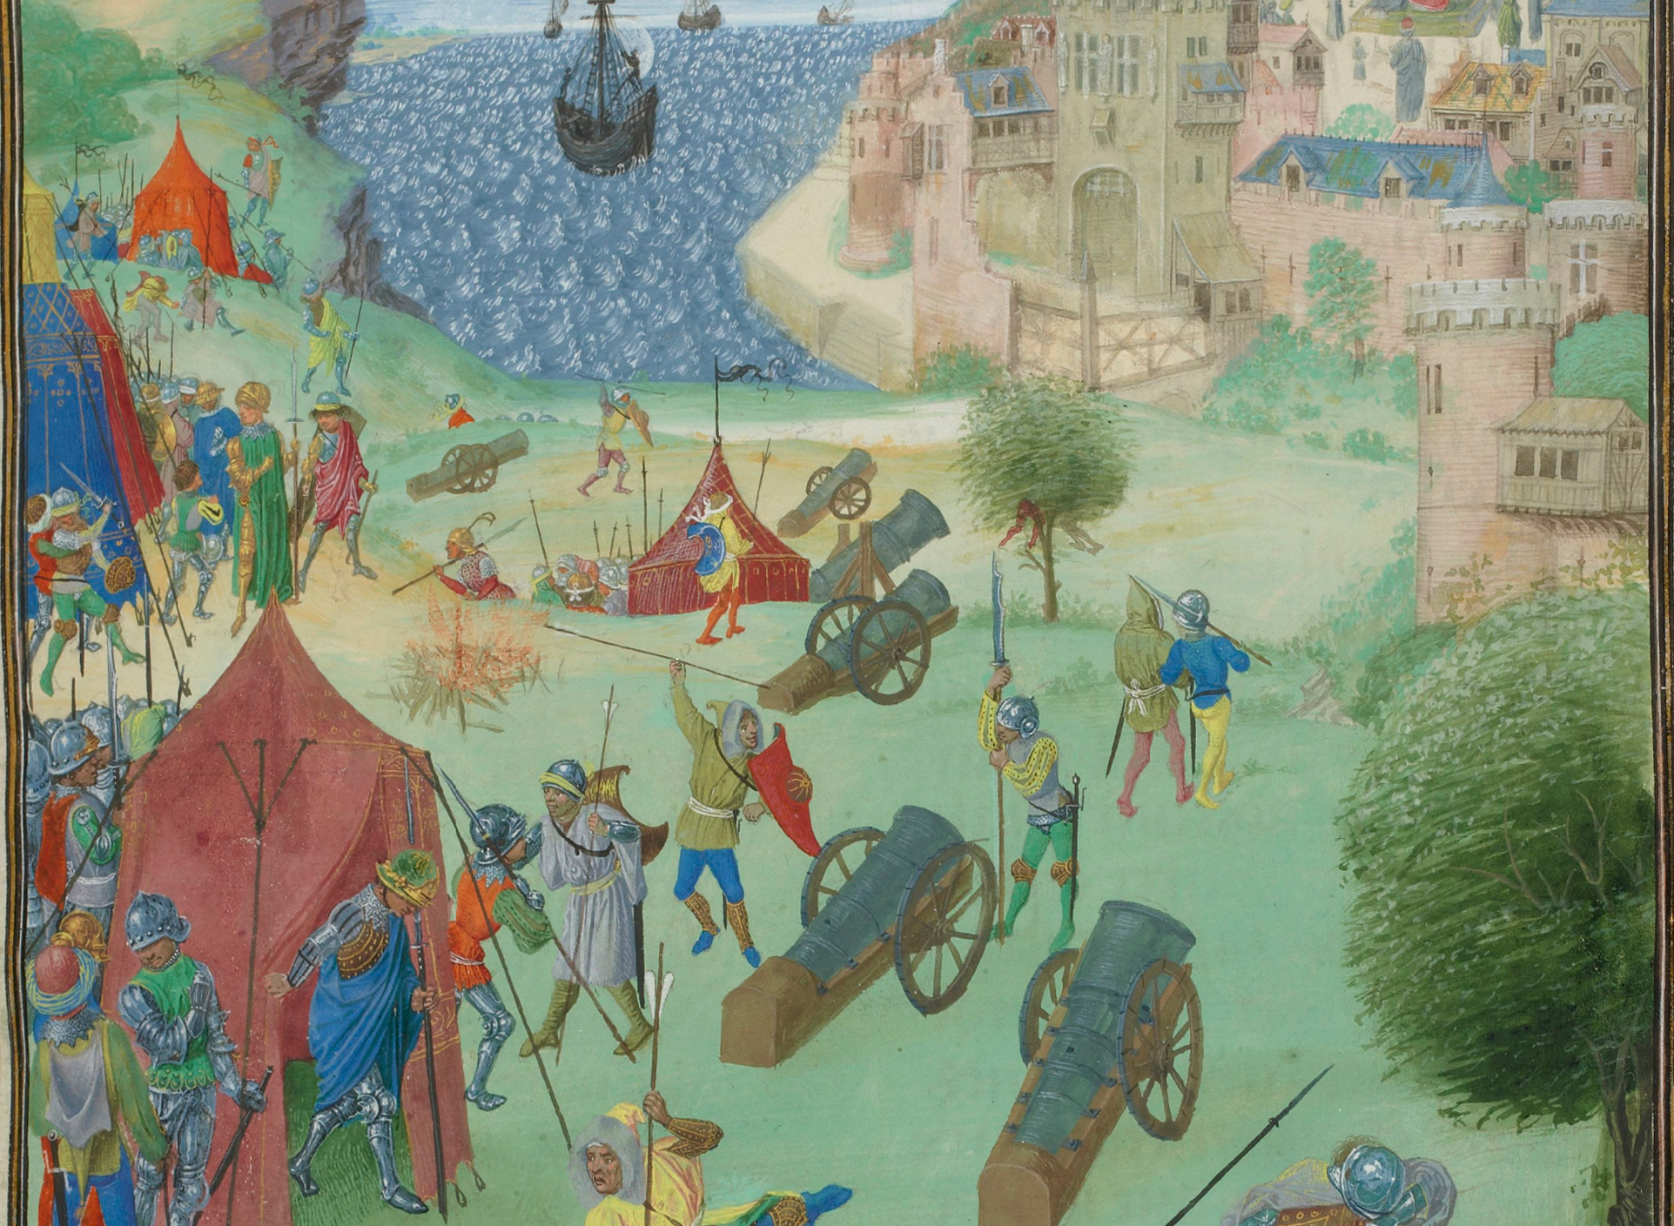
Siege of Lisbon - 1385

Slide 15
King Edward of Portugal (1433-1438)

Slide 16
Alfonso V (1438-1481)

Slide 17
Prince Henry the Navigator

Slide 18
Prince Henry the Navigator at the Maritime Museum

Slide 19
Pope Gregory XI

Slide 20
Strait of Gibraltar

Slide 21
Ceuta

Slide 23
Conquest of Ceuta (Sao Bente Railway Station)

Slide 27
Portuguese Excursions into North Africa

Slide 28
Madeira

Slide 29
Beatus Map of 1050 ce

Slide 30
Portion of the Catalan Map of 1375

Slide 31
Sahara Trade Routes

Slide 32
Prester John

Slide 33
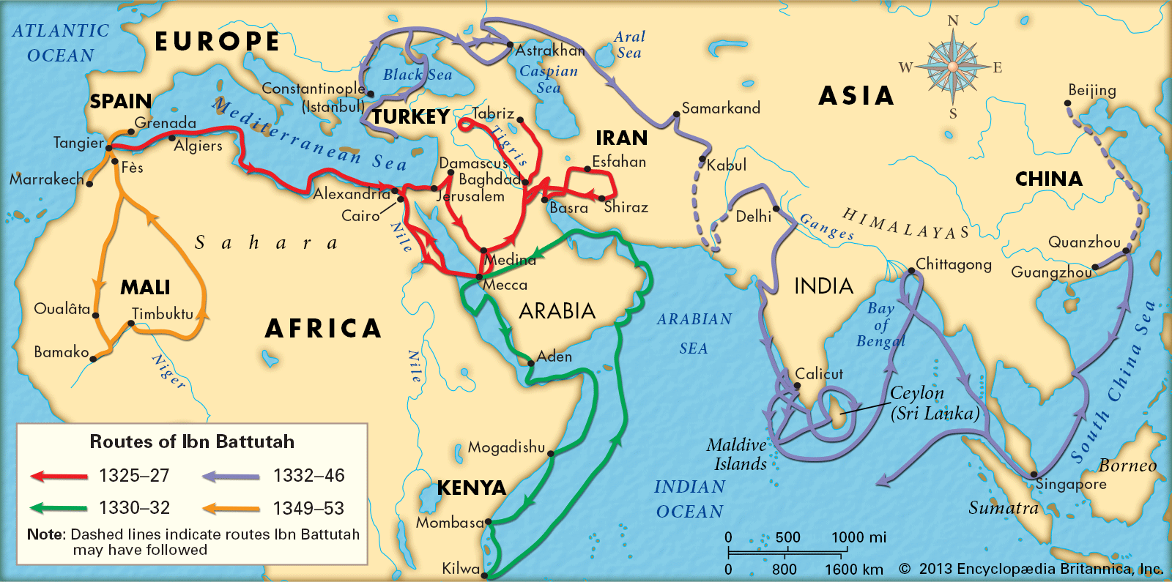
Travels of Ibn Battutah

Slide 35
African Gold Production

