Slide 1
Spain in Europe

Slide 2
Video Questions? Basic Debate over Charles
Success
Is there a link to motivations of exploration?
Failure

Slide 3
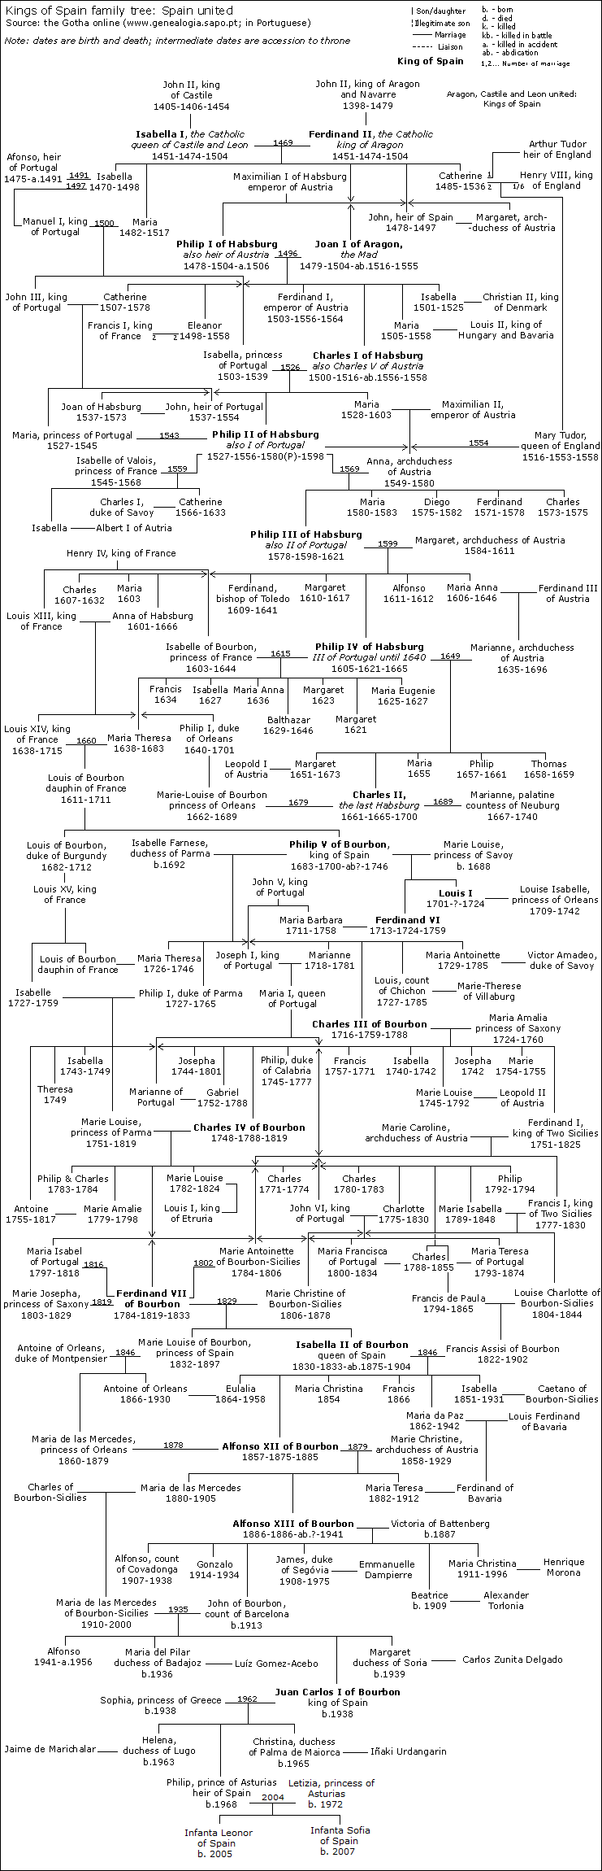
This is the Family Tree of the
Spanish Royal Family
What can we tell about this without even studying it?

Slide 4
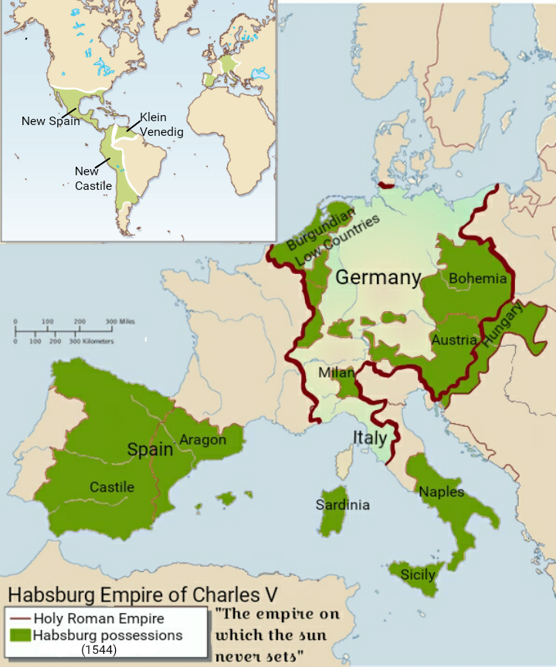
Territories of Charles V

Slide 5
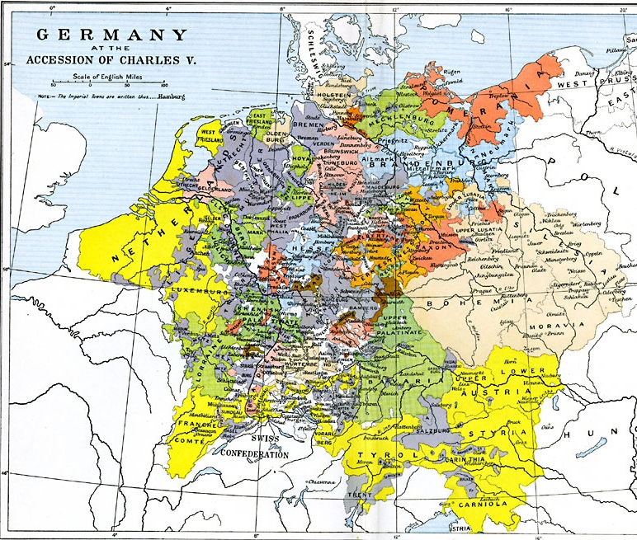
Germany at the Accession of Charles V

Slide 6
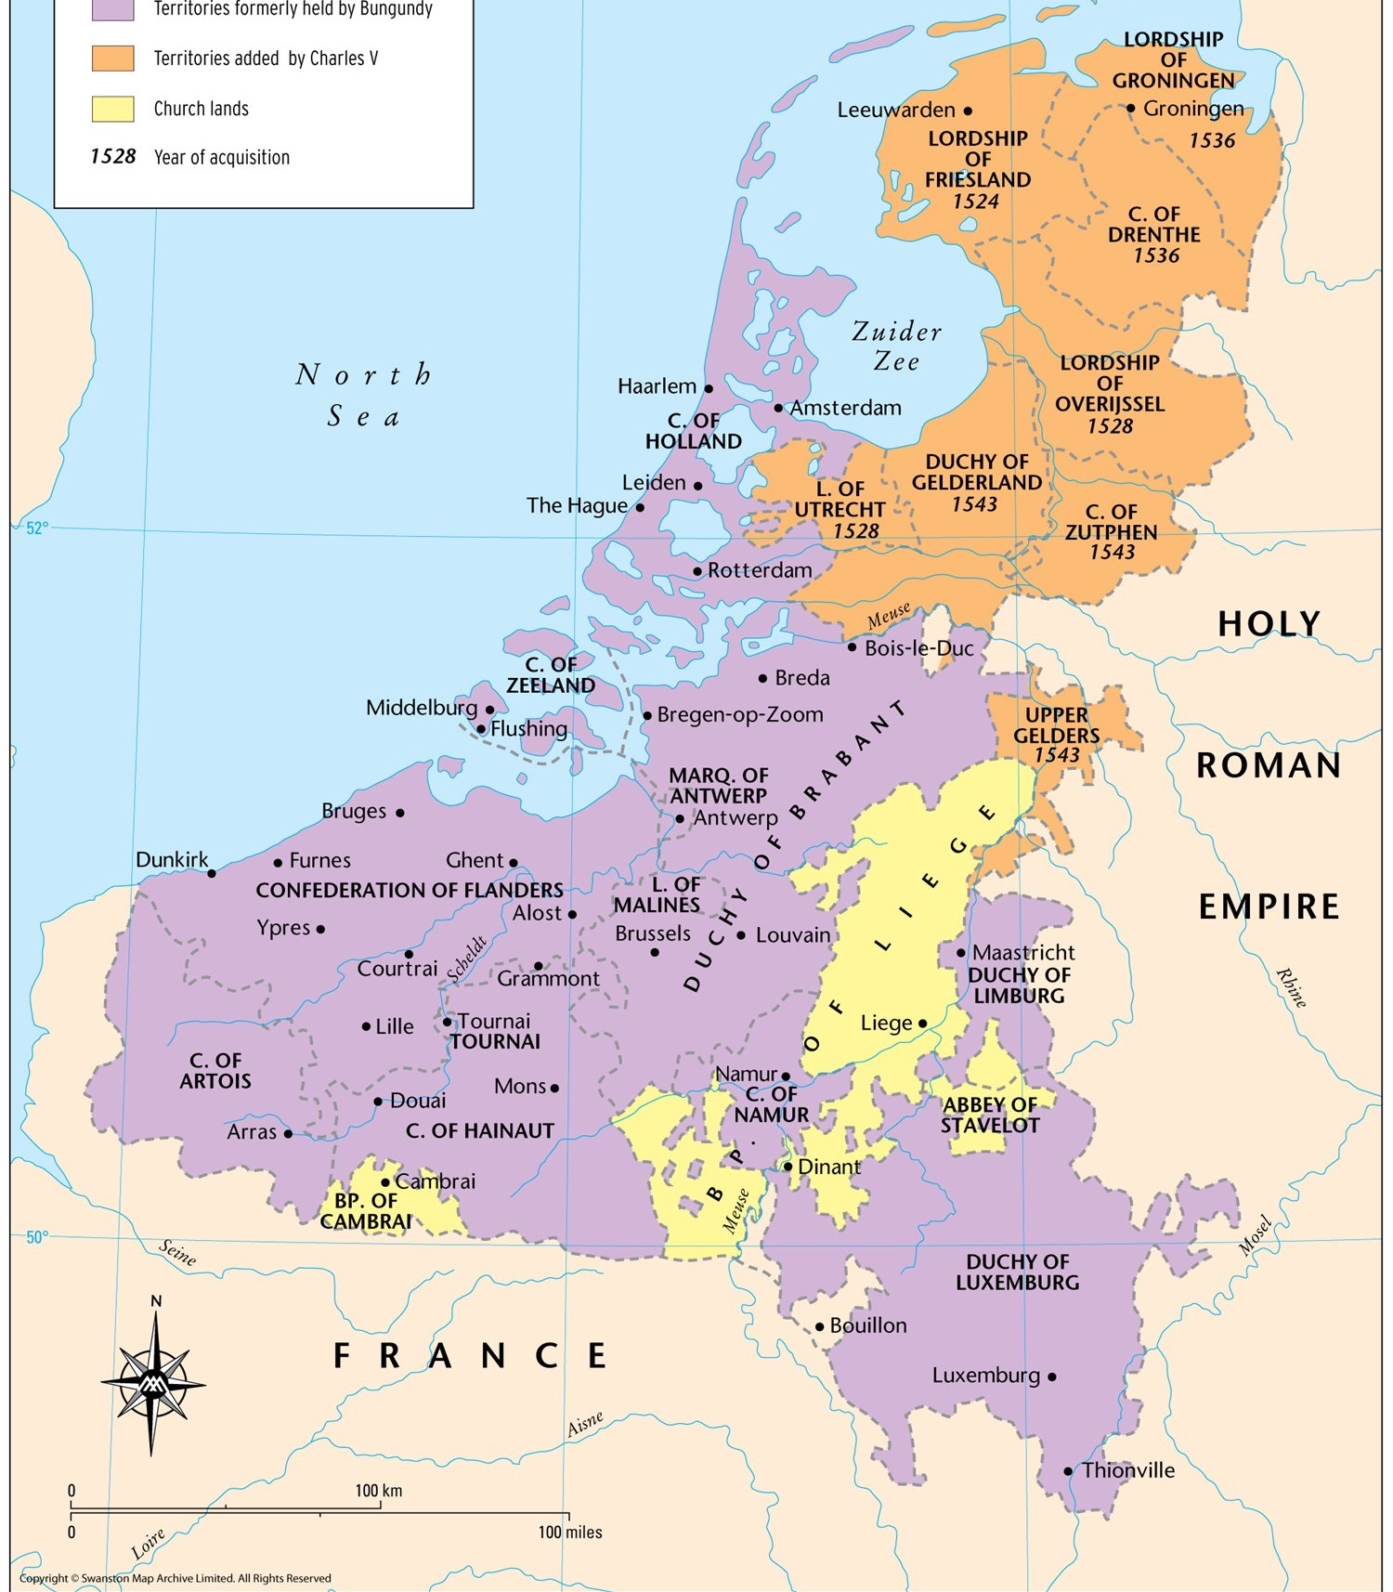
Netherlands under Charles V

Slide 7
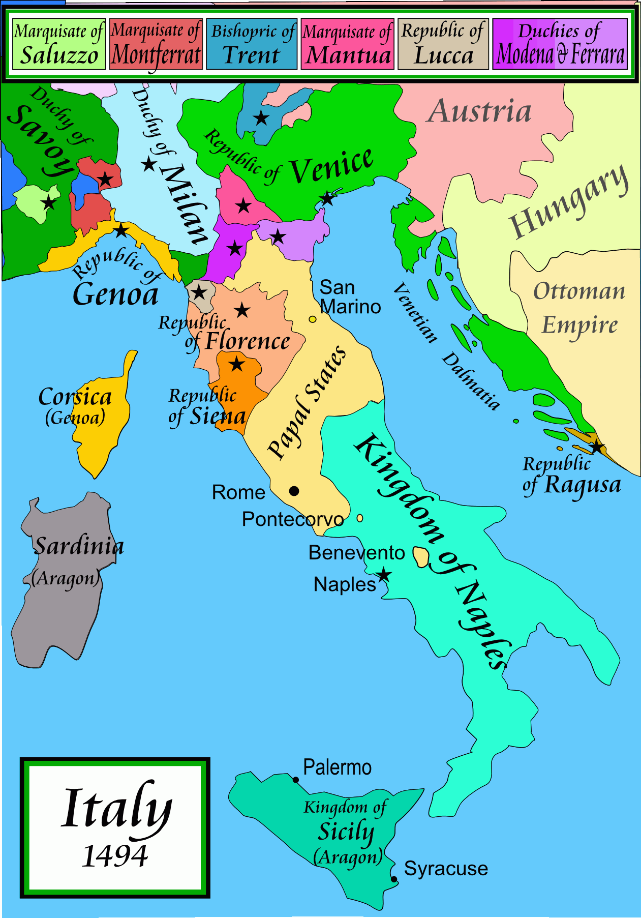
Italy in 1494

Slide 8
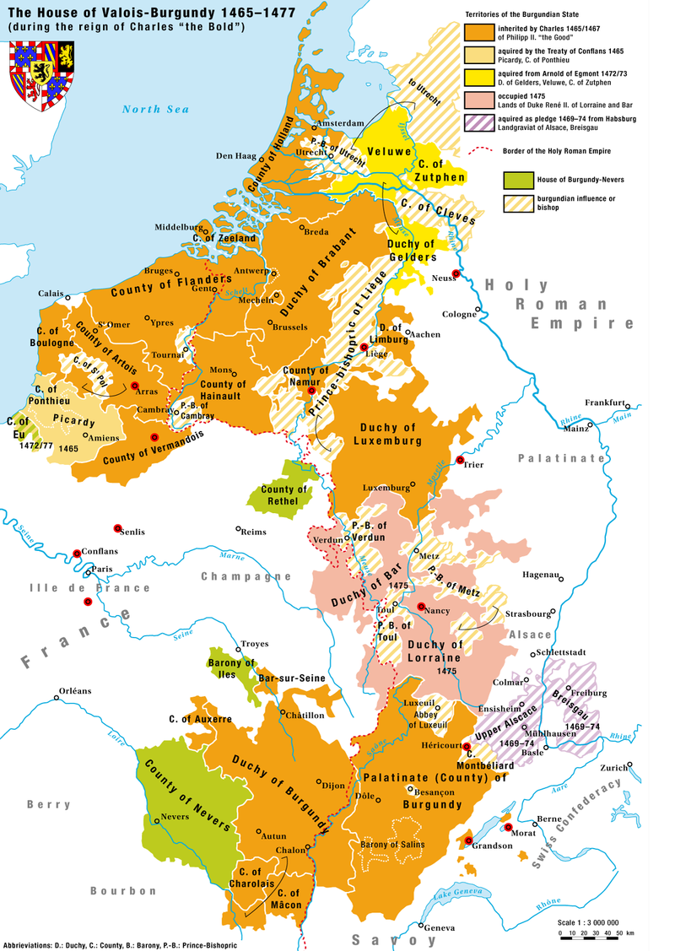
Kingdom of Burgundy

Slide 9
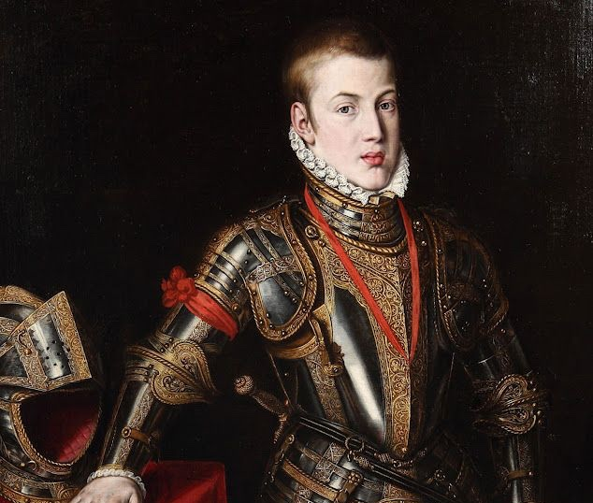
John, Prince of Asturias (1478-1497)

Slide 10
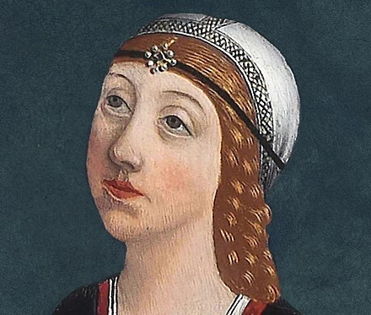
Isabella, Princess of Asturias and Queen of Portugal (1470-1498)

Slide 11
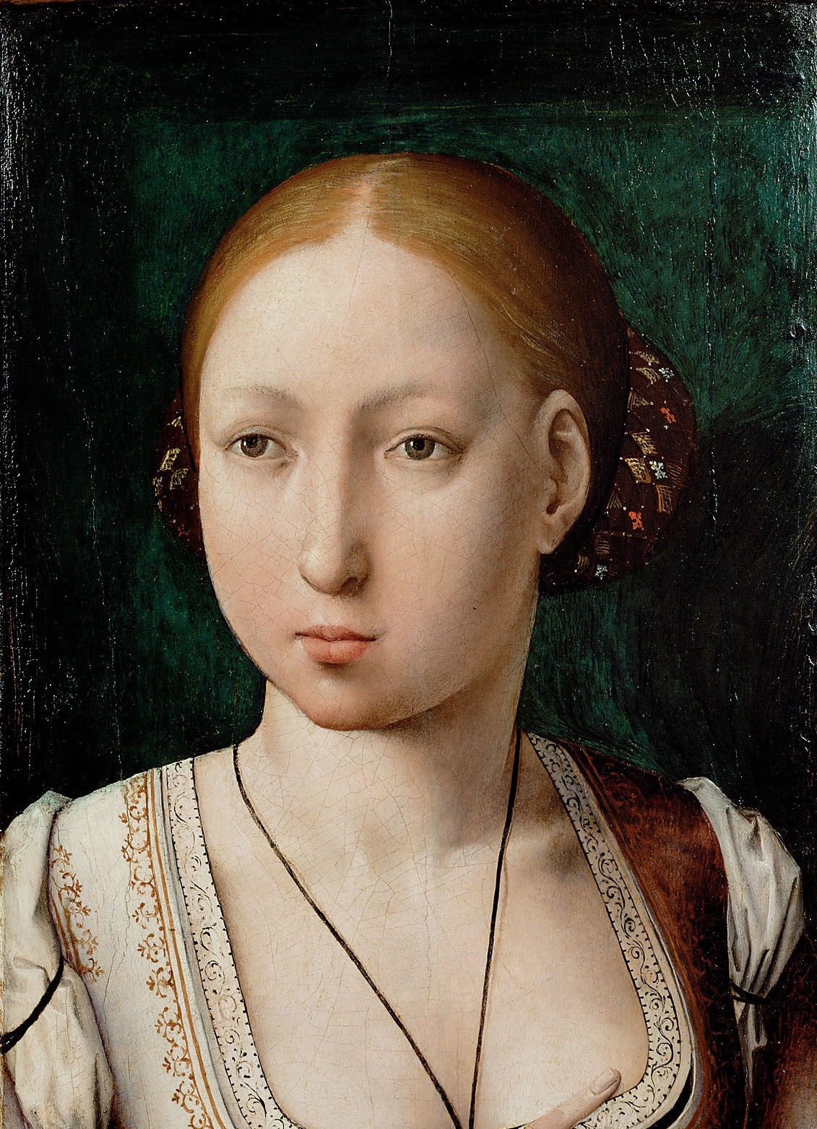
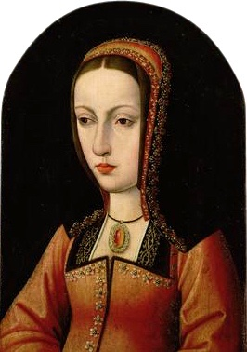
Joanna of Castile: Joanna the Mad (1479-1555)

Slide 12
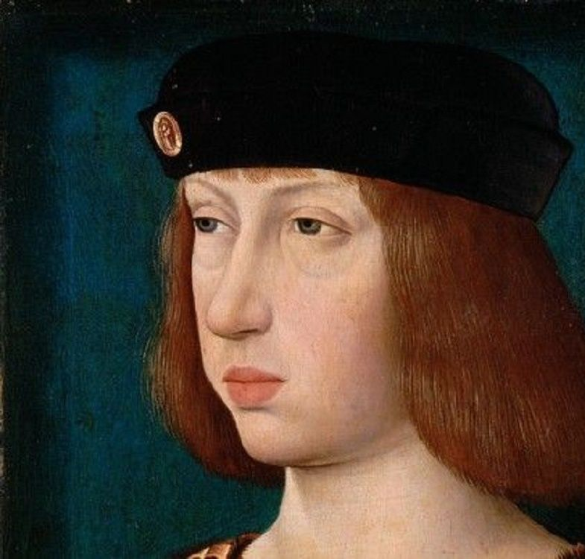
Philip I of Castile: the Handsome (1478-1506)

Slide 13
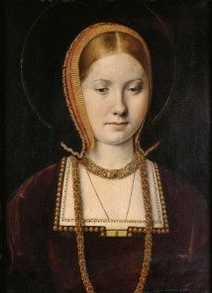
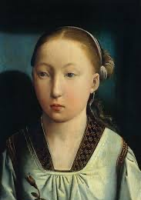
Catherine of Aragon (1485-1536)

Slide 14
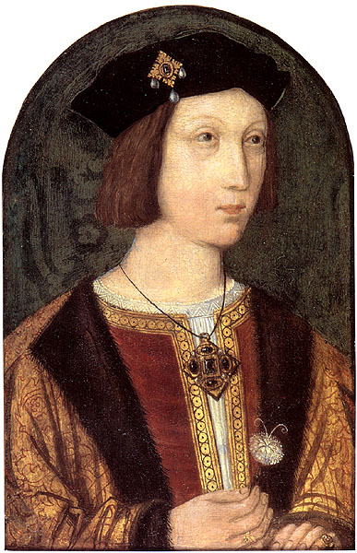
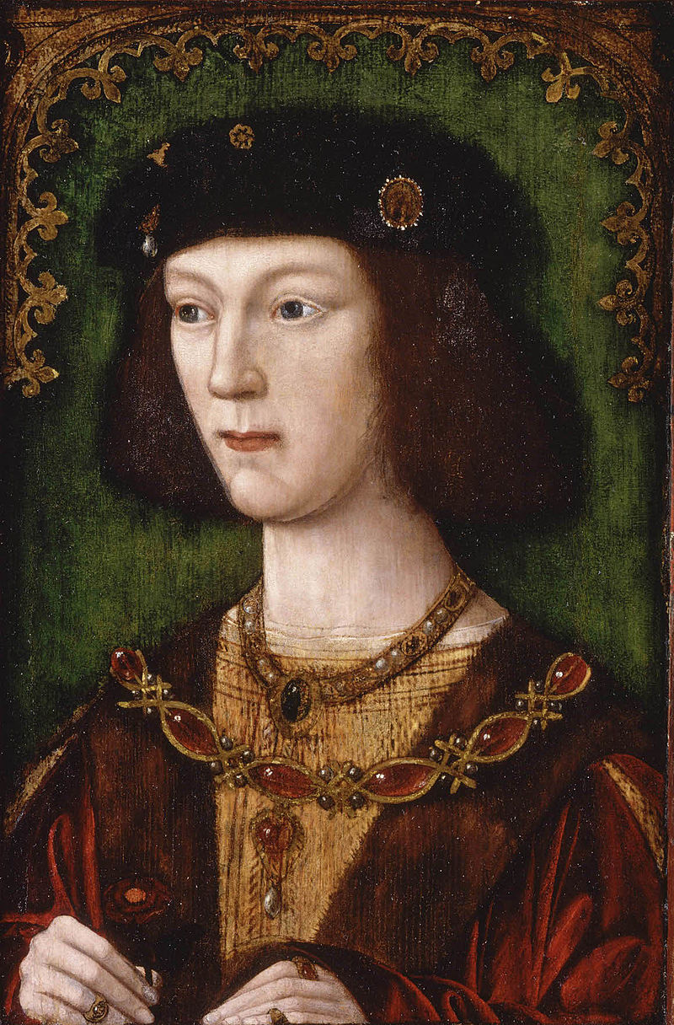
Arthur Prince of Wales (1486-1502) and Henry VIII (1491-1547)

Slide 15
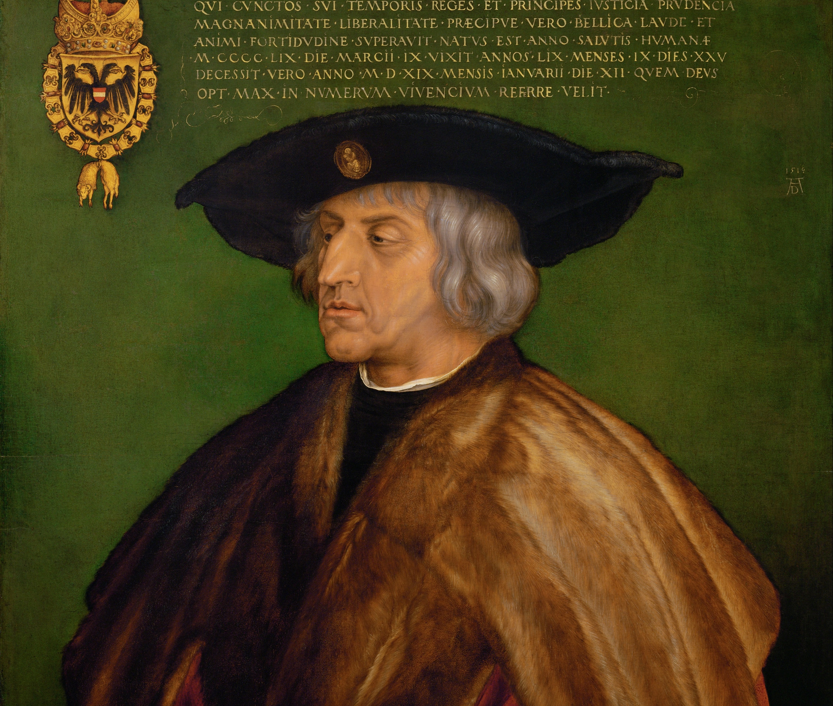
Maximillian I, Holy Roman Emperor (1459-1519)

Slide 16
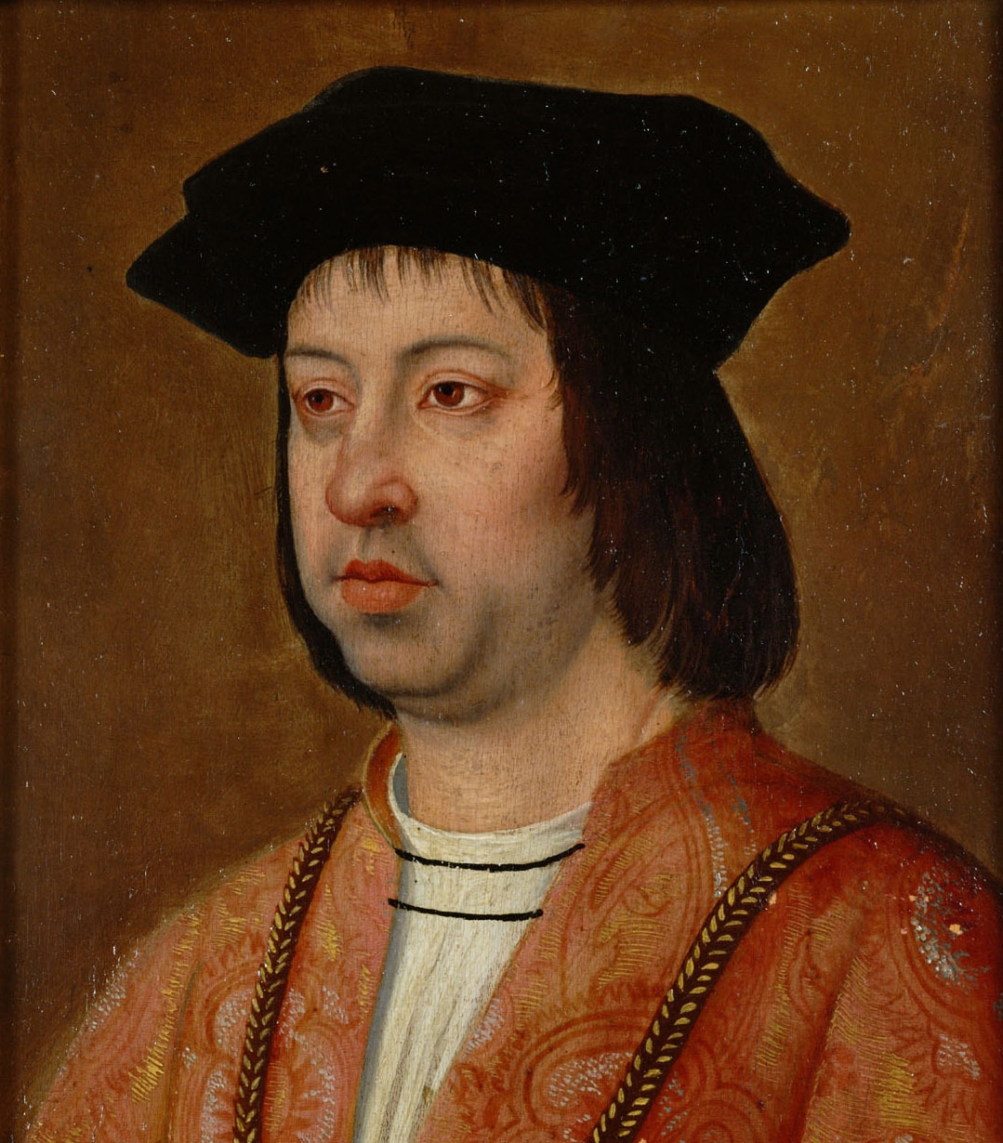
Ferdinand of Aragon (1452-1516)

Slide 17
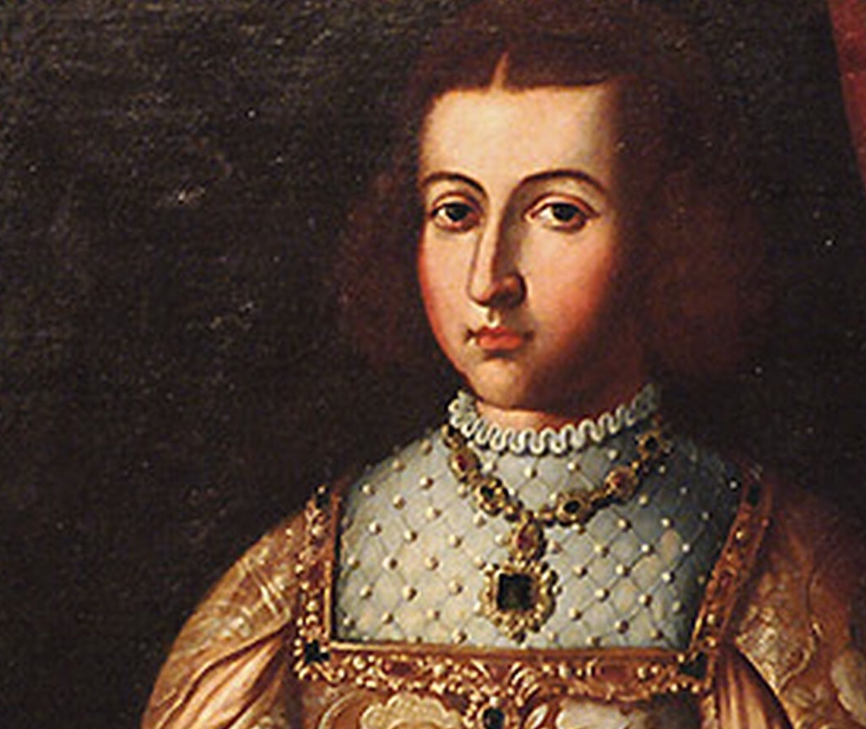
Germaine de Foix (1488-1536)

Slide 18
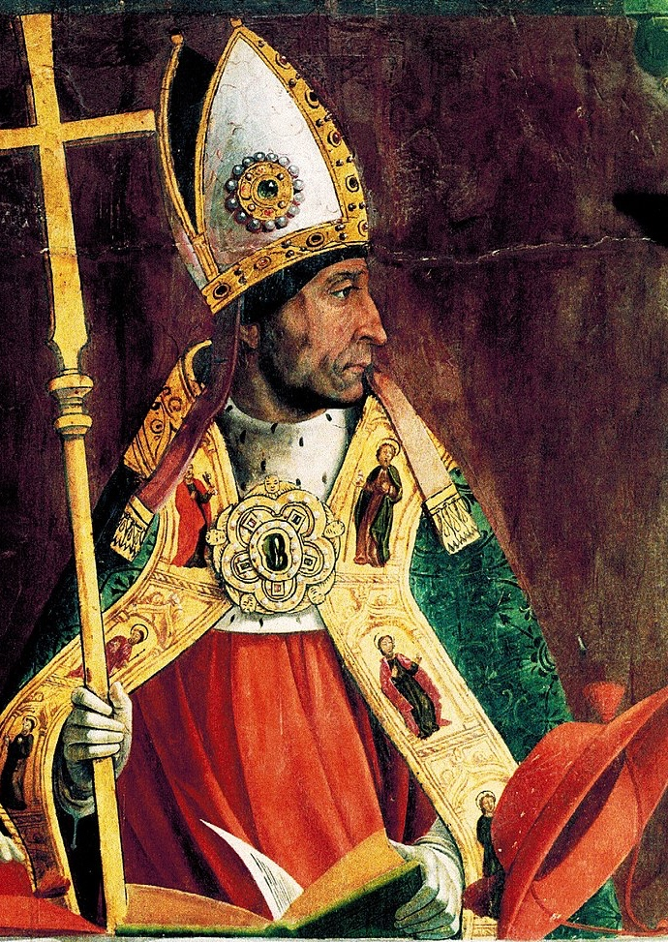
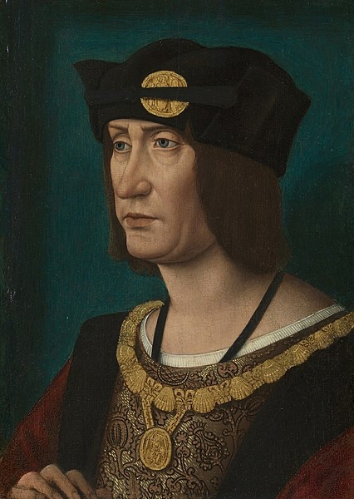
Cardinal Cisneros (1436-1517) and Louis XII (1462-1515)

Slide 19
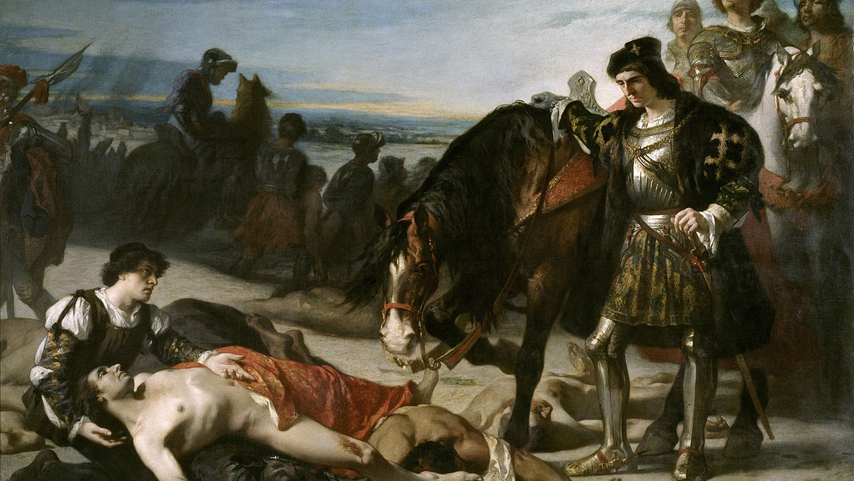
Gonzalo de Córdoba (1453-1515)

Slide 20
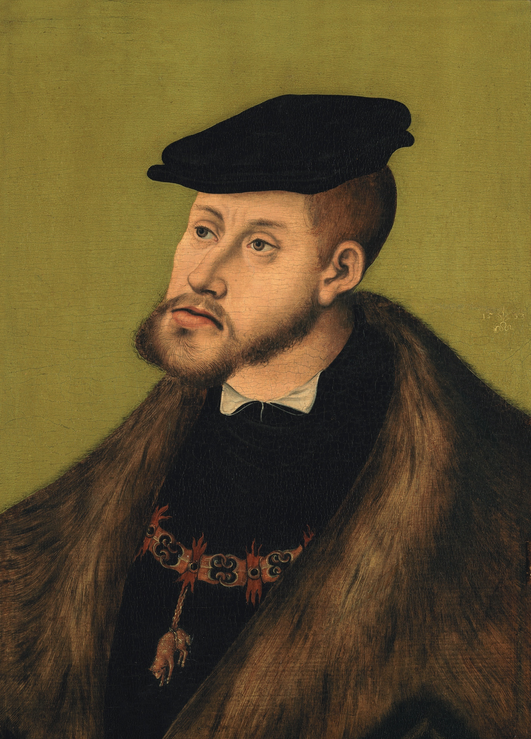
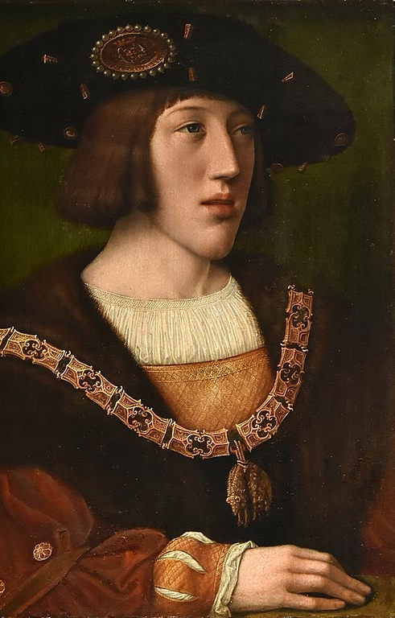
Charles V of Spain, Burgundy and the Holy Roman Empire (1500-1558)

Slide 21

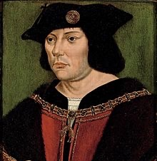
Lord of Chiévres (1458-1521)

Slide 22
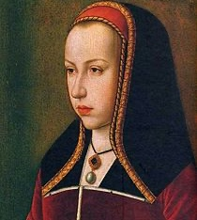
Margaret of Austria (1480-1530)

Slide 23
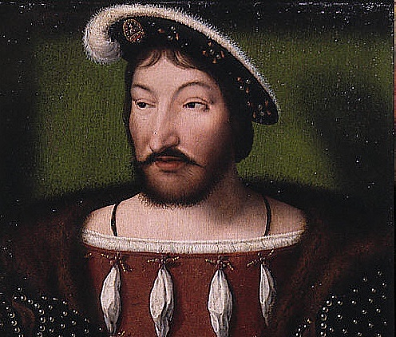
Francis I of France (1494-1547)

