Slide 1
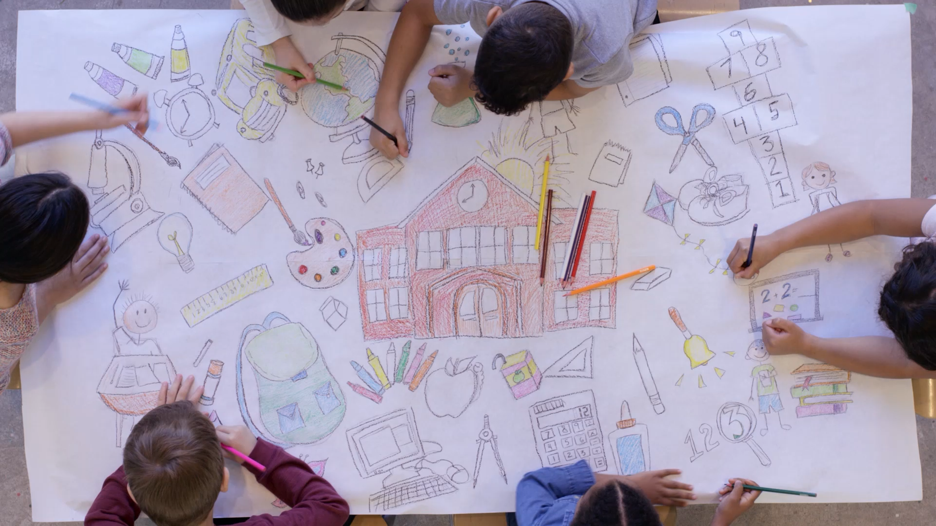
Education and Youth in Mao’s China

Slide 2
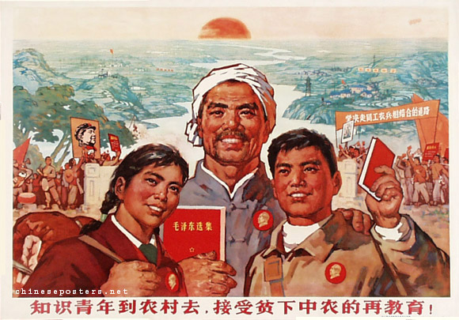
Ideology
For Mao, education was the major problem in Chinese society. If society is to undergo a radical and irreversible transformation, the needs of politics must come before all else. This is the only way to abolish classes and class struggle for good and make it no longer necessary to send vast numbers of townspeople periodically to the countryside; it is the only way to get cadres and workers to share the same attitude to such an extent that they can become virtually interchangeable apart from their speciality, which would then be only a modest part of their activities. This would mean that the producer was no longer subject to production and that man could take his place in a world made for him, not for his machines.”
Primary and secondary education was to be decentralised as far as possible. Administration, finance, admissions, and examinations were to be in the hands of collectives to manage them openly. This arrangement, which would benefit the state financially, would also maintain frequent contact between poor and lower-middle peasants on the one hand and pupils and teachers on the other, ensuring that the latter were subordinated to the former in every respect. It would also provide the brigades and communes with good cadres because they could hold back capable pupils who had previously been sent to secondary and higher education establishments.
In the new society, the age-old cleavage between the scholar/civil servant and the common man had once more to be avoided at all costs. Cadres' regular participation in the physical labour of the workers and peasants at the primary level met this need.
Theoretically, cadres in enterprises have spent two half-days a week in the workshops. In the countryside, the periods often lasted several months.
Despite their rank, senior army officers had to spend a month every year at the company level as plain soldiers.
The Anti-Rightist Movement after the Hundred Flowers also witnessed the return of many cadres and intellectuals to the countryside.

Slide 3
Statistics
Elementary school enrolment increased from 25% in 1949 to 96% in 1976.
The number of towns with primary schools increased from 50 per cent in 1950 to 80 per cent in 1965 and reached 90 per cent in 1970. During the Great Leap Forward, 30,000 agricultural middle schools were opened.
The number of rural graduates from elementary schools increased from 450,000 to 21 million between 1965 and 1977.

Slide 4
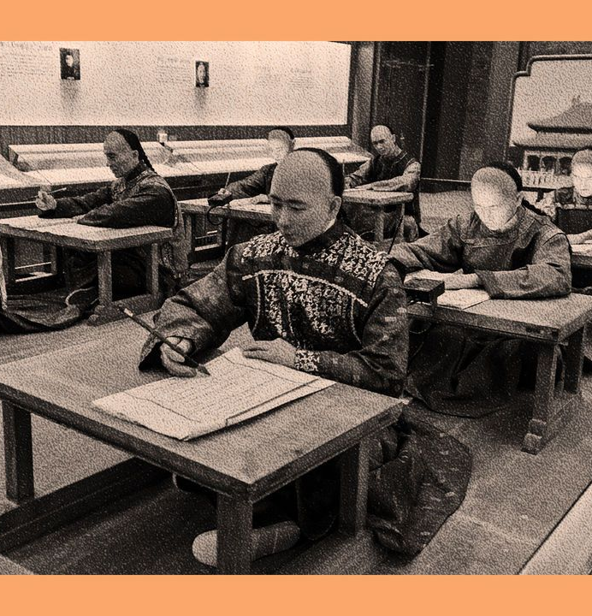
The Old System
For centuries, the imperial civil service exams were the pinnacle of Chinese education. They took place for between 24 and 72 hours, with no break. Around 20,000 would apply yearly, and less than 1% would pass.
The set curriculum focused on the Six Arts: music, archery, horsemanship, writing arithmetic, history and knowledge of the public and private life rituals and ceremonies. The content was gradually expanded to cover the Five Studies: military strategy, civil law, revenue and taxation, agriculture and geography. Students also had to memorise the four books of Confucius and the Five Classics. They also had to memorise 450,000 Chinese characters.
It was supposed to produce a meritocracy but rarely did so. Families that could afford study guides and tutors were few, and they guarded their privileges carefully. The system also neglected any scientific or technological knowledge. It discouraged creative problem-solving in favour of rote learning.
It was abolished in 1905, but in the confusion that followed, a uniform system was not introduced.

Slide 5
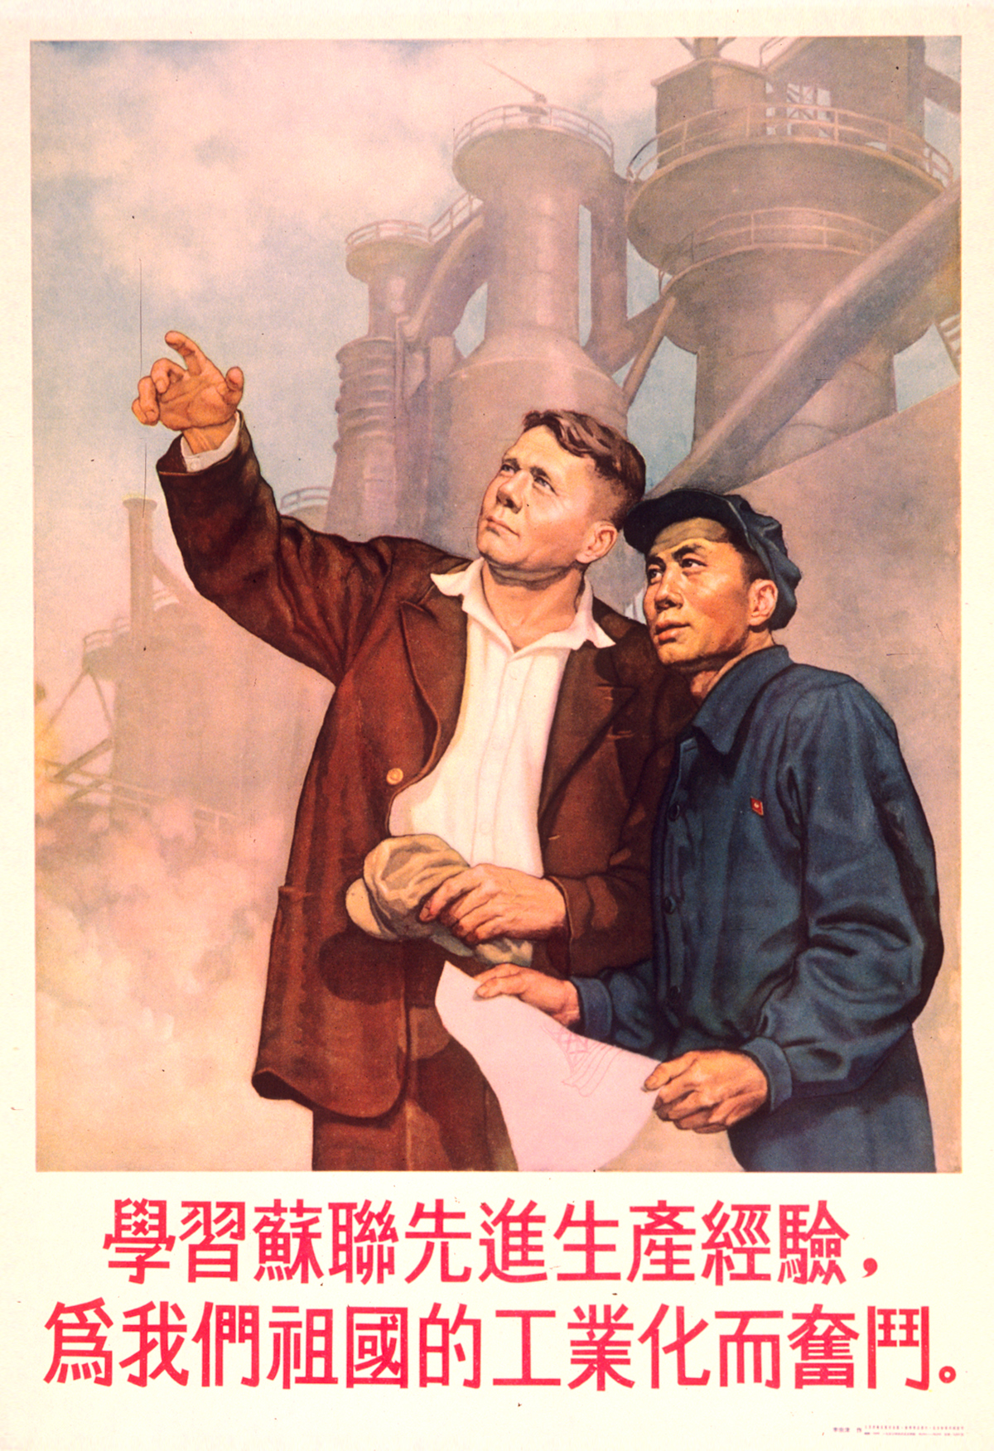
Mao’s Changes
Pinyin was introduced as the official system for romanizing Mandarin.
A new form of standardized Chinese writing called Simplified Chinese was introduced to encourage literacy.
Between 1949 and 1958 China relied on Soviet teachers to help to establish colleges and secondary schools. Russian textbooks, as well as literary work, were translated from Russian into Chinese. All foreign and Chinese universities were nationalised, and the new curriculum focused mainly on engineering, mathematics and electronics, as well political economy. The Soviet model proved unsuccessful as it failed to address illiteracy.
Primary schools were built all over China and secondary schools were established in each district.
Girls particularly benefited.

Slide 6
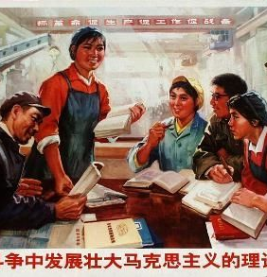
Limits
The quality of education was low. Children learned little beyond basic reading, writing and political ideology, the importance of which the party continued to stress.
The Cultural Revolution had a noticeable negative impact on literacy, particularly for those children who turned eleven in the chaotic years between 1966 and 1967 when all schools were closed. When they reopened, students and secondary school pupils were asked to go back to their institutions "to study and make revolution there," to prepare the reform of the educational system and to receive military training.” Bereft of teachers, the army had to take over the management of schools in urban areas. Workers' propaganda teams would work in conjunction with army propaganda teams to ensure necessary changes, see that education did not once more fall under the domination of "bourgeois intellectuals," and create a proletarian education system associating theory with practice.
Schools could adapt their own curriculum to suit their particular needs from the 1970s. However, decisions regarding the nature and length of courses, the choice of textbooks, and the rules for organisation and administration need some coordination on a national scale. The devolvement of education to individual entities did nothing to improve outcomes.
In 1971, officials claimed that the illiteracy rate was as low as 10 per cent, or around 85 million people, but the 1982 census arrived at a much higher number, 236 million. More than twice as many women as men could not read and write, including the majority of women above the age of 50. Far more illiterate people living in the poor minority regions in the west than in the more developed provinces on the coast.

Slide 7
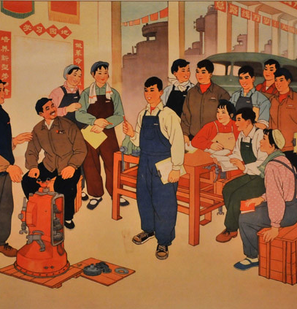
Half-Work, Half Study
Mao devised this program in 1958, but was delayed implemented due to the failure of the Great Leap Forward.
It aimed to make "new men" out of the youth. Other, more practical reasons were behind it as well: the need to make local institutions particularly factories and people's communes, responsible for education; to intensify the schooling of young peasants without taking them away from the land; and to spread and develop a taste for technical skill and physical effort in university and school circles, the members of which still bore the imprint of the literary tradition and were unwilling to indulge in physical exertion.
The half-work, half-study schools were set up hastily, with inadequate resources, and resulted in severe troubles in the normal educational system. In country towns, many secondary schools were simply transformed into agricultural training schools.

Slide 8
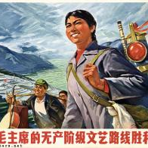
Socialist Education Movement
The failure of the Great Leap Forward had a greater effect on the morale and revolutionary spirit of the countryside population than elsewhere. The process of de-collectivisation had to be stopped, confidence in the Party had to be renewed, and primary-level cadres had to be purified and full authority restored to them. It solved the problem of what to do with recent graduates in an economic downturn.
The Socialist Education Movement aimed to bring the study of Mao's thought and imitation of the army to the masses. Since 1959, the army had returned to its people's army tradition. Its indoctrination methods were fully developed; it was wholeheartedly loyal to Mao and was to become a model of civic virtue, moral perfection, and ideological rigour for the entire nation. Everyone was expected to imitate the army's total lack of self-interest (the soldier had no personal belongings), its acceptance of collective living, and its zeal for spreading ideology.
Teachers and students sent into the countryside in the same spirit as the cadres were urged to share in manual work. This found added justification in the eyes of the Communists because a large proportion, if not the majority, of the students at the higher education level were still of bourgeois origin. In 1964, 270,000 high schoolers were sent from Beijing and Shanghai to help with the harvest.

Slide 9
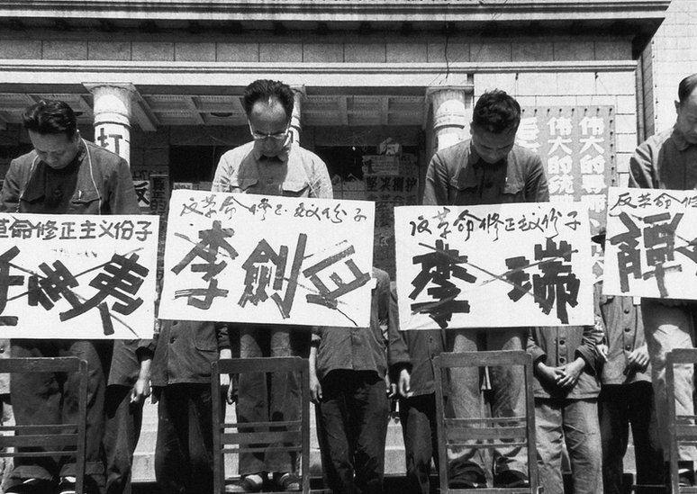
Cultural Revolution
In June 1966, the Central Committee and the State Council announced their intention of abolishing the system of university entrance examinations, held to be "feudal" and "bourgeois.”
The Cultural Revolution's impact on higher education was devastating. Most universities recruited no new students between 1966 and 1971 or, in some cases, even later. All academic journals ceased. Courses were to be considerably shortened. Students were to be prepared for work in industry and agriculture and trained to "approach military questions."
After inflicting degrading humiliation on their teachers and taking the violence into the streets, red guards and student "revolutionary rebels" split into rival factions; hard fighting frequently broke out between rival groups from the same establishment or between groups from different units, often involving casualties.

Slide 10
Paragraph
Positives
Drawbacks

